Slide 1
高中英语课件
madeofcanruohanxing

Slide 2

Unit1
A
dvertising
Wordpower

Slide 3
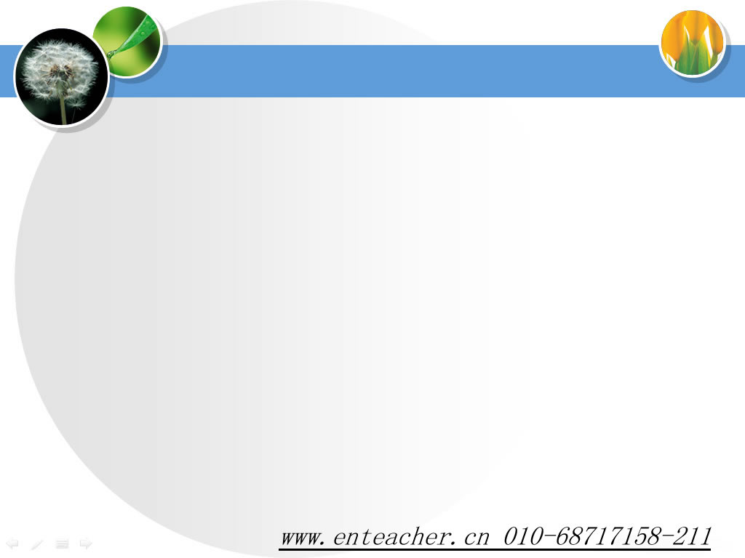
Comparethefollowingwords
Lovely
Beautiful
Lucky
love
beauty
luck

Slide 4
Howtoformadjectivefromnounsandverbs?
WuPing:Doalladsplaytricksonpeople?
WuHong:No.PSAsusesomeofthesamemethodsascommercialads,like
persuasivelanguageandexcitingimages,buttheyarenotmeanttotrickus.
Usingsuffixes
commerceN.commercial
persuadeV.persuasive
exciteV.exciting

Slide 5
Commonprefixes
un---unhappy,unfold,unfair
im---impossible,impatient
dis----dislike,disagree,disappear
re---rewrite,retell,rebuild
en-------enable,enrich,enlarge

Slide 6
Othersuffixes:
+able:
+ish
+less
+like
comfortable,believable,terrible,horrible,valuable,fashionable,
childish,foolish,
helpless,hopeless,useless,careless,
childlike,godlike

Slide 7

Noun---------------------adjective
health
wealth
dirt
luck
hand
healthy
wealthy
+y
dirty
lucky
handy

Slide 8
Noun---------------------adjective
week
month
day
year
friend
love
weekly
monthly
daily
+ly
yearly
friendly
lovely

Slide 9

Noun---------------------adjective
hero
class
fantasy
energy
heroic
classic
+ic
fantastic
energetic

Slide 10

Noun---------------------adjective
center
commerce
function
nation
office
race
culture
origin
central
commercial
functional
+al
national
official
racial
cultural
original

Slide 11
Noun---------------------adjective
danger
poison
fame
adventure
dangerous
poisonous
+ous
famous
adventurous

Slide 12
Noun---------------------adjective
help
use
success
hope
beauty
peace
pain
care
helpful
useful
successful
+ful
hopeful
beautiful
peaceful
painful
careful

Slide 13
verb---------------------adjective
amaze
interest
surprise
excite
encourage
bore
disappoint
please
amazing/amazed
interesting/interested
surprising/surprised
+ed/ing
exciting/excited
encouraging/encouraged
boring/bored
disappointing/disappointed
pleasing/pleased

Slide 14
verb---------------------adjective
attract
act
talk
compete
create
produce
effect(n.)
attractive
active
talkative
+ive
competitive
creative
productive
effective

Slide 15
Canyouthinkofmoreexamples?
Noun+y +ly +ic +al +ous +ful | healthhealthy weekweekly heroheroic originoriginal dangerdangerous helphelpful
Verb+ed +ing +ive | amazeamazed exciteexciting attractattractive

Slide 16
Suffix | Meaning | Examples(adj.)
-ical | havingthequalityof
-able | havingthequalityof
-ous | like,fullof
-ful | characterizedby
-less | without
medical,
electrical
enjoyable,
reasonable
dangerous,
adventurous
joyful,
mouthful
cloudless,
hopeless

Slide 17
Agroupoflettersaddedtothebeginningofaword
Themainpartofaword
agroupoflettersplacedattheendofaword

Slide 18

international
bimonthly
prefix
suffix

Slide 19
exercise:
Thisbookisofgreathelp,thatistosay,itisvery___________.
Idon’tthinkithasanyuse,thatistosay,Ithinkitis_________.
Hedoesn’tlikethatguy------He______thatguy.
Themessageisveryvaluable.Thatistosay,itisofgreat_______.
theoldmanisingoodhealth.----Heis____________.
Drunkdriversareagreatdangertopeopleontheroad.thatmeanstheyare____________drivers.
Helikestalkingverymuch.---------Heisvery_________.
helpful
useless
dislikes
value
healthy
dangerous
talkative

Slide 20
Moreexamples:
1.Thisbookisofgreathelp,thatistosay,itisvery_______.
2.Idon’tthinkithasanyuse,thatistosay,Ithinkitis______.
3.Themessageisveryvaluable.Thatistosay,itisofgreat_____.
4.Theoldmanisingoodhealth.----Heis_______.
5.Drunkdriversareagreatdangertopeopleontheroad.thatmeanstheyare__________drivers.
helpful
useful
value
healthy
dangerous

Slide 21

Lovely
Attractive
Boring
Creative
Fantastic
Exciting
Friendly
Competitive
Famous
lucky
love
attractattraction
boreboredboredom
createcreationcreativity
fantasy
exciteexcitementexcited
friendfriendship
competecompetitioncompetitor
fame
luckluckily

Slide 22
Talking:
Usesomeofthenewwordsyouhavejustlearnedtodescribeyourfriends,parents,teachers,school,studying,lifeandsoon.(nolessthan5sentences).
Example:MyfriendTomisveryfriendly.Hehelpsmealot.Heisveryhelpful….

Slide 23
Somewordstohelpyou:
friendly,lovely,beautiful,healthy,boring,bored,interesting,interested,wealthy,lucky,monthly,helpful,helpless,daily,dangerous,energetic,official,cultural,comfortable,terrible,fashionable,reasonable,hopeful,careful,successful,active,….

Slide 24
Blank-filling
____________(advertise)areanimportantpartoflife.Theyuselotsof____________(persuade)and_______(excite)imagestosellproductsorservices.________(general)speaking,therearetwomaintypes:______(commerce)adsandPSAs.Theydonotalwaystellyouthe_______(true).Weshouldbe________(care).
Advertisements
persuasive
exciting
Generally
commercial
truth
careful
Question:Howarethesenewwordsformed?

Slide 25
Moreexamples:
Root | derivatives/newwords
health
interest
depend
use
difficult
week
healthy
interesting
dependent
useful
difficulty
weekly

Slide 26
Exercise:BestClothingShop
Possibleanswers:
(1)lovely(2)attractive(3)boring
(4)creative(5)fantastic(6)exciting
(7)friendly(8)competitive(9)famous
(10)lucky
Let’slearnmoreaboutsuffixes.

Slide 27

Challenge!
Pairwork:
CompletethedialoguebetweenMr.CarterandMsJonesonpage7inyourtextbook.

Slide 28
Mr.Carter:Ournew________hasbeenonthemarketfortwoweeks.Whatisits_____________now?
MsJones:Wehaveabout15percentshareofthemarketatthemoment.The____________roseby2percentyesterdayacrossthewholecountry.
MrCarter:That’squiteencouraging.Ithinkitmightbebecause__________reallylikethedesignand___________oftheproduct.Iwouldlikeyoutodosomefurther_______________aboutyoungpeople’sviewsontheproduct.The________________________shouldalsofinishthe
product
marketshare
salesfigures
consumers
highquality
marketresearch
sales/marketingdepartment

Slide 29
salestarget
reportonthe___________bynextweek.
MsJones:We’redoingitrightnow.I’llpresentittoyoutomorrowmorning.
Mr.Carter:That’sgreat.Ifwewanttobethe_____________inourfield,weneedtogetasmuchinformationabout
___________________aswecan.
marketleader
salesandmarketing

Slide 30


Attention!
Whenthenewproductisproducedafterthemarketresearch,westillneeddesignsomehelpful,excitingandattractiveadvertisementssothattheadvertisementscanhelpusexcitethereadersandattractmorecustomerstobuytheproduct.
Question:
What’stherelationshipbetweenthesetwodifferentcoloredgroups?

Slide 31
Usefulexpressions:
Whatdotheymean?
Canyouhaveaguess?
Product
Marketresearch
Salesandmarketing
Sales/marketingdepartment
Consumers
Marketshare
Salestarget
Marketleader
Highquality
Salesfigures

Slide 32
productsalesquality figureconsumerdiscount
Iwanttobuysomemilk________fromtheshop.________ofmilkusuallygoupduringthistime.Ilike‘Fresh’milkverymuchbecausethisbandusuallyhasagood________.Recentsales________
showthatitispopularamong_______.Theshopalsogivesmuch_______of10percentforcash.`Whydon’tyouhaveatry?
products
Sales
quality
figures
consumers
discount

Slide 33
Homework
1FinishtheExonPage91.
2MakegoodpreparationforGrammarandUsage.

Slide 34

Thankyou

Slide 35
Competition:
Thinkmorewordsthatarecreatedthisway.
Whichgroupcanwin?
Thegroupthathasthemostwordswins.

Slide 36
Practice:
Beforeacompanystartsmakinganewp_______,theymustcollectandstudyinformationaboutwhatpeoplewantandneed.So,theydom_____________.Thebossofthecompanyneedsalotofinformationaboutthes_________________oftheproduct.So,thes________________________,ledbyasales/marketingmanager,willpresenttheinformationfromtheirmarketresearchtotheboss.Thecompanycanthenchoosetherightproducttoproduce,theonewhichisexpectedtobemostpopularwithc_________.Oneofthe
roduct
arketresearch
alesandmarketing
ales/marketingdepartment
onsumers

Slide 37
Practice:
mostimportantpiecesofinformationisthem__________-----thepercentageofamarketthatthecompanyhas.Alsoimportantarethes__________-----theamountwhichtheythinktheywillsellinafutureperiod.Iftheywanttobecomethem____________,thecompanymustensurethattheirproductisofh___________.Oncetheproductgoesonthemarket,itss____________-----theamountwhichhasbeensold-----shouldbereportedeveryday,sothecompanycanchecktheprogressoftheirproduct.
arketshare
alestargets
arketleader
ighquality
alesfigures

Slide 38
Brainstorming:
SupposeyouareLiYang,andyouwishtoproduceanewkindofelectricaldictionary(电子词典),whatpreparationsshouldyoumakeinordertoattractmostcustomers?
Technology
Marketresearch（市场研究/调查）
Advertisements
……

Slide 39
Marketresearch
salesandmarketing
sales/marketingdepartment
consumers
marketshare
salestargets
marketleader
highquality
salesfigures

Slide 40

Marketresearch
salesandmarketing
销售目标
sales/marketingdepartment
市场份额
consumers
市场主导者
marketshare
销售/营销部门
salestargets
(产品)销售和市场营销
marketleader
销售量
highquality
消费者
salesfigures
高质量

