Slide 1

Continuation Writing
LOCK 故事情节创设原理&Three-act故事架构理论在读后续写中的应用
To be a good story weaver ;
To be the world winner !

Slide 2
warming up
《错位》
一个姑娘上了高铁，见自己的座位上坐着一男士。她核对自己的票，客气地说：“先生，您坐错位置了吧？”
男士拿出票，大声嚷嚷：“看清楚点，这是我的座位，你瞎了眼吗？！”
女孩仔细看了他的票，不再做声，默默地站在他的身旁。
一会儿火车开动了，女孩低头轻轻地对男士说：
“ ”
有一种忍让，叫做让你后悔都来不及，如果嚎叫能解决问题，驴早就统治了世界。
女孩低头轻轻地对男士说：先生，您没坐错位，但您坐错了车！
先生，您没坐错位，但您坐错了车！

Slide 3



I .lock原理
Confrontation
Leader
girl
Objective
seat
Man
big; strong; rude; noisy
Knockout

Slide 4
A good story = plot1+plot2+plot3 ?
A good story > plot1+plot2+plot3 !
Conclusion:
A good story consists of not only well-woven plots but also the way you tell them ,
the way you weave them.
logical
scientific
persuasive
structure

Slide 5
II. Three-act & two-door 理论
读后续写题型分析—结构特征
The four men—the captain, the sailor, the reporter and the cook, had been struggling in the sea for seven days after their ship sank. They had to abandon the ship and got into a life-boat. The coast lay before the eyes of them. They could see a small house against the sky.
The waves grew stronger. It seemed that they were just about to break and roll over the little boat. The coast was still far away. The sailor said, "Boys, the boat won't live three minutes more, and we're too far out to swim. Shall I continue to row
Paragraph 1： The reporter saw the sailor in front of him,swimming strongly and quickly._____ ________________________________________________________________________________________________________________________________
Paragraph 2： Then the reporter saw a strange man on the beach jumping into the water.______ _________________________________________________________________________________________________________________________________
plot1--given
door 1--given
door 2--given

Slide 6
内容特征
问题解决
end
问题恶化
Plot3
body
问题初萌
Door 2
Plot2
beginning
Plot1
Door 1

Slide 7
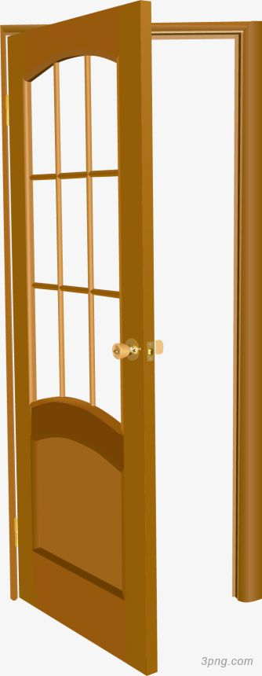
逻辑之门
不可折返之门
悠闲稳定的生活
未知的领域
黑暗的森林
集结外在的力量
内心力量
面对终绝之战

Slide 8
思维力考查
logical thinking
critical thinking
creative thinking

Slide 9
III. 课例应用
The bus stopped in front of my office, and just as I was about to step off, I heard a man call me:“Madam.”I’ve been used to knowing that is me. I turned around. “Is that your scarf?”I looked back. The thin black cotton scarf was alone on the bench. My eyes watered and I said thank you in my way that wasn’t enough .And then I smiled.
It’s not the scarf. It’s rather ordinary and has two holes in it. But if you’ve seen me in the fall or winter, I wear it almost every day. The real reason why I wear the scarf is that it is my mother’s.
My mother wasn’t a person with a lot of things. She had a lovely house built on the side of the Phoenix

Slide 10
Mountain Preserves, filled with plants and books. She spent most of her money on travel. So when she died almost seven years ago, there really wasn’t anything that would help me remember her. My sister, a lawyer, did everything about my mom’s will. My sister had to find out what to donate, what to throw, and what to stare.
My sister went through my mom’s house and picked a few things that, she thought, would remind me of our mom; A pair of diamond earrings, a silver ring, sweaters, notes and cards. And then she packed a few of scarves and a hat in a box. She sent the box to me, believe had just gone on a trip. She was often on the way for months at a time, and even though we talked daily on the phone during that time. I would tell myself she would be back soon, which could keep lying to myself.

Slide 11
注意：
1.所续写短文的词数应为150左右；
2、至少使用5割短文中标有下划线的关键词；
3、续写部分分为两段，每段的开头语已为你写好；
4、续写完成后，请用下划线标出你所使用的关键词语。
Paragraph1:
I put away the box sent to me by my sister, because things in it would remind remind me of my mother._______________
Paragraph2:
I will say thank you to the man finding my scarf. ________

Slide 12
Step1 main idea
Give the main idea in a stating way:
Sb do sth. for some purpose in some way in some situation at some time in sp.with some feeling.
I thanked the man for returning the scarf belonging to my mum,who died 7 years ago,leaving me in unacceptable sorrow .

Slide 13
What does the SCARF mean to the leader?
it is more than a scarf——Perhaps it is a symbol of mother's love ,company or encouragement.
It may have something hidden behind———maybe it is a bond between ___________
my mum and me

Slide 14
Step2:Determine the objective of the passage
Confrontation
Leader
I
Objective
?
L
O
my mum's death
mom's love in another way ;
step out of sorrow;
embrace future life;
step onto future journey
Knockout

Slide 15
内容特征
问题解决
end
问题恶化
Plot3
body
问题初萌
Door 2
Plot2
beginning
Plot1
Door 1

Slide 16
Step 3: Determine the theme line of P1 and P2
Paragraph 1
I put away the box sent to me by my sister ,because things in it would remind me of my mum.
Paragraph 2
I will say thank you to the man finding my scarf .
定情节主线
I went through a dark period of my life after mum's death
Door 2
Plot2
I accepted mum's death and stepped out of darkness because of the scarf/with the encouragement from the man

Slide 17
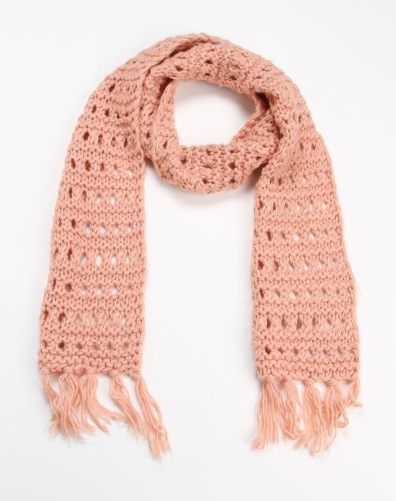
Step 4 ：Determine the confrontation of P1
Paragraph 1：I went through a dark period of my life after mum's death
Confrontation
Leader
I
Objective
wear the scarf
my sorrow/pain
my unacceptance
my dark days/moods in life
low spirits
Knockout

Slide 18
Determine the condition of P2
Paragraph 2：I accepted mum's death and stepped out of darkness
Condition
LeaderI
Objective
embrace future life
1、the man's kindness
2、understand life is a journey,death is another form of journey
3、the best way to remember a beloved one is to live well,live a happy life of your own
......
Knockout

Slide 19
Step5 : Determine how to develop a plot
Beats =action +feeling!
*to show,not tell
*In a proper twisting way
*evaluate your theme

Slide 20
Appreciation2018（浙江高考参考）
Suddenly a little rabbit jumped out in front of my horse. This unexpected appearance frightened my horse, which made it run wildly. I tried my best to control it, but in vain. Frightened as I was, I tried to keep my balance to prevent myself from falling off.
Fortunately, minutes later, the horse stopped before a river, out of breath, and so did I. At that moment, my dad also came up. Seeing I was OK, he was quite relieved. But it was clear that we got lost.

Slide 21
Beat1
frighten,run, control,keep banlance+ wildly,in vain,frightened
+
action feeling
the horse and I in a mass
Beat2
stopped, came up, relieved+fortunately, out of breath, also,
+
action feeling
calm down

Slide 22
1lock
2door
3act
3定
3增强
4发展
一、定结局----ending
二、定情节主线——theme line
三、定对立场元素——confrontation/condition
四、赋予对立场双方力量——let the story happen
1.增加主角力量 2.增加对手力量 3.第三方力量增援
五、情节发展手法
Beats = action + feeling!
*to show,not tell
*In a proper twisting way
*evaluate your theme

Slide 23
Step5 Self Review&Peer Review
评价项目 | 评分标准 | 得分
续文结构 | 1、根据“三幕、两门”理论，确定故事结局 （主角要实现的总目标） | 0-2分
 | 2、依据总目标，确定续写情节分目标 | 0-2分
 | 3、依据分目标，确定续写情节主题线 | 0-4分
续文内容 | 依据目标筛选对立场元素，有效支撑情节主题发展 三增强（主角、对手、第三方） | 0-6分
续文手法 | 1运用“适当曲折”原则，合理分布情节元素 | 0-2分
 | 2精准使用语言知识，恰当使用“展示而非讲述”策略 | 0-6分
 | 3构建节拍 Beats=action+feeling! | 0-3分
 | 4评价主题意义 | 0-2分

Slide 24
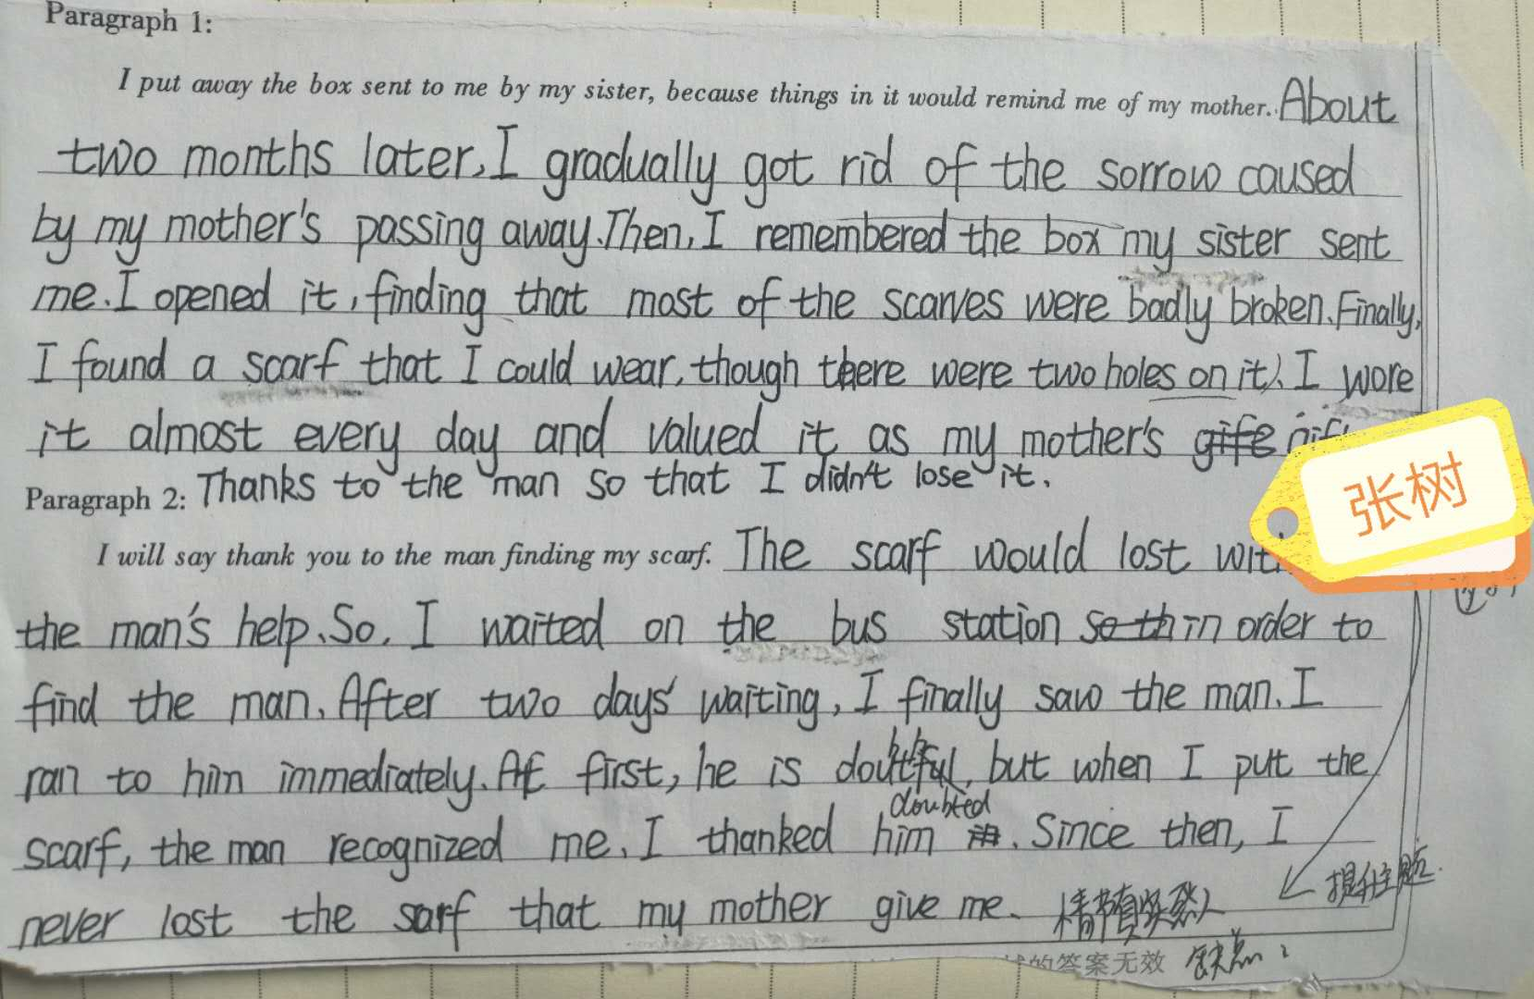
Step 6 学生作品点评

Slide 25
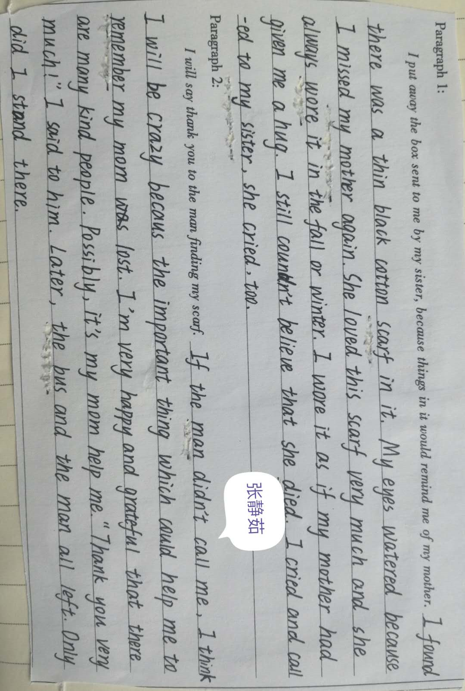

Slide 26
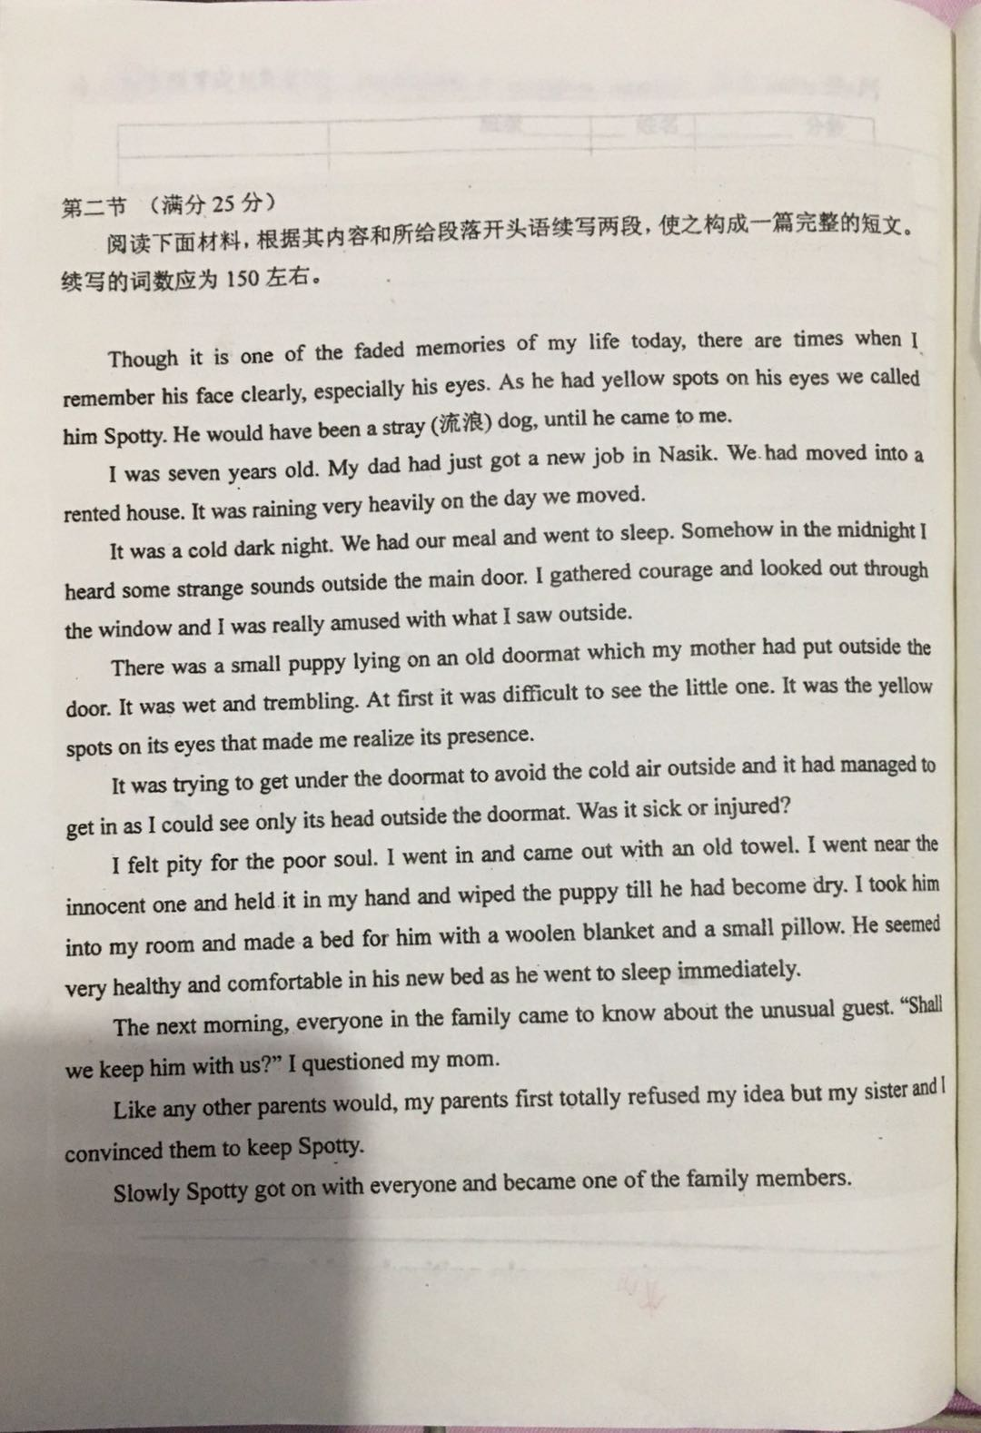
Homework 山东高考模拟

Slide 27
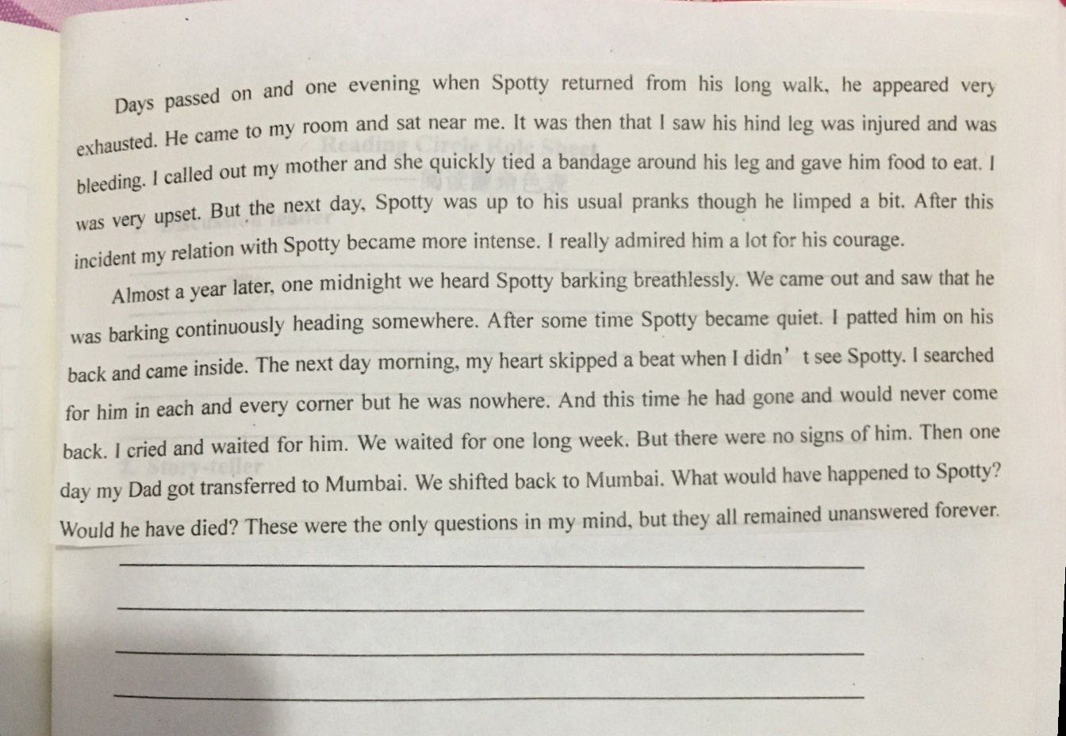
Homework2019山东高考模拟

Slide 28


