Slide 1

Unit 2 Let’s talk teens
Project

Slide 2


Sharing stories
Tell a short story about you and your parents.

Slide 3
Free talk
Do you often quarrel with your parents?
We often quarrel about ______.
friends
Generation gap
Quarrels

Slide 4
Choose a topic
Parent-child tensions
hate
misunderstand
disbelieve
disagree on values with
Parents
Children
Tip Conflicts in a play are expected by the audience. If a topic can carry a conflict, it is a good topic.

Slide 5
Choose a topic
Good parent-child relationships
love
understand
respect
help
Parents
Children
Tip A good topic should reflect the change of the parent-child relationship.

Slide 6
Choose a topic
Case study: Is “Dream” a good topic?
Conflict: You want to be a singer while your parents want you to be a writer.
Change
(Climax)
How
Solution: You and your parents come to an agreement—be a song composer and singer.

Slide 7
Choose a topic
Decide on a topic in your group
Our topic is:
__________

Slide 8
Elements of a play
Setting
When and where the play is set
A person or sometimes even an animal appearing in the play
Character
Plot
The things that happen in the play and the ways in which those incidents are connected
Theme
The controlling idea or central insight that the author of the play is trying to get across

Slide 9
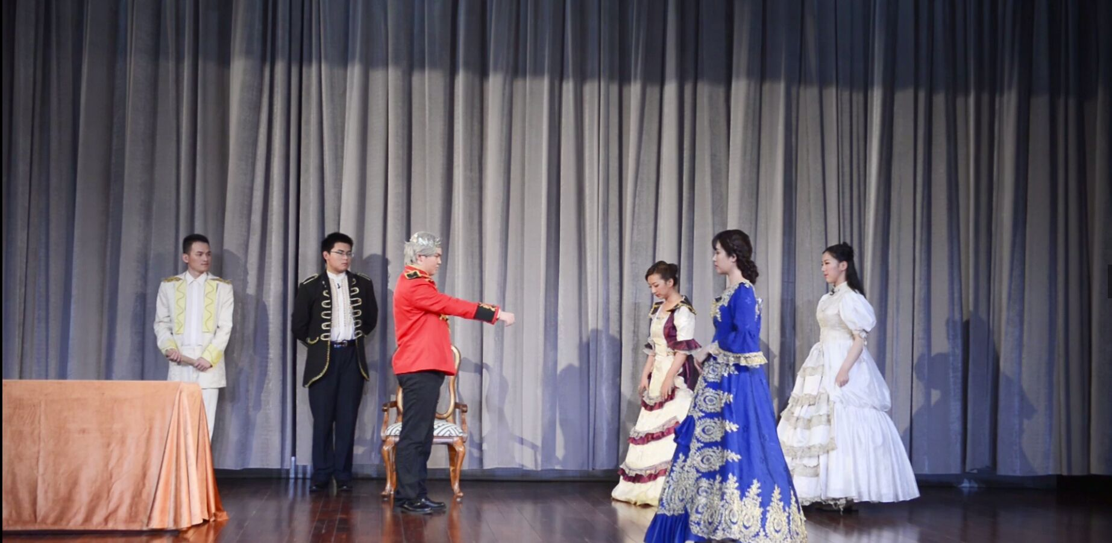
Watch a video
Watch a video
Adapted from King Lear by William Shakespeare, written in 1605–1606 and published in 1608

Slide 10
Watch a video
Watch a video
Elements of a play | The play you watch
Setting
Characters
Plot
Theme
In the court of King Lear
King Lear, Goneril, Regan, Cordelia, Kent

Slide 11
Watch a video
Plot
King Lear decided to divide his kingdom according to his daughters’ love.
Goneril and Regan lied to King Lear and told him they loved him the most.
Cordelia told her true feelings about King Lear.
Kent tried to persuade King Lear to forgive Cordelia.
King Lear got angry and asked Kent to leave his country.
Kent left.

Slide 12
Watch a video
Characters | Feelings
King Lear
Cordelia
Kent
satisfied
furious
disapproval of her sisters
sure of herself
pleading
disappointed and determined to leave
Inner story
(The feelings)
Outer story
(The incidents)

Slide 13
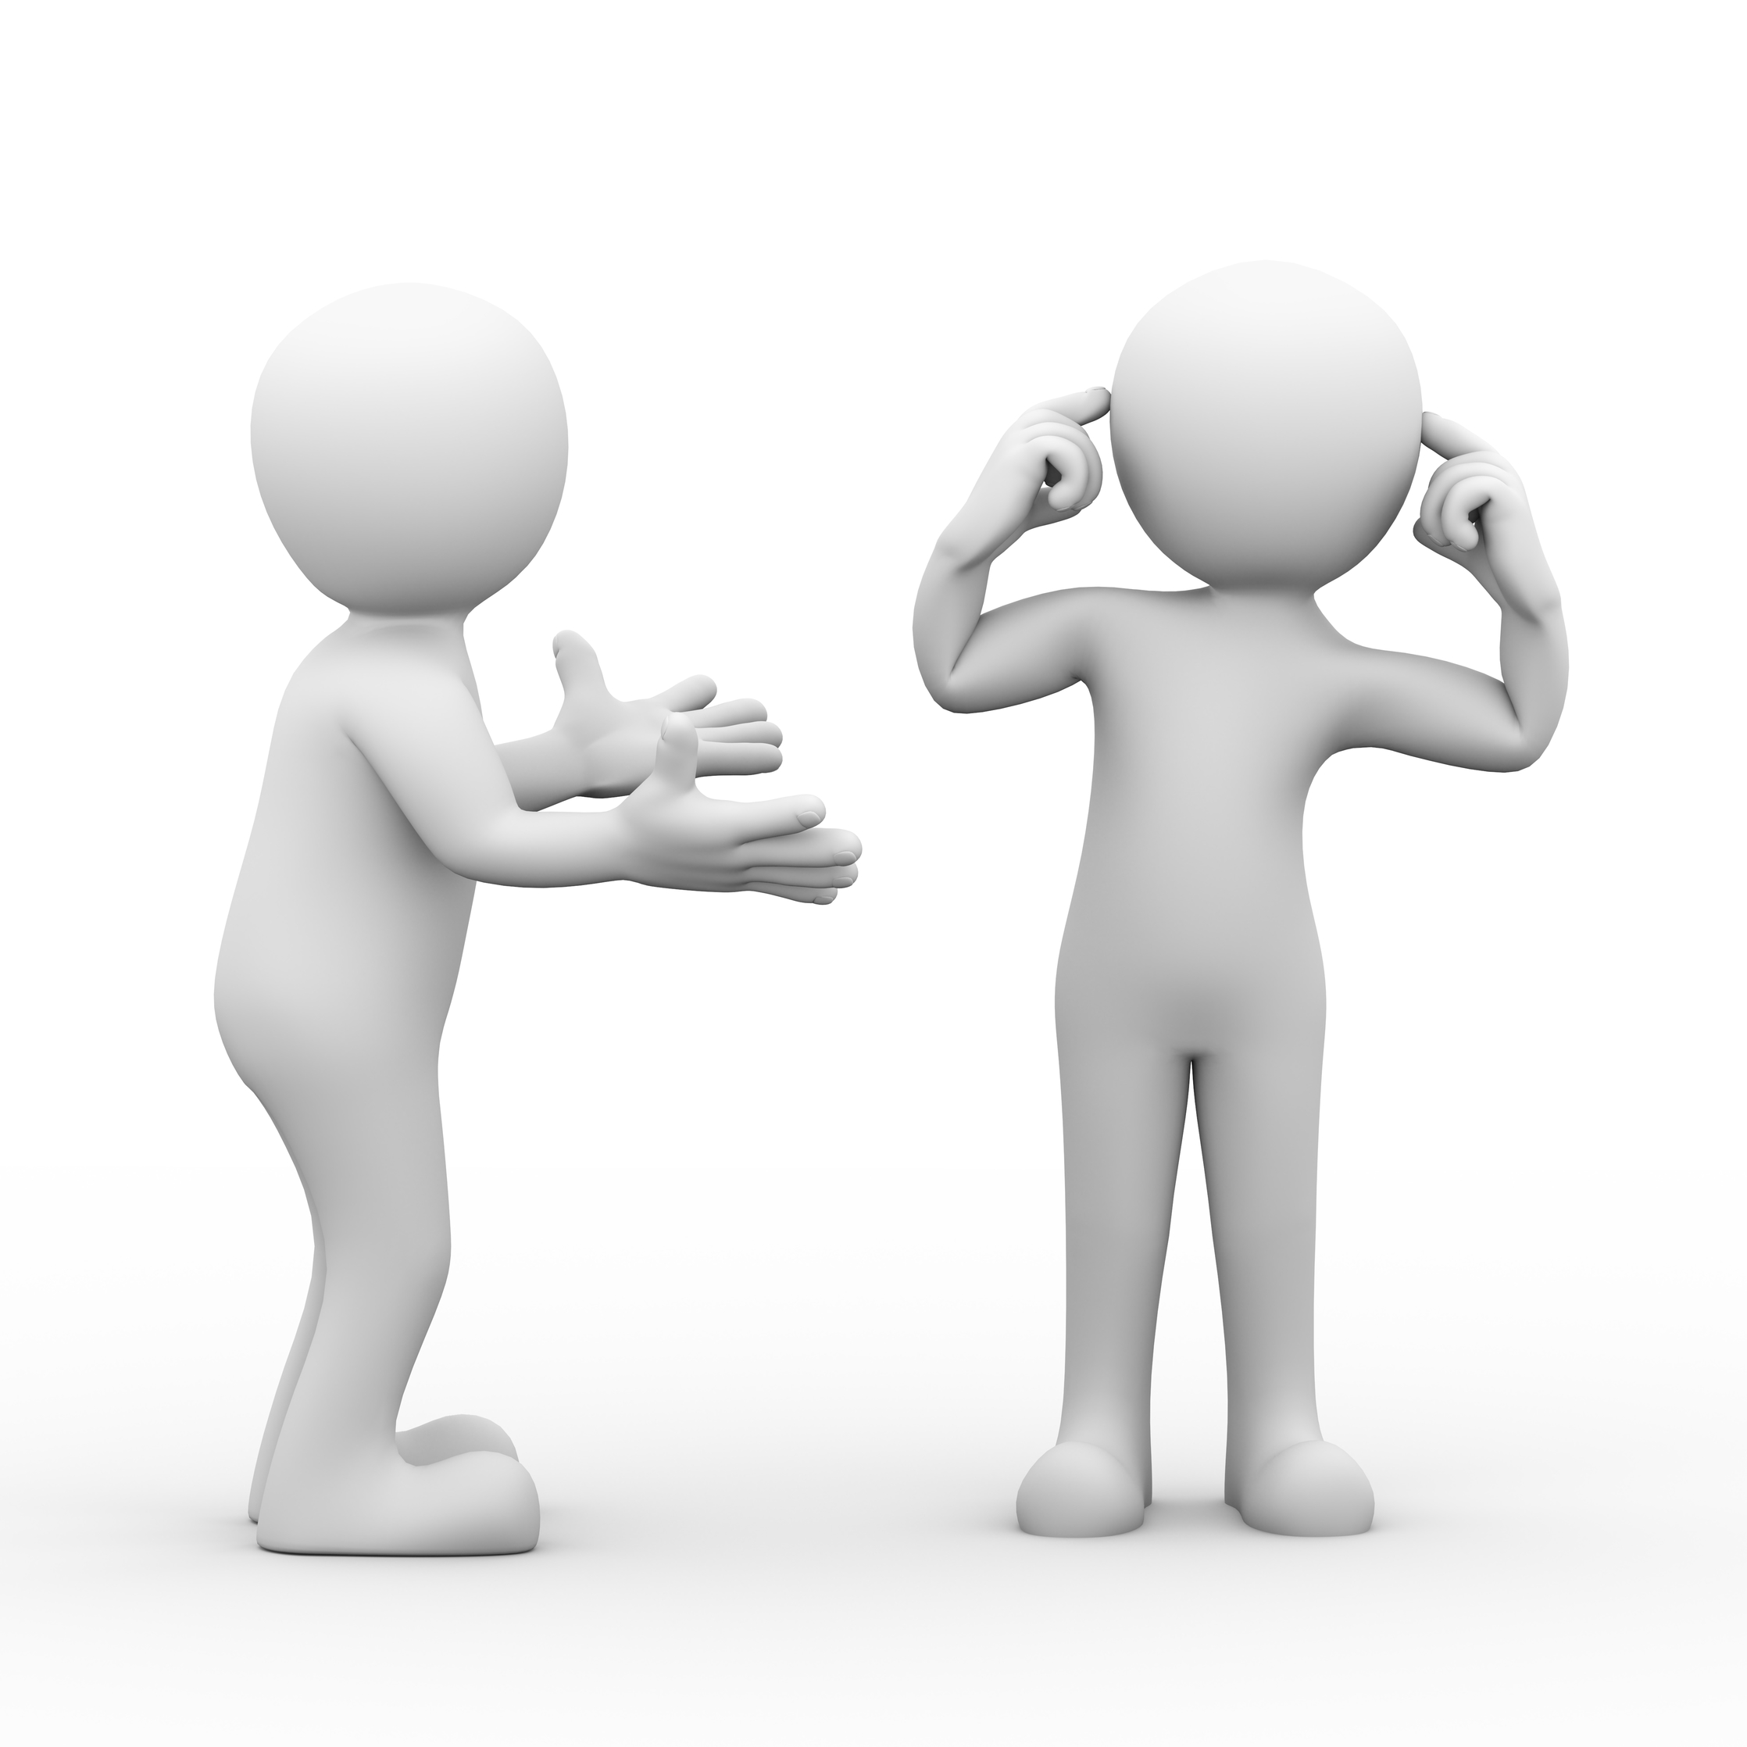
Tip
☆ Feelings can reveal characters’ personalities.
☆ Feelings can be shown through characters’ words and actions.
☆ The change of feelings can
promote the development of the plot.

Slide 14

Watch a video
Theme
Cordelia had a deep love for King Lear, and Kent was loyal to King Lear. But King Lear turned a blind eye to all these.
Tip:

Slide 15
Decide on the elements of your play
Elements of a play | Your own play
Setting | ?
Characters | ?
Plot | ?
Theme | ?

Slide 16
Decide on the elements of your play
Plot
The exposition is the part of the play (normally in the beginning) in which the writer “exposes” the background information that the audience needs to understand the story.
Exposition
The conflict is a dramatic struggle between two forces in the play. It can be anything from a concept in one person’s head to a battle between characters.
Conflict
The climax happens when the conflict is resolved in some way. It is the most exciting part of a play, but the journey toward a climax can be difficult. A play can have a mini-climax, a setback, and then a bigger, final climax.
Climax
Ending
The ending is what becomes of the characters at the end of the play.

Slide 17
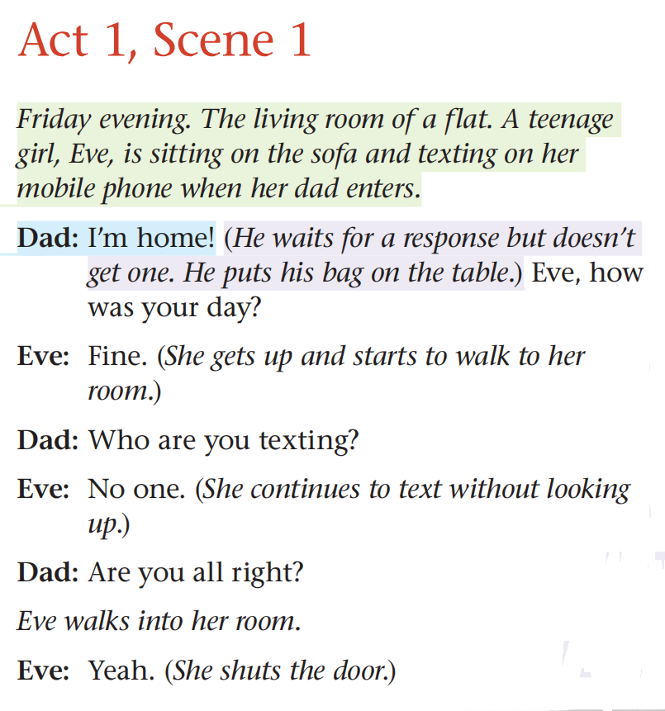
Write a play
Break the plot into acts and scenes.

Slide 18
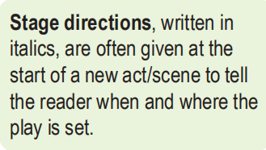
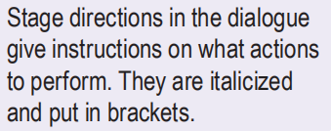
Write a play
Include stage directions
clear and able to reveal the feelings of the characters

Slide 19
Write a play
Physical actions
Emotional states
(Anxiously)
(Enthusiastically)

Slide 20
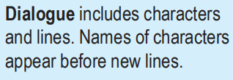
Write a play
Write the dialogues for the characters
oral and natural

Slide 21
Write a play
Write your own play
Tip Lines and actions of the characters should reveal their feelings.

Slide 22
Stage your play
Tip
To perform a play well, you should:
☆ learn how to say your lines. Try to speaking in different ways, e.g. softly, angrily, to see which way works best;
☆ perform with confidence. Speak loudly so that you can be heard clearly;
☆ use body language to show your feelings.

Slide 23
________________________________________________________________________________________________________________________________________________________________________________________________________________________________________________
Homework
Watch the other group’s play and write a
review about the play.

Slide 24


