Slide 1

Unit 1 Back to school
Project

Slide 2

A letter from …
Goal
Hello, my friends,
I’m John Li studying in the UK. My foreign classmates are curious about school life in China. Can you send me a booklet about your school?
Yours,
John Li
Make a booklet about our school

Slide 3
Free talk
Lessons
My school life

Slide 4
Steps to make a booklet
Step 1 How to nail down a topic
Step 2 How to get information
Step 3 How to make a booklet

Slide 5
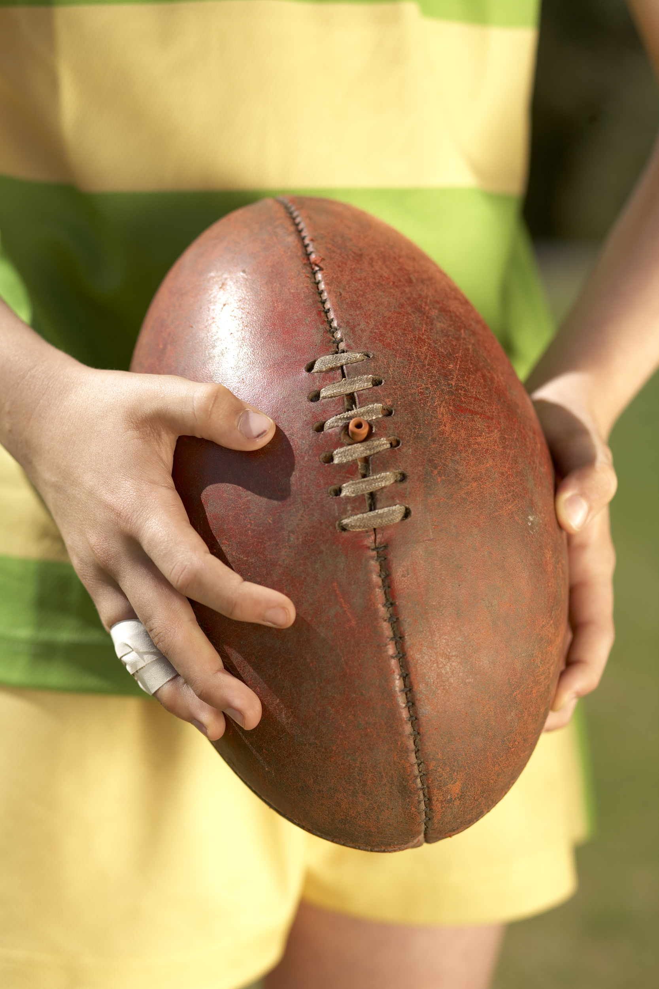
Step 1 How to nail down a topic
What is a good topic?
annual sports meet
VS
campus culture
Specific!

Slide 6
Step 1 How to nail down a topic
What is a good topic?
English classes given by foreign teachers
VS
English classes
Interesting!

Slide 7


Step 1 How to nail down a topic
Is “school events” a good topic?
Tip: Be specific and interesting.

Slide 8


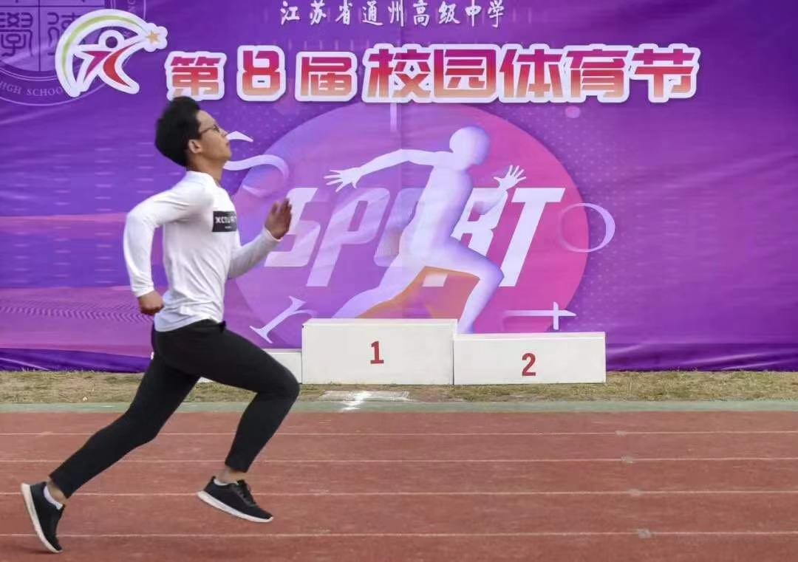
Step 1 How to nail down a topic
School events
Notes:
更换版式

Slide 9
Step 1 How to nail down a topic
Decide on a topic in your group.
Our topic is:
__________

Slide 10
Step 2 How to get information
Who
What
Where
When
How
School events
Tip: Take down your questions.

Slide 11

Step 2 How to get information
How
Research
Interview
Websites
Library
Museum
Teachers
Schoolmates
*********************************************
All roads lead to Rome.

Slide 12
Step 2 How to get information
Websites
How can you find information you want online?
Tip: Type in KEY words.
school events key words?

Slide 13
Step 2 How to get information
Websites
What websites will you visit? Why?
School websites or Baidu?
Tip: The information should be ACCURATE and RELIABLE.

Slide 14
Step 2 How to get information
Websites
What can you get from the websites?
Any other ways to get pictures?
Tip: Download pictures or take photos.

Slide 15
Step 2 How to get information
Teachers or schoolmates
Who will you interview?
What do you want to know?
What kind of questions should you ask in an interview?
Example
Can you tell me something about the history of our school? (general)
When was the main teaching building built? (specific)

Slide 16
Step 2 How to get information
Teachers or schoolmates
What kind of questions should you ask in an interview?
Tip: It’s a good idea to start with general questions and then move on to specific ones.

Slide 17
Step 2 How to get information
Teachers or schoolmates
Design your interview questions about “school events”.
Can you tell me something about the school events?
How many school events do we have?
When are these school events held?
Who can take part in these school events?
What do students do in these school events?
Example

Slide 18
Step 2 How to get information
Teachers or schoolmates
Group work: Design your interview questions and present them to the class.
Class work: Comment on others' interview questions and help polish up those questions.

Slide 19

Step 2 How to get information
Decide on one or more ways of getting information.

Slide 20
Step 3 How to make a booklet
Case study: look at the example and summarize the features of a good booklet
＊clear
＊precise
＊…
language
picture
Booklet
layout
….

Slide 21

Step 3 How to make a booklet
Assignments
◇Write a passage about your selected topic.
◇Polish up your writing.

Slide 22
Step 3 How to make a booklet
Case study: look at the example and summarize the features of a good booklet
language
＊clear
＊beautiful
＊….
picture
Booklet
layout
….

Slide 23
Step 3 How to make a booklet
Case study: look at the example and summarize the features of a good booklet
language
picture
＊neat
＊creative
＊….
Booklet
layout
….

Slide 24
Step 3 How to make a booklet
Put together all the information.
Tips: 1. Use clear and precise language.
2. Use clear and beautiful pictures.
3. Use neat and creative layout.

Slide 25
Presentation and appreciation
Show time!

Slide 26
Homework
1. Read the booklet and appreciate the work of other groups.
2. Reflect on the booklet and think about how you can make the school a better place. Write a letter to your school principal presenting your suggestions.

Slide 27


