Slide 1

Unit 2 Let’s talk teens
Grammar and usage

Slide 2
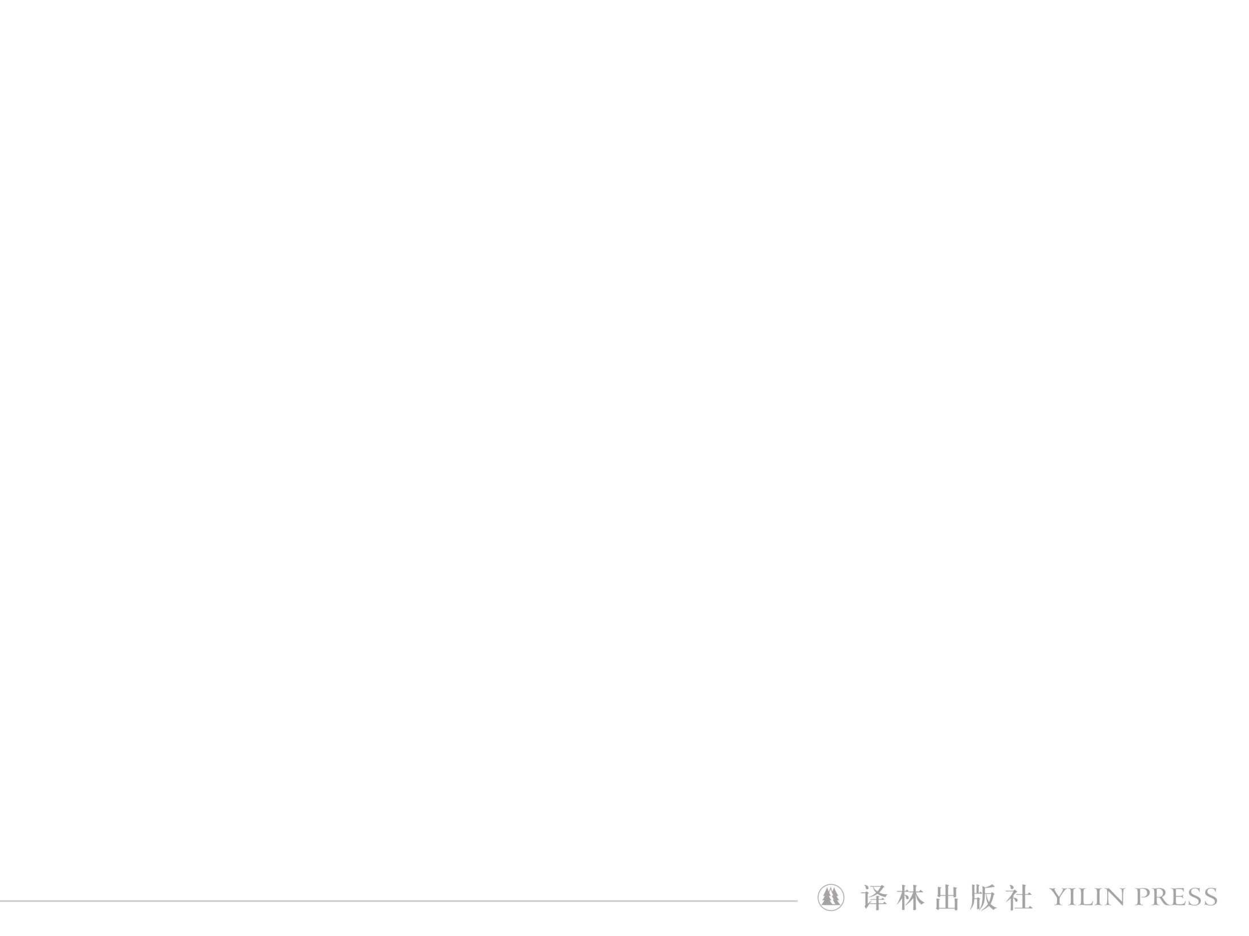
Family is the kingdom of father, the world of mother and the paradise of children.
Family should be the palace of love, joy and laughter.
parents
child
love
Let’s talk teens

Slide 3
Parent-child relationship
曹霞
Developing mental needs
中学一级教师
南通市青年教师基本功比赛 二等奖
通州区优质课评比 一等奖
通州区高三优秀教师
Physical changes
Teenagers’ growth
Let’s talk teens

Slide 4
Parent-child relationship
曹霞
中学一级教师
南通市青年教师基本功比赛 二等奖
通州区优质课评比 一等奖
通州区高三优秀教师
Heated arguments
Cold silence
Let’s talk teens

Slide 5
How can teenagers solve parent-child problems?
1
Visit websites designed for teens
Visit TeenHealthWeb
2
Talk to friends
3
Communicate with parents
Let’s talk teens

Slide 6
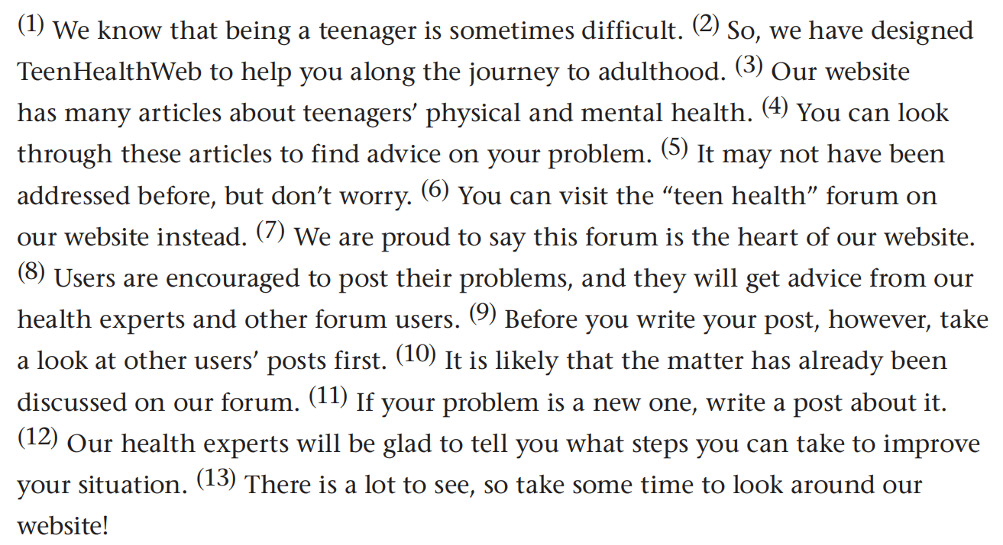
中学一级教师
南通市青年教师基本功比赛 二等奖
通州区优质课评比 一等奖
通州区高三优秀教师
TeenHealthWeb

Slide 7
In TeenHealthWeb, teens can
look through many articles about teenagers’ physical and mental health to find advice on your problem;
visit the “teen health” forum and post the problem and get advice from our health experts and other forum users.
TeenHealthWeb

Slide 8
Sentence elements
Subject
曹霞
主语
The teacher gave a speech.
Verb
谓语
Many students join school club.
Object
宾语
We should develop good study habits.
Complement
补语
Listening to music makes me relaxed.
Adverbial
状语
Maggie plans her study carefully.
Predicative
表语
It’s a lovely day.
Attributive
定语
I went to a large library yesterday.

Slide 9
Sentence structures
1
S + V
主谓
2
S + V + P
主系表
3
S + V + O
主谓宾
Sentence structures
4
S + V + O + O
主谓宾宾
5
S + V + O + C
主谓宾补
6
S + V + A
主谓状
7
S + V + O + A
主谓宾状
8
There be
存现句

Slide 10
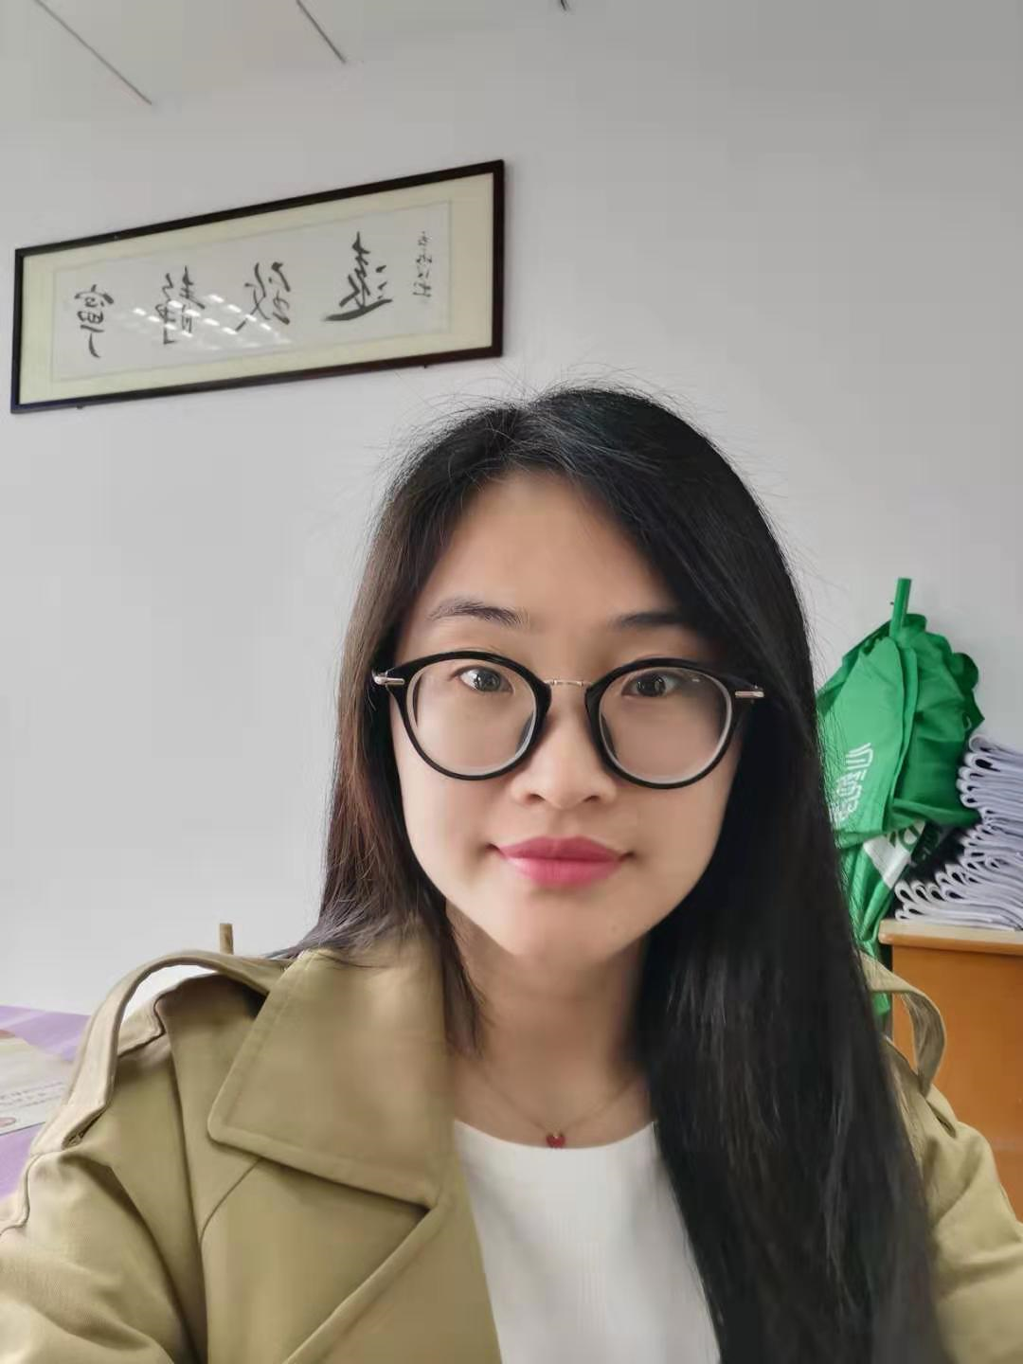
曹霞
Simple sentences
(2, 3, 4, 6)
E.g. He left his hometown.
中学一级教师
南通市青年教师基本功比赛 二等奖
通州区优质课评比 一等奖
通州区高三优秀教师
Types of sentences
Compound sentences
(5, 8, 13)
E.g. He left his hometown and served in the army.
Complex sentences
(1, 7, 9, 10, 11, 12)
E.g. He left his hometown where he had lived for two decades.
Exploring the rules

Slide 11
Simple sentences
S
V
O
A
(2) So, we have designed TeenHealthWeb to help you
along the journey to adulthood.
(3) Our website has many articles about teenagers’ physical and mental health.
(4) You can look through these articles to find advice on your problem.
(6) You can visit the “teen health” forum on our website instead.
S
中学一级教师
南通市青年教师基本功比赛 二等奖
通州区优质课评比 一等奖
通州区高三优秀教师
V
O
Attr.
S
V
O
A
S
V
O
Attr.
A
Exploring the rules

Slide 12
A simple sentence
a subject
a verb
E.g. My uncle works in a factory.
I enjoy playing football.
Exploring the rules

Slide 13
Compound sentences
a linking word
a linking word
a simple sentence
a simple sentence
(5) It may not have been addressed before, but don’t worry.
(8) Users are encouraged to post their problems, and they will get advice from our health experts and other forum users.
(13) There is a lot to see, so take some time to look around our website!
but
中学一级教师
南通市青年教师基本功比赛 二等奖
通州区优质课评比 一等奖
通州区高三优秀教师
two simple sentences
and
two simple sentences
a linking word
so
two simple sentences
Exploring the rules

Slide 14
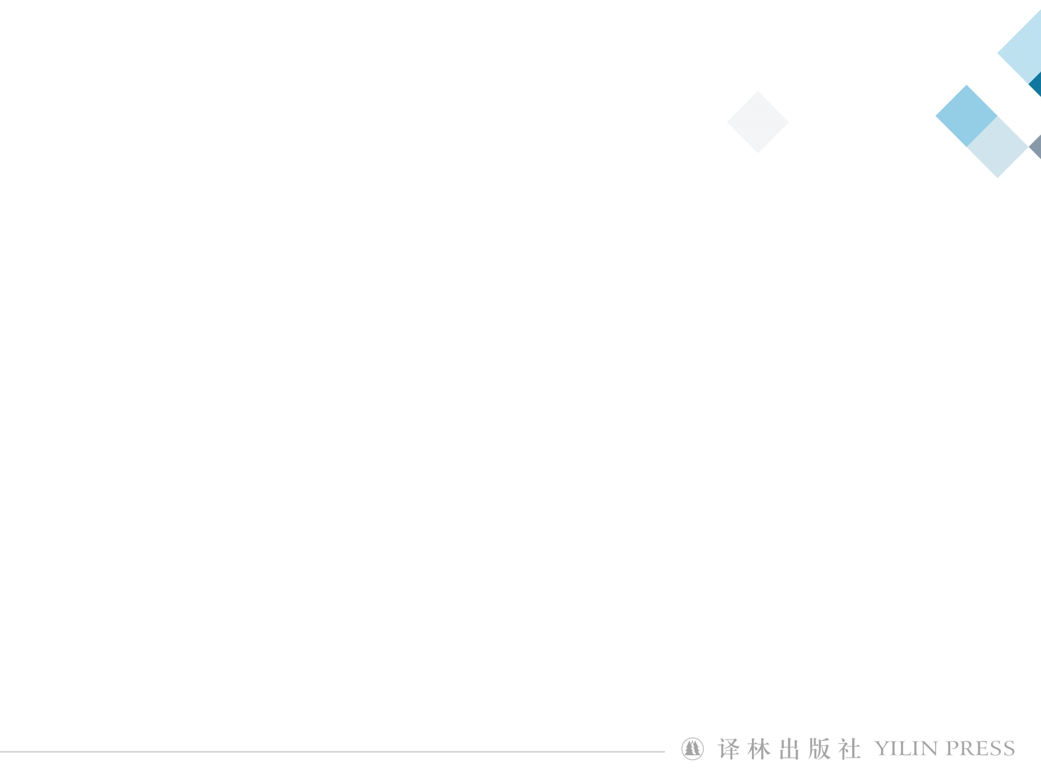
曹霞
contains two or more main clauses;
A compound sentence
uses linking words:
and, but,
中学一级教师
南通市青年教师基本功比赛 二等奖
通州区优质课评比 一等奖
通州区高三优秀教师
or, so, for, nor ...
E.g. Shall I send the book to you, or will you come to get it?
Oxford is not far from Stratford, so you can visit both in a day.
I cannot tell Mary’s appearance, for I have never seen her.
He didn’t return my calls, nor did he respond to any of my texts.
Exploring the rules

Slide 15
Coordinating conjunctions
Coordinating conjunctions | Functions
and | It is used for two similar items, or to connect a series of events.
but, yet, while | They are generally used to show a contrast between two clauses.
or | It is used to suggest an option or alternative.
for, so | They are used to show the consequence or result of something.
nor | It is used for two similar items but in the negative sense.
Exploring the rules

Slide 16
Practice
I like tea_______ she likes coffee.
我喜欢喝茶而她喜欢喝咖啡。
2. I am thirsty, _______ it is very hot.
我口渴, 因为天气很热。
3. Do you want to take them to the zoo, _______ would it be wiser to go to the park?
你是想带他们去动物园呢，还是去公园更好？
4. I’ve been away from my hometown for only two years, ________ now I can hardly recognize it.
我离开家乡才两年，现在却几乎认不出来它了。
while
for
or
but/yet

Slide 17
Complex sentences
subordinate
clauses
main clauses
object
(1) We know that being a teenager is sometimes difficult.
(7) We are proud to say this forum is the heart of our website.
(9) Before you write your post, however, take a look at other users’ posts first.
(10) It is likely that the matter has already been discussed on our forum.
(11) If your problem is a new one, write a post about it.
(12) Our health experts will be glad to tell you what steps you can take to improve your situation.
中学一级教师
南通市青年教师基本功比赛 二等奖
通州区优质课评比 一等奖
通州区高三优秀教师
object
adverbial
subject
adverbial
object
Exploring the rules

Slide 18
one main clause
A complex sentence
subject
predicative
at least one subordinate clause
object
attributive
adverbial
e.g. I hope that high school will be more exciting.
As I grow older, I became more interested in poems.
Exploring the rules

Slide 19
Practice
★ We never know the love of our parents for us till we have become parents. 养儿方知父母恩。
Adverbial clause
★ Happy are the families where the government of parents is the reign of affection, and of the children the submission to love. 幸福的家庭，父母靠慈爱当家，孩子也是出于对父母的爱而顺从大人。
Attributive clause
★ It is a truth universally acknowledged that the relationship between a parent and a child is the most significant one in a person’s life. 父母和孩子之间的关系是一个人一生中最重要的关系，这是一个举世公认的真理。
Subject clause
Attributive clause Noun clause Adverbial clause
Attributive clause
Noun clause
Adverbial clause

Slide 20
Quick judgement
(1) Heated arguments and cold silences are common between teenagers and their parents.
(2) Teenagers’ physical changes may result in such family tensions.
(3) It can be a big headache to balance your developing mental needs too.
(4) Although sometimes it may seem impossible to get along as a family, you can take action to improve the situation. (5) The key to keeping the peace is regular and honest communication.
(6) The good news is that this stormy period will not last. (7) Everything will turn out all right in the end, and the changes and challenges of your teenage years will prepare you for adulthood.
Simple sentence
1, 2, 3, 5
Compound sentence
7
Complex sentence
4, 6

Slide 21
Your password should be more than eight letters or numbers. This makes it difficult to guess.
Tips
Posts should not give out personal information. They should not include advertisements.
on how to use TeenHealthWeb
Describe your problems clearly. Other people can understand them easily.
The experts will reply to you. They see your posts.
What do you think of our forum? Let us know.
Applying the rules

Slide 22
Compound/Complex sentences
Simple sentences
Your password should be more than eight letters or numbers. This makes it difficult to guess.
添加标题
Your password should be more than eight letters or numbers because this makes it difficult to guess.
Complex
Posts should not give out personal information. They should not include advertisements.
and
Posts should not give out personal information and they should not include advertisements.
Compound
Applying the rules

Slide 23
Describe your problems clearly. Other people can understand them easily.
Describe your problems clearly so other people can understand them easily.
so
compound
The experts will reply to you. They see your posts.
The experts will reply to you when/once/as soon as they see your posts.
complex
What do you think of our forum? Let us know.
Let us know what you think of our forum.
complex
Applying the rules

Slide 24
How can teenagers solve parent-child problems?
1
Visit TeenHealthWeb
2
Talk to friends
3
Communication with parents
Let’s talk teens

Slide 25
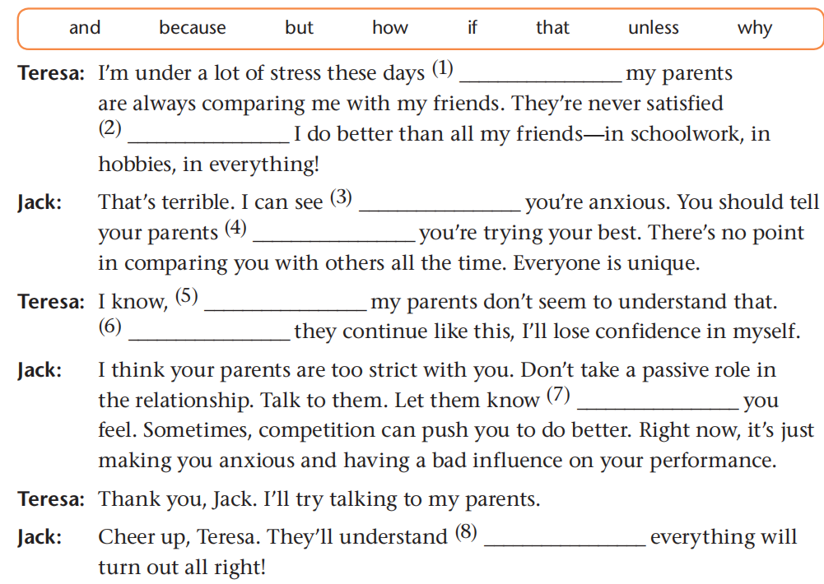
because
unless
why
that
but
if
how
and
Applying the rules

Slide 26
Teresa's problem
She feels stressed in that her parents are always comparing her with her friends and they are never satisfied.
Jack's suggestions
1. Take an active role in the relationship.
2. Talk to her parents and let them know her feelings.
Let’s talk teens

Slide 27
How can teenagers solve parent-child problems?
1
Visit TeenHealthWeb
2
Talk to friends
3
Communicate with parents
Let’s talk teens

Slide 28
Teresa
Convey her ideas to her parents clearly and sincerely.
parents
Listen attentively and show respect.
family
Make joint efforts to improve the relationship.
Let’s talk teens

Slide 29
Role-play
Teresa: Hi Mum! Can we please talk?
Mother: Sure, dear. What’s the matter?
...
Note：
Use simple, compound and complex sentences.
Applying the rules

Slide 30
曹霞
regular and honest communication
parent-child relationship
中学一级教师
南通市青年教师基本功比赛 二等奖
通州区优质课评比 一等奖
通州区高三优秀教师
peaceful and harmonious relationship
Let’s talk teens

Slide 31
Just remember that it is completely normal to struggle with the stress that parent-child tensions create, and that you and your parents can work together to improve your relationship. The good news is that this stormy period will not last. Everything will turn out all right in the end, and the changes and challenges of your teenage years will prepare you for adulthood.
Let’s talk teens

Slide 32

Homework
Finish the exercise on page 64.

Slide 33


