Slide 1

Unit 2 Let’s talk teens
Reading (II)

Slide 2
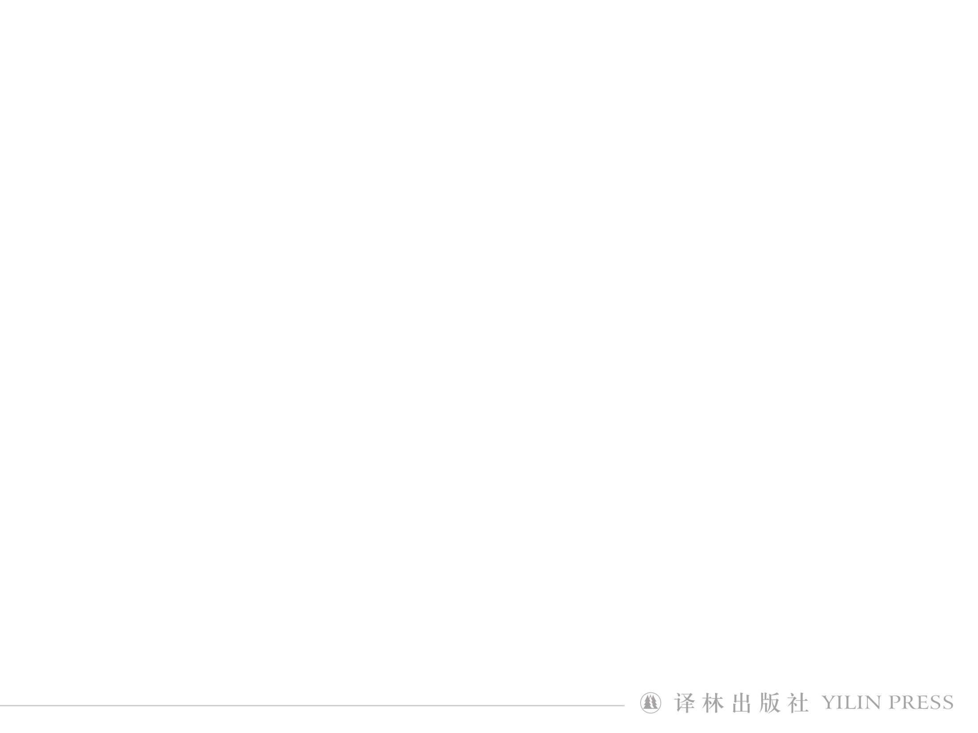
Reading (II)
Strangers
under the same roof?

Slide 3
In today’s class, we shall：
☆ review the text;
☆ discuss how to use some of the
words and phrases;
☆ practise using them in different
situations.

Slide 4
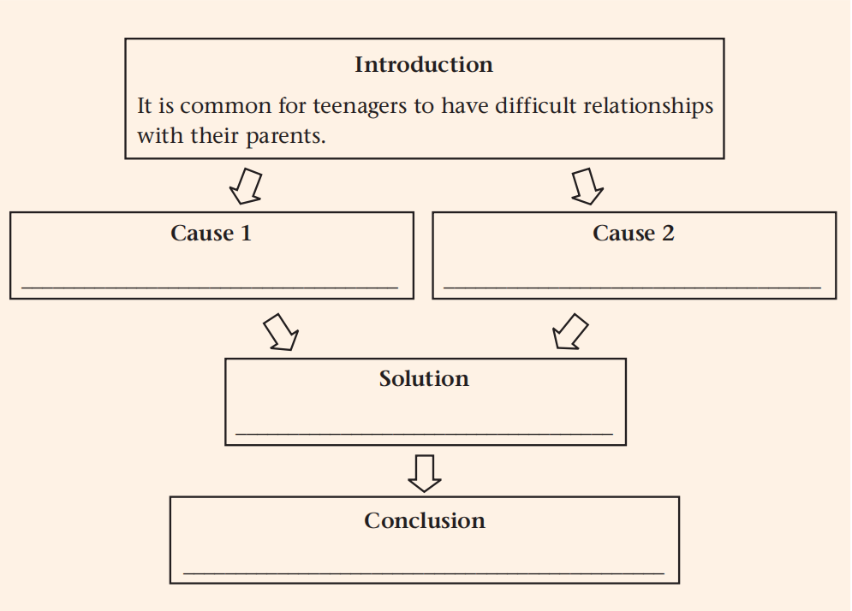
Review
Physical changes
Mental needs
Regular and honest communication
Everything will turn out all right in the end.

Slide 5
Word study: rate
You may feel anxious that you are developing at a
different rate to your friends, shooting up in height or
getting left far behind. (para. 2)
a measurement of the speed at which sth happens
different
alarming
at a(n)
rate
average
fast/low
frightening

Slide 6
Guess the meanings of rate in the following sentences.
Australia’s unemployment rate rose to 6.5% in February.
n. a measurement of the number of times sth happens or exists during a particular period
2. We offer special reduced rates this week.
n. a fixed amount of money that is charged or paid for sth
3. I may be away next week but at any rate I’ll be back before the meeting.
used to say that a particular fact is true despite what has happened in the past or what may happen in the future
4. At this rate we won’t ever be able to afford a holiday.
(informal) used to say what will happen if a particular situation continues to develop in the same way

Slide 7
Guess the meanings of rate in the following sentences.
1. The university is highly rated for its research.
to have or think that sb/sth has a particular level
of quality, value, etc.
2. He is currently rated number three in the world.
to place sb/sth in a particular position on a scale
in relation to similar people or things

Slide 8
Translate the following sentences.
评论家和观众都认为这次演出是成功的。
The show was rated (as) a success by critics and audiences.
2. 大多数人步行的平均速度为每小时5公里。
Most people walk at an average rate of 5 kilometres an hour.
3. 不管怎样，下次会议将在星期三召开。
At any rate, the next meeting will be held on Wednesday.

Slide 9
Word study: shoot up
2. You may feel anxious that you are developing at a
different rate to your friends, shooting up in height
or getting left far behind. (para. 2)
if a child shoots up, he or she grows taller very quickly and suddenly
to increase very quickly and suddenly
E.g. I can’t believe this is David—he’s shot up since we graduated!
The company’s profit has shot up since the beginning of the year.

Slide 10
Match the sentences with the meanings of shoot.
Police shot one suspect
when he pulled a gun on them.
2. They spent the weekend in the countryside shooting deer.
3. The band’s last single shot straight to number one in the charts.
4. He should have shot instead of passing.
5. The film was shot in New Zealand.
to move suddenly or quickly in one direction; to make sb/sth move in this way
to fire a gun or other weapon; to fire sth from a weapon
to make a film or photograph of sth
to try to kick, hit or throw the ball into a goal or to score a point
to hunt and kill birds and animals with a gun as a sport

Slide 11
Translate the following sentences.
1. 去年票价猛涨。
Ticket prices shot up last year.
2. The movie was shot in black and white.
那部电影拍成了黑白片。
3. 抢劫过程中有三人被开枪打死。
Three people were shot dead during the robbery.
4. He suddenly shot from the halfway line.
他突然在中线上射门。

Slide 12
Word study: struggle
3. On the other hand, when you are struggling to
control your feelings, you wish they could be more
caring and patient—sometimes they forget that growing up is a rough ride. (para. 3)
to try very hard to do sth when it is difficult or when there are a lot of problems
for
struggle
against/with
to do
E.g. She’s struggling to bring up a family alone.

Slide 13
Word study: breakdown
4. All of this can lead to a breakdown in your relationship. (para. 3)
a failure of a relationship, discussion or system
E.g. This led to the breakdown of the negotiations.
breakdown
breakthrough
outbreak
overturn
break down
break through
break out
turn over

Slide 14
Guess the meanings of break down in the following sentences.
The printing machines are always breaking down.
2. Negotiations between the two sides have broken down.
3. She broke down in tears when she heard the news.
4. He showed us the whole dance, and then broke it down
so that we could learn it more easily.
5. Her health broke down under the pressure of work.
to stop working because of a fault
to fail
to lose control of your feelings and start crying
to divide sth into parts in order to analyse it or make it easier to do
to become very bad

Slide 15
Match the sentences according to the meaning of break down.
1. Because he was being so
kind and concerned, I broke
down and cried.
2. Talks with business leaders
broke down last night.
3. The question can be broken
down into two parts.
4. The car broke down just
north of Paris.
Twice his small electric fan
broke down.
At first he refused to admit
his guilt but when he was
shown the evidence he
broke down and confessed.
I left London when my
marriage broke down.
Break your expenditure down into bills, food and other.

Slide 16
Word study: view
5. When you disagree with your parents, take a minute to calm down and try to understand the situation from their point of view. (para. 4)
have/hold a view
express a view
share a view
support a view
one’s view on…
in one’s view
from one’s point of view
come into view
in view
in view of
view … as…
view … from a …
perspective

Slide 17
Choose the phrases from the box to complete the sentences.
support the view come into view view … as …
in view of in one’s view
In view of
____ ____ ____ the weather, the event will now be held indoors.
2. When the car was first built, the design ____ ____ ____ highly original.
3. This evidence _____ _____ _____ that there is too
much violence on television.
4. The lake soon ____ ____ ____.
5. ____ ____ ____ it was a waste of time.
was viewed
as
supports the view
came into view
In my view

Slide 18
Word study: go through
6. Perhaps they have experienced something similar and do
not want you to go through the same pain. (para. 4)
to experience or suffer sth
E.g. He’s amazingly cheerful considering all he’s had
to go through.

Slide 19
Guess the meanings of go through in the following sentences.
We went through five pints of milk last week.
She went through her bag looking for the keys.
3. Let’s go through the arguments again
4. The deal failed to go through.
5. When you’re going through a crisis, it often helps to talk
to someone.
to use up or finish sth completely
to look at or examine sth carefully, especially in order to find sth
to study or consider sth in detail, especially by repeating it
if a law, contract, etc. goes through , it is officially accepted or completed
to experience or suffer sth

Slide 20
They were suddenly plunged into darkness as the train
went through a tunnel.
into one side or end of an entrance, passage, hole etc and out of the other side or end
through
across
over

Slide 21
Word study: concern
7. After you have thought it through, explain your actions and feelings calmly, listen carefully, and address their concerns. (para. 4)
a feeling of worry, especially one that is shared by many people
express
raise
voice
show
address
concern
about
for
over
that
growing
widespread
primary

Slide 22
Guess the meanings of concern/concerned/concerning in the
following sentences.
concern n.
concern v.
concerned adj.
concerning prep.
She was concerned that she might miss the turning and get lost.
worried and feeling concern about sth
What concerns me is our lack of preparation for the dry season.
to worry sb
As far as Americans are concerned, a lot of our hotels are
below average.
used to show what someone’s opinion on a subject is or how it affects them
He asked several questions concerning the causes of the accident.
about sth; involving sb/sth

Slide 23
Fill in the blanks with the proper forms of concern.
1. He expressed _______ over the spread of the disease.
2. Many people are _________ about the current economic situations.
3. Discussions ___________ the plan got under way on 15th March.
4. Our primary _________ is providing jobs for young school leavers.
5. As far as I’m ___________, the children come first.
6. It _________ me that you no longer seem to care.
concern
concerned
concerning
concern
concerned
concerns

Slide 24
Word study: stress
8. Just remember that it is completely normal to struggle with
the stress that parent-child tensions create, and that you and
your parents can work together to improve your relationship.
(para. 5)
pressure or worry caused by the problems in sb’s life
deal with
cope with
struggle with
relieve
reduce
suffer from
stress
E.g. Things can easily go wrong when people are under stress.

Slide 25
Guess the meanings of break down in the following sentences.
The company places too much stress on cost and not enough on quality.
She lays great stress on punctuality.
n. special importance given to sth
I must stress that every one of you must keep the project a secret.
He stressed the importance of a good education.
v. to emphasize a fact, an idea, etc.
In “strategic”, the stress falls on the second syllable.
n. an extra force used when pronouncing a particular word or syllable
You stress the first syllable in “happiness”.
v. to give extra force to a word or syllable when saying it

Slide 26
Translate the following sentences.
一些人受工作压力的影响，最后病倒了。
Some people suffer from stress at work and become ill as a result.
2. She stresses the syllables as though teaching a child .
她重读这些音节，像教小孩似的。
3. 我总是一紧张就吃东西。
I always eat when I'm under stress.

Slide 27
Consolidation
rate
shoot up
struggle
breakdown
view
go through
concern
stress

Slide 28
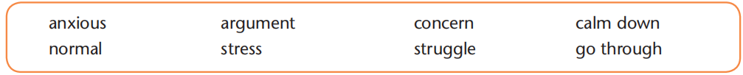

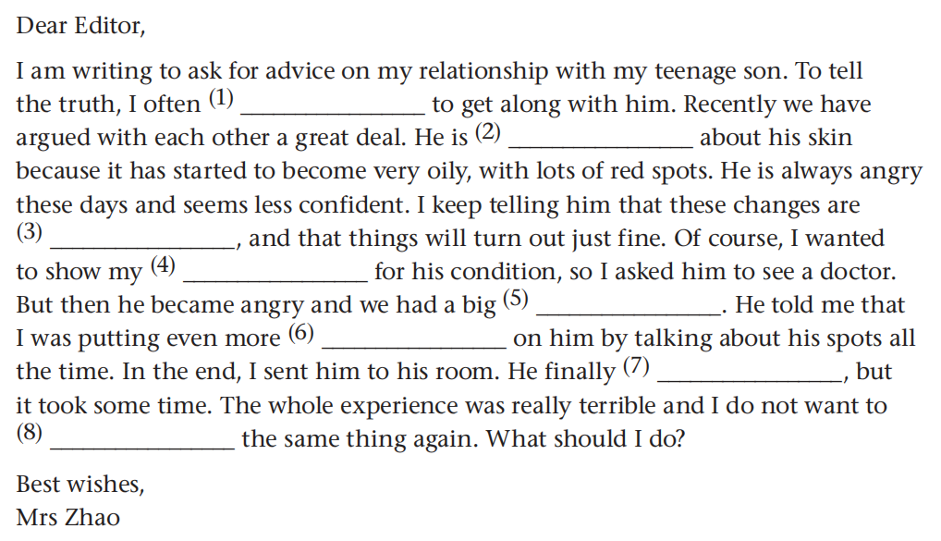
struggle
anxious
normal
concern
argument
stress
calmed down
go through

Slide 29

Word formation
The article uses some abstract nouns. Note the following suffixes and think of more abstract nouns formed with them. Then fill in the tablebelow with as many words as you can.
Parts of speech | Suffixes | Words
Adjectives | -ce
 | -ty/ity
independence, silence, absence, significance, patience, confidence, evidence, intelligence, distance, importance
honesty, safety, certainty, difficulty,
loyalty, cruelty, naughty, sincerity,
majority, ability

Slide 30
Parts of speech | Suffixes | Words
Nouns | -hood
 | -ship
adulthood, childhood, likelihood,
boyhood, brotherhood, manhood,
neighborhood
relationship, friendship, partnership,
hardship, ownership, scholarship

Slide 31
Parts of speech | Suffixes | Words
Verbs | -ment
 | -tion/sion
 | -th
argument, movement, punishment,
achievement, development,
improvement, treatment, judgment,
agreement
communication, decision, conclusion, action, solution, devotion, education, description, education, discussion
growth, breath

Slide 32

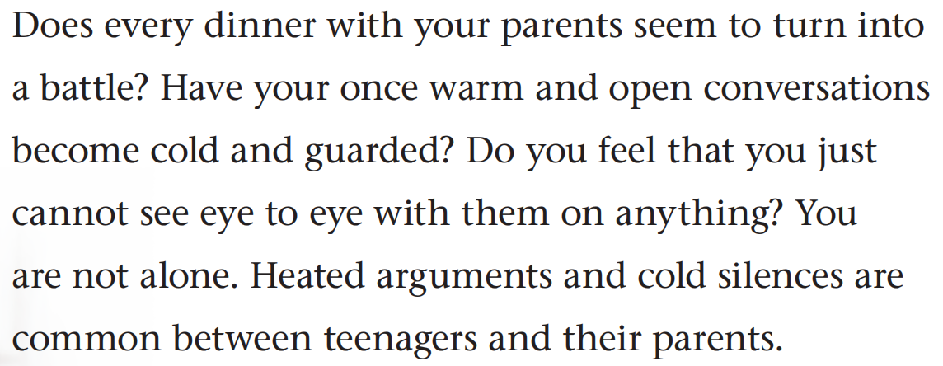
Mini Writing
The magazine article uses a group of questions to introduce the topic of parent-child tensions. Read the first paragraph of the magazine article.
To draw the reader’s attention to the topic and make them think about and take an interest in it

Slide 33
Have you ever gone to a masquerade party (假面舞会) where you dressed up as someone else with a full costume including wearing a head mask so no one would recognize you? And, while you at this party, did you take on the attitudes, manners, or characteristics of a person totally different than yourself? If you have, was this different you more appealing to you, or did it feel totally foreign?
Well, what is interesting is that there are a lot of people who constantly masquerade in real life on a regular basis. No, I do not mean that they attend a lot of parties—I mean that they are not who they really are while at work, while talking with family, or hanging out with friends.
—“Are You Really Who You Are”, by Catherine Pulsifer

Slide 34
What is the charm of necklaces? Why would anyone put something extra around their neck and then invest it with special significance? A necklace doesn’t afford warmth in cold weather, like a scarf, or protection in combat, like chain mail; it only decorates. We might say, it borrows meaning from what it surrounds and sets off, the head with its supremely important material contents, and the face, that register of the soul.
—“On Necklaces” in Prairie Schooner, by Emily R. Grosholz

Slide 35
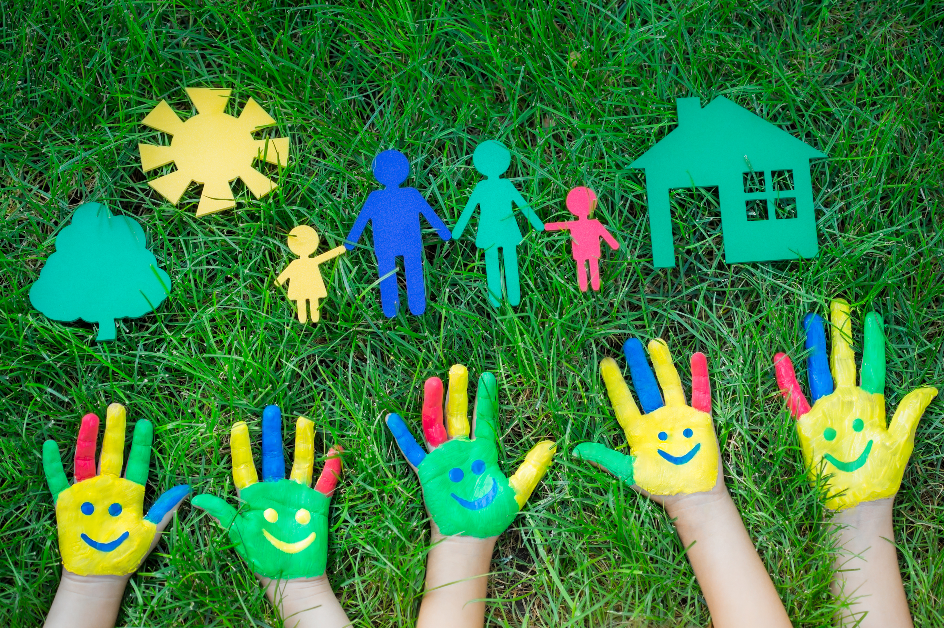
Introduce the topic of parents’ love for their children by asking questions.

Slide 36
Sample
Do your parents always let you know they are proud of you? Do they always stand by you no matter what decisions you make? Do they love you the way you are?

Slide 37
Homework
Write a paragraph to give your suggestions about teenagers’ relationship with parents. Try to use questions in the beginning of the paragraph.

Slide 38


