Slide 1

写对句子，写好句子

Slide 2
Correct sentences:
1 主谓
2 主系表
3 主谓宾
4 主谓双宾
5 主谓宾宾补

Slide 3
Splendid sentences：
句型1 there be : (will be ; is going to be ; has/have been; must have been ;used to be ; seems to be ; happens to be )
1 翻译：
有些人认为他说的是错的。
There are some people .
2 改错：
There are some people don’t believe in science.

Slide 4
句型2 ： 被动句式
翻译：
1 我们学校建于1990年。
2 他们建议更多的旅游应该被组织起来。
句型3： 并列句句型（运用连词）
1 I am delighted to go to school, the teacher has been especially good to me .
2 太阳从东方升起，从西边落下。
3 要么你离开这所房子，要么我叫警察。

Slide 5
句型6 ： 倒装句
常见：only位于句首+介词短语或状语从句
否定倒装。Never，little, not only ….but also…., as
地点状语置于句首。
改写：I have never heard such nonsense in all my life.
I not only enrich my work experience but I also make some money.
Though I was terrified, I didn’t regret my decision to go abroad.
翻译：
1 只有用这种方式我们才能成功。only
2 他不但在学校里教英语，还写小说。Not only…but also…
3 我永远不会忘记我们在一起度过的日子。
4 一家小型工厂坐落在河的南岸。South of the river

Slide 6
句型4 ：It结构
翻译：
1如果你能给我这个机会，我将不胜感激。
2没有什么同学认为读大学没有。
句型5：强调句式：
Do的强调；
It is / was +所强调部分+that +句子剩余部分
It is / was not until …..that……
改写：You don’t fly until you fall.
翻译：
1就是在中山路我遇到了我的朋友。
2所有这一切发生在周一晚上。
3就在那时我才意识到什么是值得尊敬的，什么是对我们年轻人最重要的。

Slide 7
句型7：分词结构。
改写：
Patients in hospitals are increasingly quickly and will cause problems to medical care system.
1他的父母对他严格要求，希望他将来成为一位名人。
2他问了一些关于我健康的问题。
3听到这个坏消息，这位年轻人忍不住哭了。
4从山顶上看，这个城市就像一个大花园。
5 因此有些学生在参加考试的时候，他们会作弊来获得高分以取悦他们的父母与老师。
句型8：状语从句

Slide 8
句型9：定语从句
1改写：
A man is completely satisfied with the present situation .
He is a failure.
2我想有一座房子，面朝大海。of which
句型9：名词性从句
1 重要的是你做什么，而不是说什么。表语从句
2 我通过了考试这一消息是真的。同位语从句
3 今日的中国不再是过去的中国。表语从句
4天气预报说今天由大雾是真的。主语从句

Slide 9
句型10 ：

Slide 11
目录
Summer a lot of things began to trivial for example, I hide in behind the morning in a hurry to eat text, breathed life back to the story.
一、点击输入标题名称
二、点击输入标题名称
三、点击输入标题名称
四、点击输入标题名称

Slide 12
一、点击输入标题名称
Click to enter the title name

Slide 13
点击输入标题名称
To complete this work, the role and task of everyone in the team,Everyone's role is essential, and it is an important part of the goal.
Click here to change the content, can be modified
Click here to change the content, can be modified
Click here to change the content, can be modified

Slide 14
点击输入标题名称
Summer a lot of things began to trivial for example, I hide in behind the morning in a hurry to eat text, breathed life back to the story.

Slide 15
二、点击输入标题名称
Click to enter the title name

Slide 16
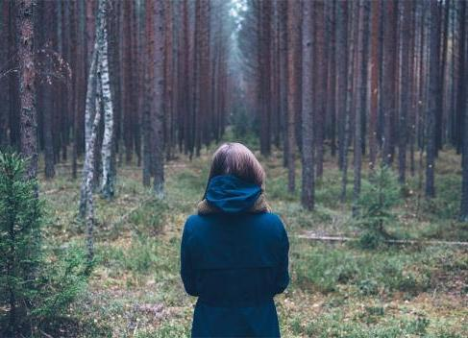
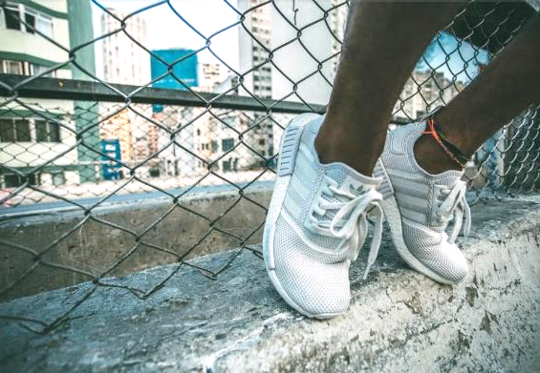
点击输入标题名称
Click to enter the title name
Summer a lot of things began to trivial for example, I hide in behind the morning in a hurry to eat text, breathed life back to the story.

Slide 17
点击输入标题名称
点击输入标题名称
Summer a lot of things began to trivial for example.
Summer a lot of things began to trivial for example.
点击输入标题名称
Summer a lot of things began to trivial for example.
点击输入标题名称
Summer a lot of things began to trivial for example.
点击输入标题名称
Summer a lot of things began to trivial for example.

Slide 18
点击输入标题名称
Summer a lot of things began to trivial for example, I hide in behind the morning in a hurry to eat text, breathed life back to the story.

Slide 19
三、点击输入标题名称
Click to enter the title name

Slide 20

点击输入标题名称
Summer a lot of things began to trivial for example, I hide in behind the morning in a hurry to eat text, breathed life back to the story.

Slide 21
点击输入标题名称
点击输入标题名称
Summer a lot of things began to trivial for example.
Summer a lot of things began to trivial for example.
点击输入标题名称
点击输入标题名称
Summer a lot of things began to trivial for example.
Summer a lot of things began to trivial for example.

Slide 22
点击输入标题名称
Summer a lot of things began to trivial for example, I hide in behind the morning in a hurry to eat text, breathed life back to the story.

Slide 23
四、点击输入标题名称
Click to enter the title name

Slide 24

点击输入标题名称
Summer a lot of things began to trivial for example, I hide in behind the morning in a hurry to eat text, breathed life back to the story.

Slide 25
70%
50%
30%
Summer a lot of things began to trivial for example, I hide in behind the morning in a hurry to eat text, breathed life back to the story.

Slide 26

SUCCESSFUL PROJECT INTRODOUCTION
Summer a lot of things began to trivial for example, I hide in behind the morning in a hurry to eat text, breathed life back to the story.

Slide 27
thanks
感谢你的聆听
简约小清新风格总结计划教育教学毕业答辩通用PPT模板

