Slide 1
Unit 4 Exploring literature
Welcome to the unit & Reading (I)
易雁翔 岳阳市第四中学

Slide 2
易雁翔
中学一级教师
湖南省岳阳市金鹗杯竞赛一等奖

Slide 3
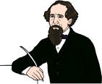
Lead-in

Slide 4
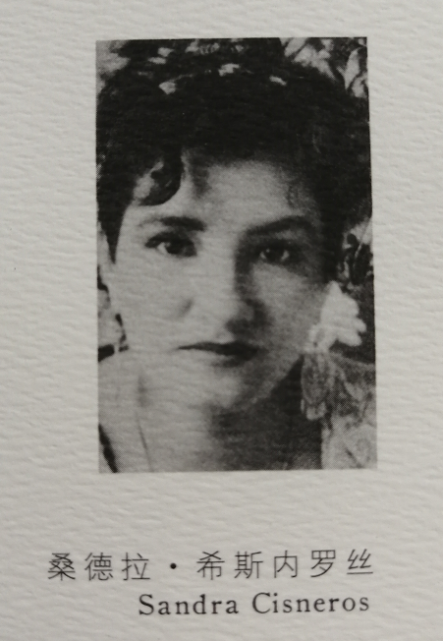
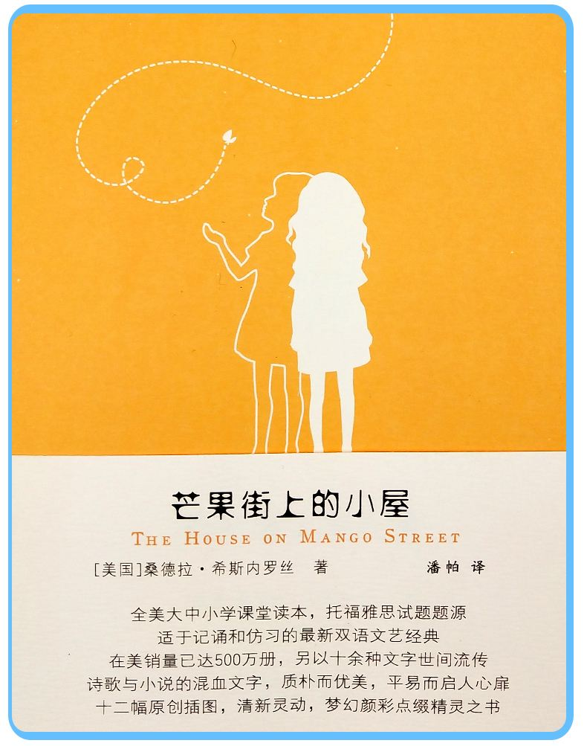

Slide 5
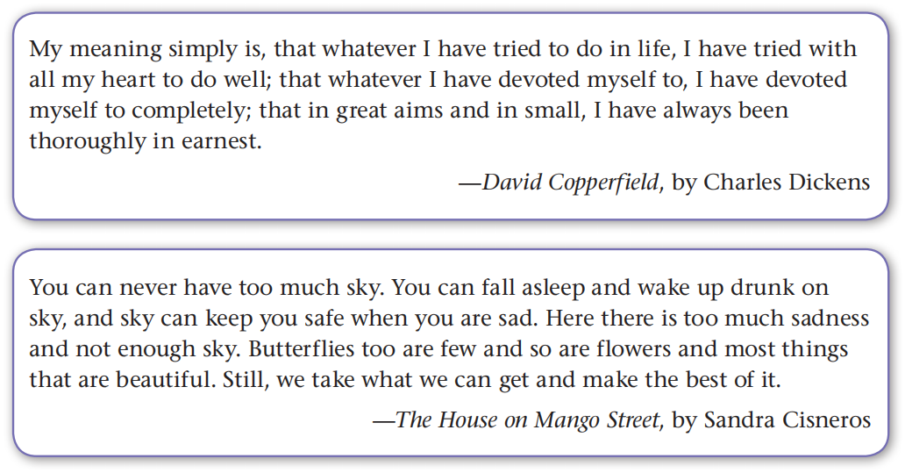
Which of the excerpts makes you feel like
reading the whole book? Why?

Slide 6
What is your favourite work of literature? Why?
My favourite work of literature is entitled ____________.
It’s a ____________ (autobiography, biography, short story collection, poetry collection, science fiction, detective novel, romance story, etc.).
It’s about ____________.
The main characters are ____________ (names, appearances, personalities, etc.).
The most impressive part is that ____________________.
I like this book because ___________________________.

Slide 7
Pre-reading
Before you read the article, think about the following questions:
What qualities do you think a great work of literature should have?
What are some of the benefits of reading literature?

Slide 8
It should be interesting to people from different countries and cultures.
It should stand the test of time.
Qualities
It should be attractive and enjoyable.
It should be creative.
It should stir readers’ imagination.
…

Slide 9
Predict what the article may talk about according to its title.

Slide 10
Reading for main ideas
Introduction (the story of a child and a man to introduce the topic)
Part 1 (Paras. 1–2)
Part 2 (Paras. 3–5)
Body (three qualities of literature)
Part 4 (Para. 6)
Summary

Slide 11
Reading for details
Read paras. 1–2 and answer the following questions.
What did the child hear?
How did the man explain what the child heard?
What do we need to do in order to enter and enjoy the new world of literature?
What does the child stand for?
What does the man stand for?
How is the story of the child and the man related to the topic of literature?

Slide 12
1. What did the child hear?
He heard strange, low, musical sounds.
2. How did the man explain what the child heard?
The man explained that the child heard nothing strange, and that the shell caught a range of sounds too faint for human ears.
3. What do we need to do in order to enter and enjoy the new world of literature?
We need to love literature and make an effort to explain it.

Slide 13
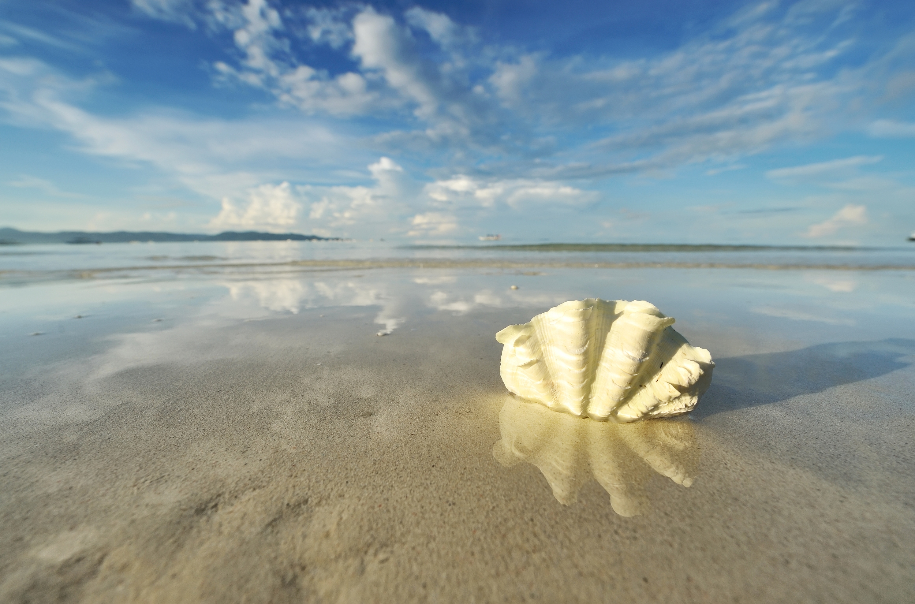
4. What does the man stand for?
The man stands for people who make an effort to explain and understand literature.
5. What does the child stand for?
The child stands for people who love and enjoy literature.

Slide 14
6. How is the story of the child and the man related to the topic of literature?
The story of the man and the child is similar to the study of literature. The child is amazed at the sounds he hears through a shell, just as a literature-lover discovers a new world through the study of literature. The shell catches a range of sounds that human ears would have missed, just as great writers bring unnoticed truth and beauty in the world to the reader’s attention.

Slide 15
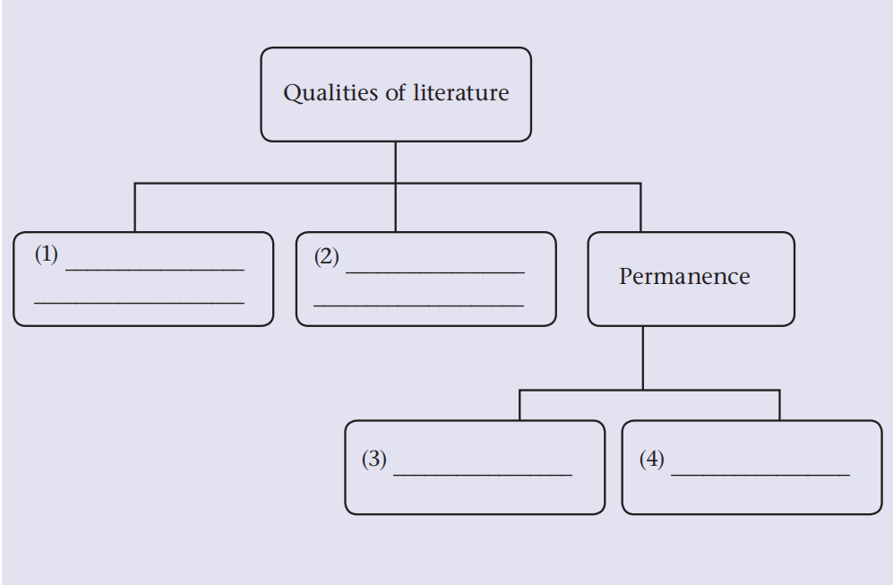
Read paras. 3–5 and finish the chart.
Its description of
truth and beauty
Its appeal to our
feelings and imagination
Universal interest
Personal style

Slide 16
The structure of para. 3
The first quality of literature is its description of truth and beauty. Some truth and beauty remain unnoticed until a sensitive human soul brings them to our attention, just as the shell reflects the unnoticed sounds. A hundred men may pass a field and see only dead grass; but a poet stops, looks deeper, sees truth and beauty, and writes, “Yesterday’s flowers am I.” One who reads it is capable of seeing the beauty that was hidden from his eyes before.
Topic sentence
Supporting sentence
Example

Slide 17
The structure of para. 4
The second quality of literature is its appeal to our feelings and imagination. Its attraction lies more in what it awakens in us than what it says. When Christopher Marlowe’s Doctor Faustus asks in the presence of Helen, “Was this the face that launched a thousand ships?” he opens a door through which our imagination enters a new world, a world of love, beauty and heroism.
Topic sentence
Supporting sentence
Example

Slide 18
The structure of para. 5
The third quality of literature, coming out of the other two, is its permanence. To achieve this, it should contain two elements: universal interest and personal style. Good literature reflects the most basic of human nature—love and hate, joy and sadness, fear and hope. It also takes on a personal style—no writer can describe
human life without reflecting his own life and experiences.
Topic sentence
Supporting sentences
The element of universal interest
The element of personal style

Slide 19
Answer the following questions.
Why does the author give the example of a poet?
What is universal about good literature according to the author?

Slide 20
1. Why does the author give the example of a poet?
He wants to prove that some truth and beauty remain unnoticed until a sensitive human soul brings them to our attention.
2. What is universal about good literature according to the author?
Good literature reflects the most basic of human nature—love and hate, joy and sadness, fear and hope.

Slide 21
Further reading
Parallelism
The figure of speech in the text
Let a little song appeal to the ear, or a great book to the heart, and we discover a new world, a world of dreams and magic. (para. 2, lines 8–9)
Parallelism, also called parallel structure, is the similarity of structure in a pair or series of related words, phrases, or clauses.
Parallelism has the potential to create rhythm, emphasis, and drama as it clearly presents ideas or action.

Slide 22
The figure of speech in the text
Anadiplosis
Behind every book is a man, behind the man is the race, and behind the race are the natural and social environments. (para. 2, lines 10–12)
Anadiplosis (蝉联) is a rhetorical and literary device wherein a word or phrase at or near the end of a clause is repeated at or near the beginning of the next clause.
Anadiplosis is commonly used for emphasis through the repetition of a key word or phrase, or to link a common theme through several separate clauses—often more than two. It’s also useful as a rhythmic device, breaking up what would otherwise be straightforward clauses and giving them an extra pause. This often results in a sentence that is more interesting to read or hear.

Slide 23
The figure of speech in the text
Simile
Some truth and beauty remain unnoticed until a sensitive human soul brings them to our attention, just as the shell reflects the unnoticed sounds. (para. 3, lines 15–17)
Simile is a figure of speech in which two fundamentally unlike things are explicitly compared, usually in a phrase introduced by like or as.
In everyday conversations as well as in writing and formal speeches, we use similes to clarify ideas, create memorable images, and emphasize key points.

Slide 24
Discuss in groups to talk about your favourite work of literature by the three qualities.
My favourite work of literature: ________________
The reason I like it: ________________
Three qualities:
Its description of truth and beauty: __________________________________
Its appeal to our feelings and imagination: __________________________________
Its permanence:
__________________________________
Summary: ________________

Slide 25
A possible version
My favourite work of literature: Romance of the Three Kingdoms
The reason I like it: It has a lot of interesting stories and fascinating characters. Moreover, I think it has the significant qualities of good literature mentioned in the article.
Its description of truth and beauty:
First of all, the book reflects the essence of Chinese culture, such as Liu Bei’s benevolence and Guan Yu’s integrity.

Slide 26
Its appeal to our feelings and imagination:
Second, as the book is set in the Three Kingdoms period, we read about the ups and downs of the main characters, so their unpredictable fates appeal to our feelings.
Its permanence:
Third, the most basic of human nature—love and hate, joy and
sadness, fear and hope—is well presented in the book. The vow Liu Bei, Guan Yu and Zhang Fei make when they join together as brothers—to save the troubled and to aid the endangered—still has value today. The author, who also lived in an unstable society, witnessed people’s suffering and saw their longing for a peaceful life, and reflected his own life and experiences in his novel.
Summary: All of the points mentioned above make Romance of the Three Kingdoms a well-loved classic that will continue to have a strong impact on generations of readers to come.

Slide 27
Homework
Write a short passage to introduce your favourite work of literature by the three qualities.

