Slide 1

Unit 4 Exploring literature
Extended reading
刘华 湖南省湘阴县洋沙湖中学

Slide 2

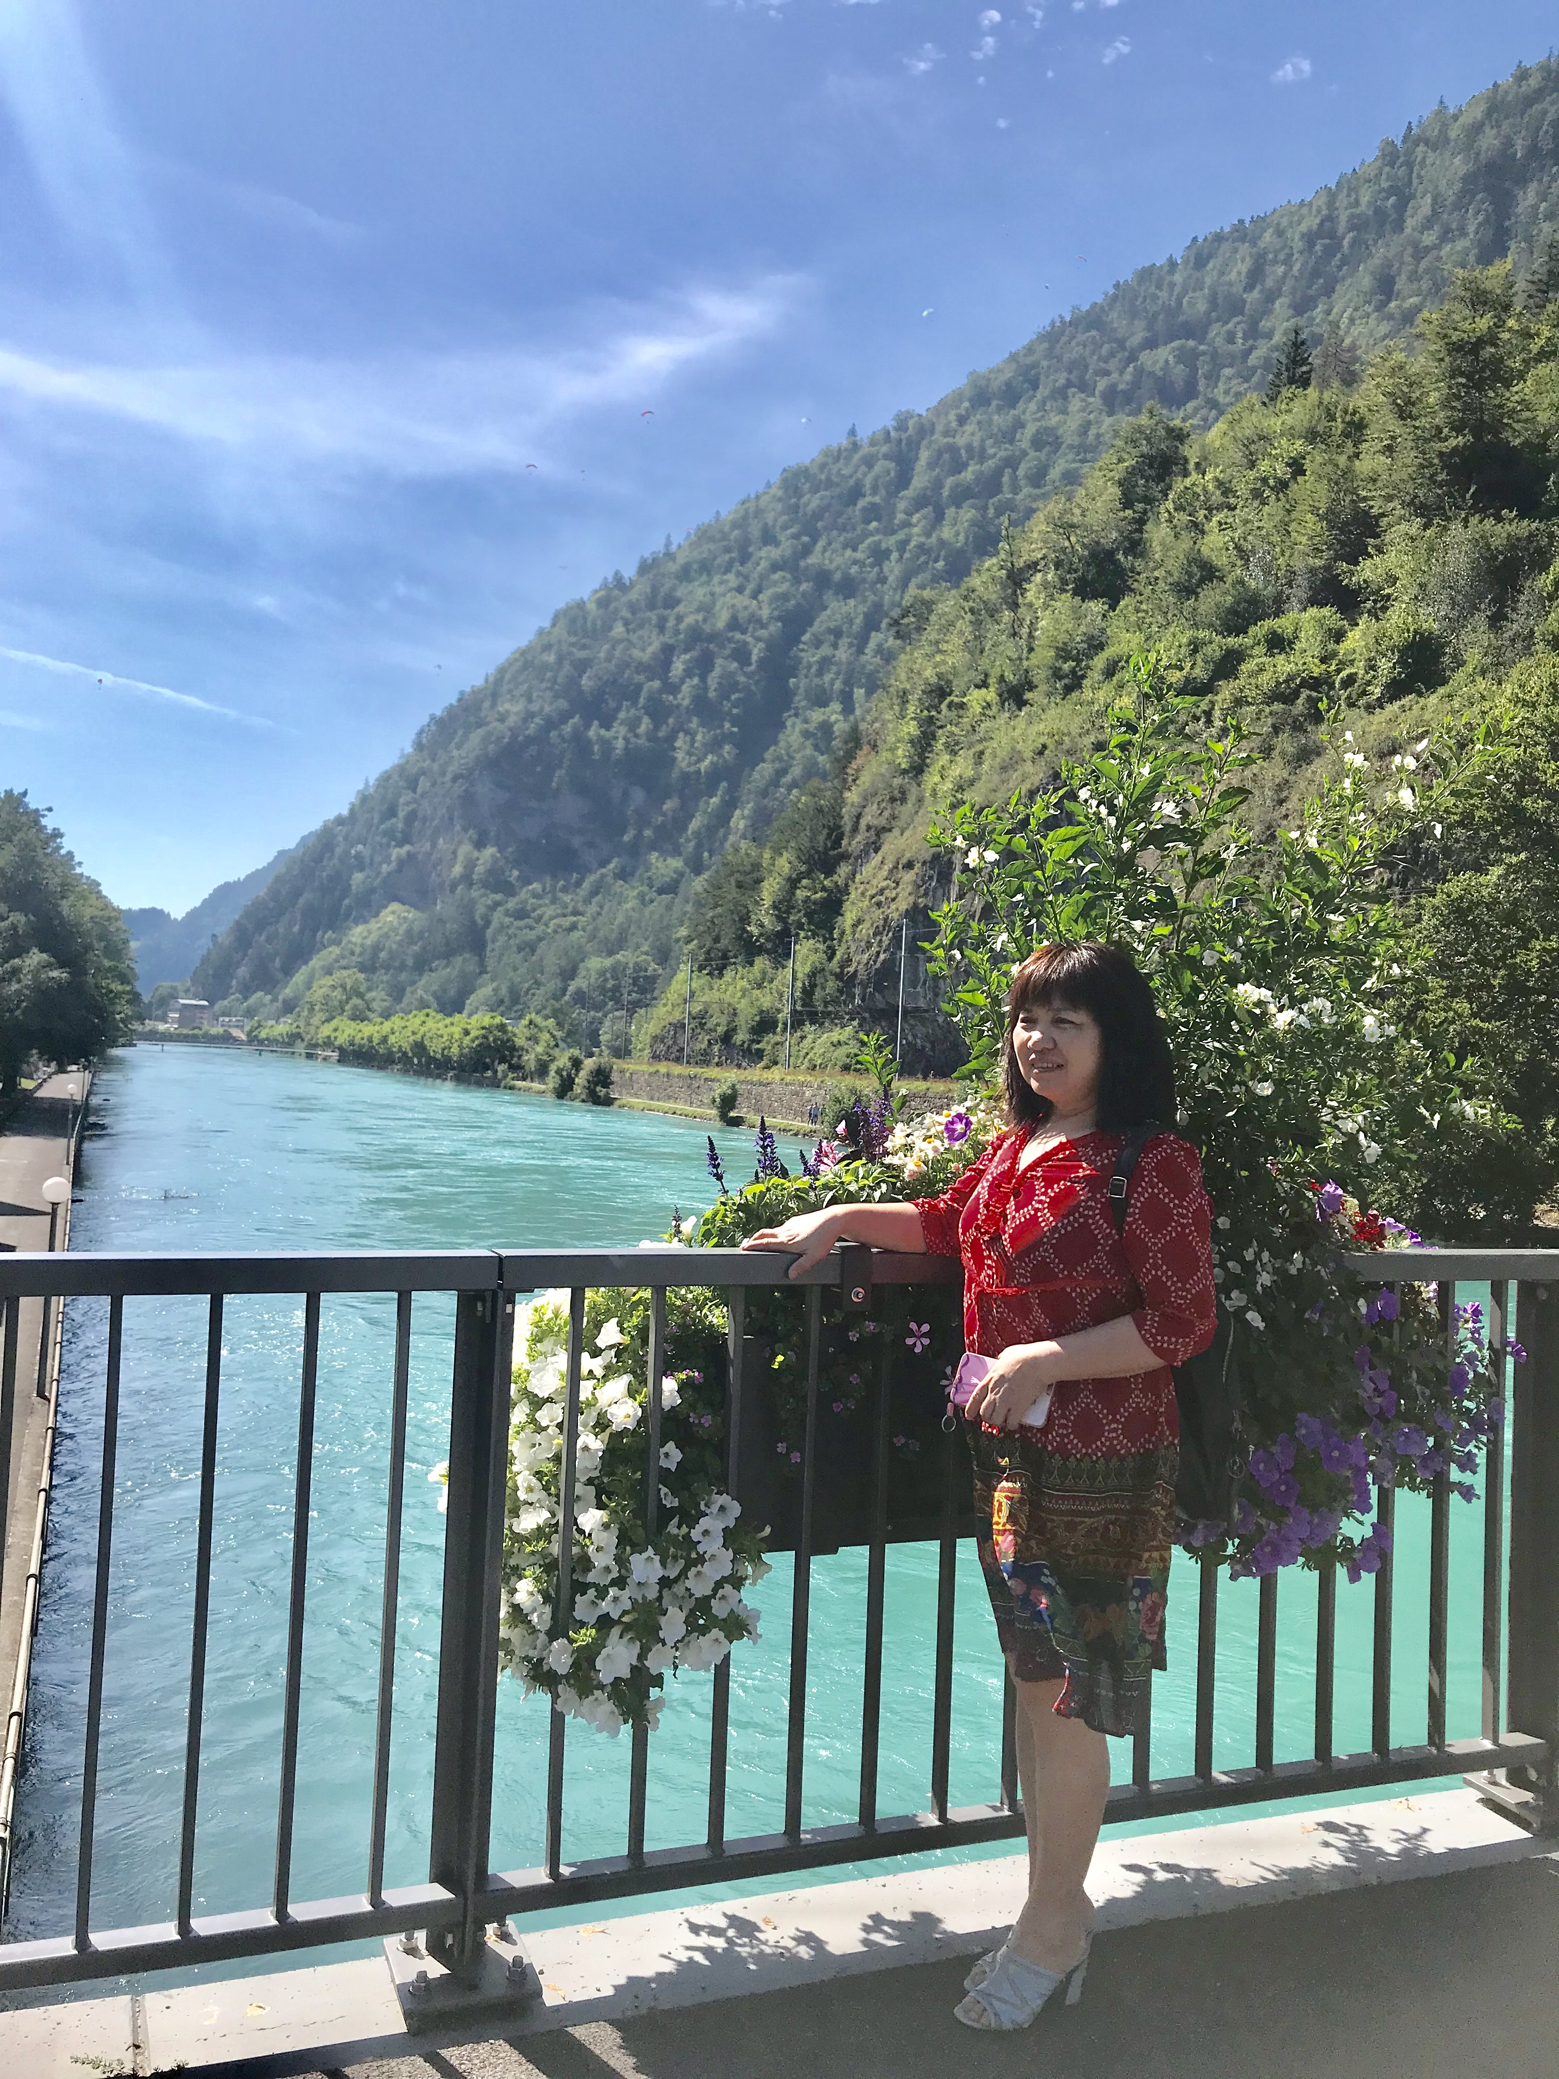
刘 华
湘阴县学科带头人
岳阳市高三教学核心小组成员
岳阳市全国英语等级考试优秀口试考官
全国中小学优秀外语教师

Slide 3
Step
1
Lead-in
Do you like reading?
Have you ever read an English novel? If yes, what is it and who is the author?

Slide 4

Step
2
Title prediction
Can you predict what will happen according to the title?

Slide 5
Step
3
Careful reading
About the author
Was born in 1899 and died in 1961
An American writer of novels and short stories
Well thought of for his unique writing style
Extremely good at describing the adventures of tough men who he believes “can be destroyed but not defeated”
About the novel
One of the most important novels of Hemingway
Tells the story of a fisherman named Santiago, who attempts to catch a huge fish after coming in empty-handed for eighty-four days

Slide 6
The Nobel Prize in Literature 1954 was awarded to Ernest Miller Hemingway “for his mastery of the art of narrative, most recently demonstrated in The Old Man and the Sea, and for the influence that he has exerted on contemporary style.”
(https://www.nobelprize.org/prizes/literature/1954/summary/)

Slide 7
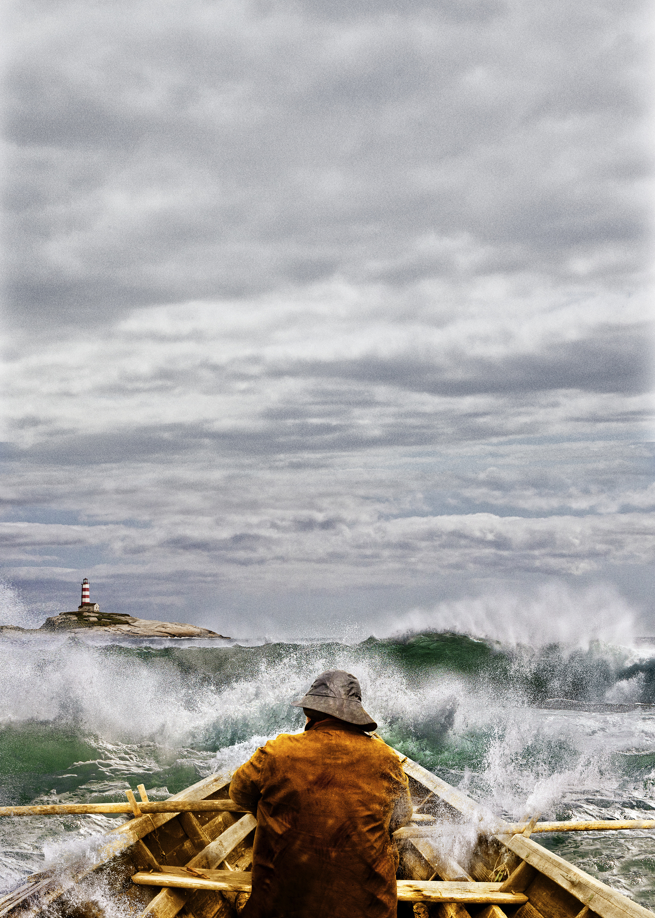
What is the adventure?
Why is Santiago a tough man?

Slide 8
Actions
The fish was coming in on his circle now calm and beautiful looking and only his great tail moving. The old man pulled on him all that he could to bring him closer. For just a moment the fish turned a little on his side. Then he straightened himself and began another circle. (para. 1)
The old man | The fish
turned a little
pulled to bring him closer
straightened himself and began another circle

Slide 9
He felt faint again now but he held on the great fish all the strain that he could. (para. 3)
But when he put all of his effort on, starting it well out before the fish came alongside and pulling with all his strength, the fish pulled part way over and then righted himself and swam away. (para. 4)
The old man | The fish
held on the great fish all the strain that he could
pulled part way over
righted himself and swam away

Slide 10
On the next turn, he nearly had him. But again the fish righted himself and swam slowly away. (para. 7)
Twice more it was the same on the turns. (para. 11)
The old man | The fish
nearly had him on the next turn
righted himself and swam slowly away
tried twice more
escaped twice more

Slide 11
He tried it once more and he felt himself going when he turned the fish. The fish righted himself and swam off again slowly with the great tail weaving in the air. (para. 13)
He tried it again and it was the same. (para. 15)
The old man | The fish
righted himself and swam off again slowly with the great tail weaving in the air
tried it once more
tried it again
escaped again

Slide 12
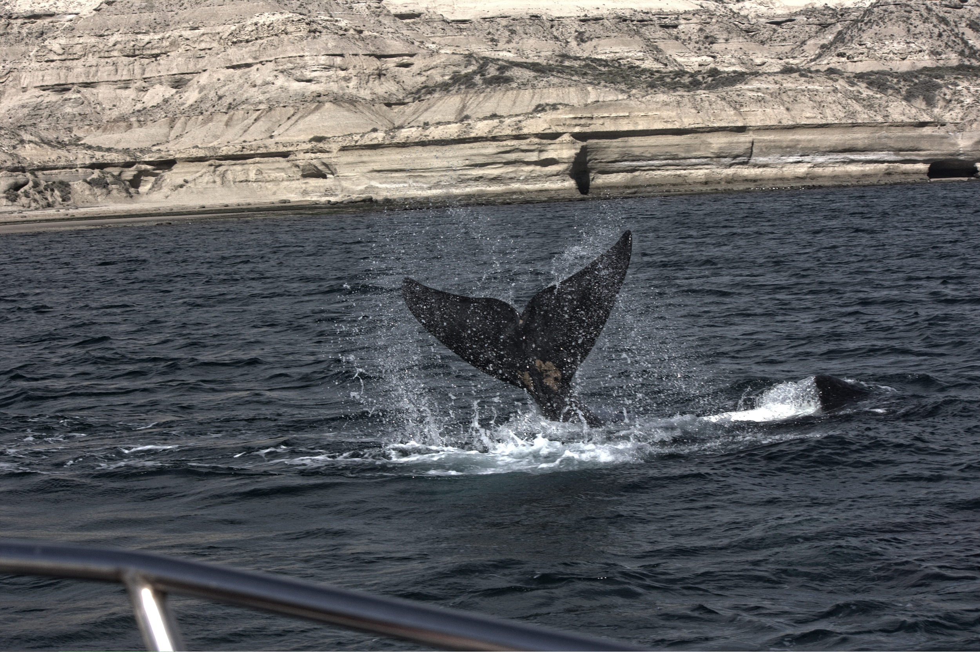
Though the fish ____________ every time, the old man never ____________ and always ____________.
swam away
gave up
tried again

Slide 13
Physical conditions
He felt faint again now ... (para. 3)
His mouth was too dry to speak but he could not reach for the water now. (para. 6)
... he said in a voice he could hardly hear. (para. 10)
After coming in empty-handed for 84 days …
He had been on the point of feeling himself go each time. (para. 12)
... although his hands were mushy now and he could only see well in flashes. (para. 14)

Slide 14
Thoughts
“I moved him,” the old man said. “I moved him then.” (para. 2)
I moved him, he thought. Maybe this time I can get him over. Pull, hands, he thought. Hold up, legs. Last for me, head. Last for me. You never went. This time I’ll pull him over. (para. 3)
“Fish,” the old man said. “Fish, you are going to have to die anyway. Do you have to kill me too?” (para. 5)

Slide 15
That way nothing is accomplished, he thought. His mouth was too dry to speak but he could not reach for the water now. I must get him alongside this time, he thought. I am not good for many more turns. Yes you are, he told himself. You’re good for ever. (para. 6)
Now you are getting confused in the head, he thought. You must keep your head clear. Keep your head clear and know how to suffer like a man. Or a fish, he thought. (para. 9)
“Clear up, head,” he said in a voice he could hardly hear. “Clear up.” (para. 10)

Slide 16
I do not know, the old man thought. He had been on the point of feeling himself go each time. I do not know. But I will try it once more. (para. 12)
I’ll try it again, the old man promised ... (para. 14)
So he thought, and he felt himself going before he started; I will try it once again. (para. 15)

Slide 17
A tough man
can be but
_{destroyed}
_{physically}
_{not defeated}
_{mentally.}
Physically
I must get him alongside this time.
faint/thirsty
in a voice he could hardly hear
Come on and kill me. I do not care who kills who.
Contrast
on the point of feeling himself go
You must keep your head
clear. Keep your head clear and know how to suffer like a man.
his hands were mushy now and he could only see well in flashes
Mentally
I will try it once again.

Slide 18

Step
4
Critical reading
Describe the old man’s personalities.
Determined
Persistent
Fearless
Brave
Confident
Unyielding
Optimistic
Strong-willed

Slide 19
Analyse Hemingway’s writing style.
Simple language
Short sentences
Vivid description of mental activities
Small words
Hemingway’s writing style
Few comments from the writer/narrator
Symbolism

Slide 20
The fish was coming in on his circle now calm and beautiful looking and only his great tail moving. The old man pulled on him all that he could to bring him closer. For just a moment the fish turned a little on his side. Then he straightened himself and began another circle. (para. 1)
Short and simple sentences

Slide 21
I moved him, he thought. Maybe this time I can get him over. Pull, hands, he thought. Hold up, legs. Last for me, head. Last for me. You never went. This time I’ll pull him over. (para. 3)
I must get him alongside this time, he thought. I am not good for many more turns. Yes you are, he told himself. You’re good for ever. (para. 6)
You are killing me, fish, the old man thought. But you have a right to. Never have I seen a greater, or more beautiful, or a calmer or more noble thing than you, brother. Come on and kill me. I do not care who kills who. (para. 8)
Vivid description of mental activities

Slide 22
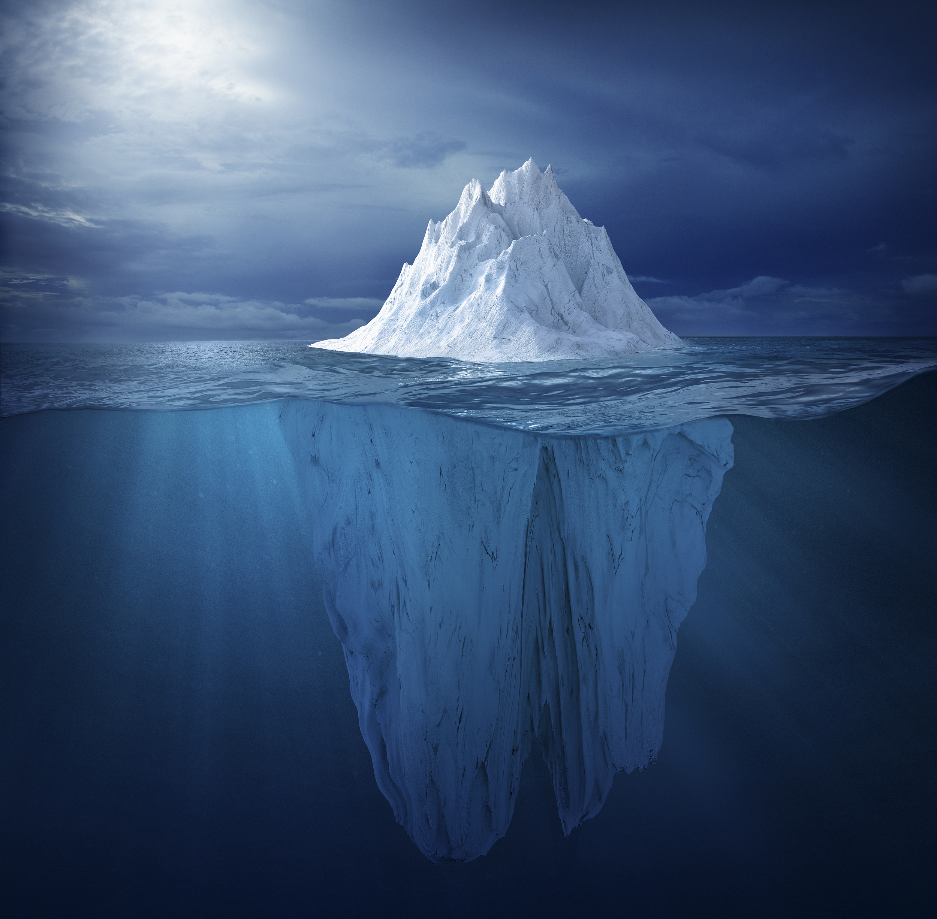
Hemingway’s Iceberg Theory
If a writer of prose knows enough about what he is writing about he may omit things that will have a feeling of those things as strongly as though the writer had stated them. The dignity of movement of an iceberg is due to only one-eighth of it being above water. A good writer does not need to reveal every detail of a character or action.
(Death in the Afternoon, by Ernest Hemingway)

Slide 23
I always try to write on the principle of the iceberg. There is seven-eighths of it underwater for every part that shows. (Hemingway)
Iceberg principle:
Concise language
Deep, complicated thoughts and meanings underneath

Slide 24
The old man
The fish
The sea
People’s strong will
People’s goal and dream
The harsh
reality

Slide 25
Explore the theme of the novel.
Honour in struggle, defeat and death
Pride as the source of greatness and determination
Santiago embodies Hemingway’s definition of courage as “grace under pressure”. He never loses dignity in the face of death. The glory and honour come not from his battle itself but from his pride and determination to fight.
The novel highlights the theme that man can be destroyed but not defeated. It is a representation of life as a struggle against forces in which only a partial victory is possible.

Slide 26
Step
5
Sharing
Share your story of dealing with difficulties in life or study.

Slide 27
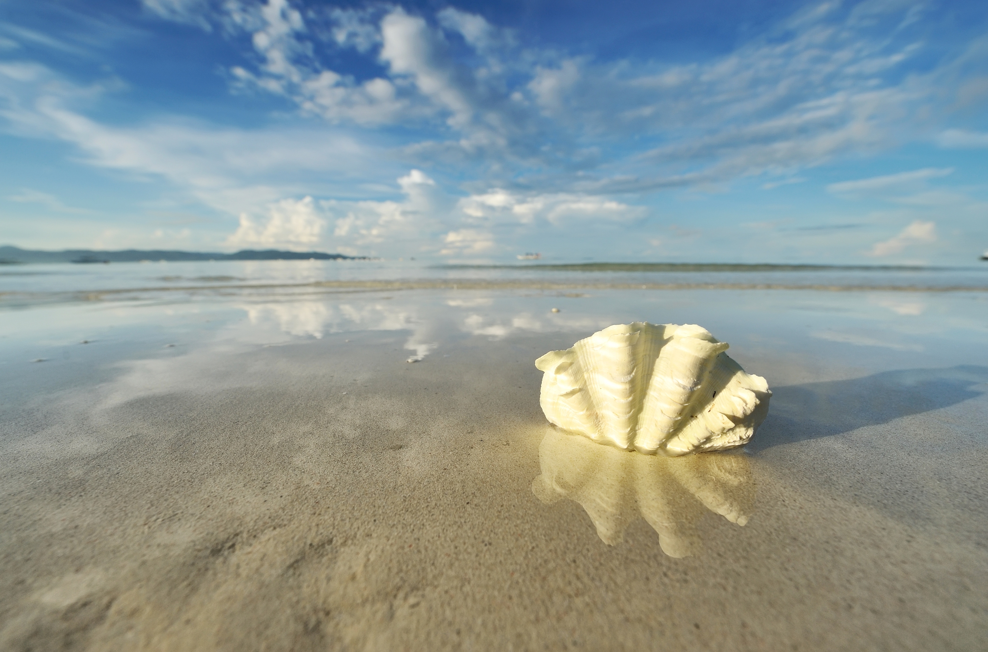
The attraction of literature lies more in what it awakens in us than what it says.
—William J. Long

Slide 28
Homework
1. Write down your reflection after learning this excerpt.
2. Read the rest of The Old Man and the Sea and find what happened before and after the excerpt.

Slide 29


