Slide 1
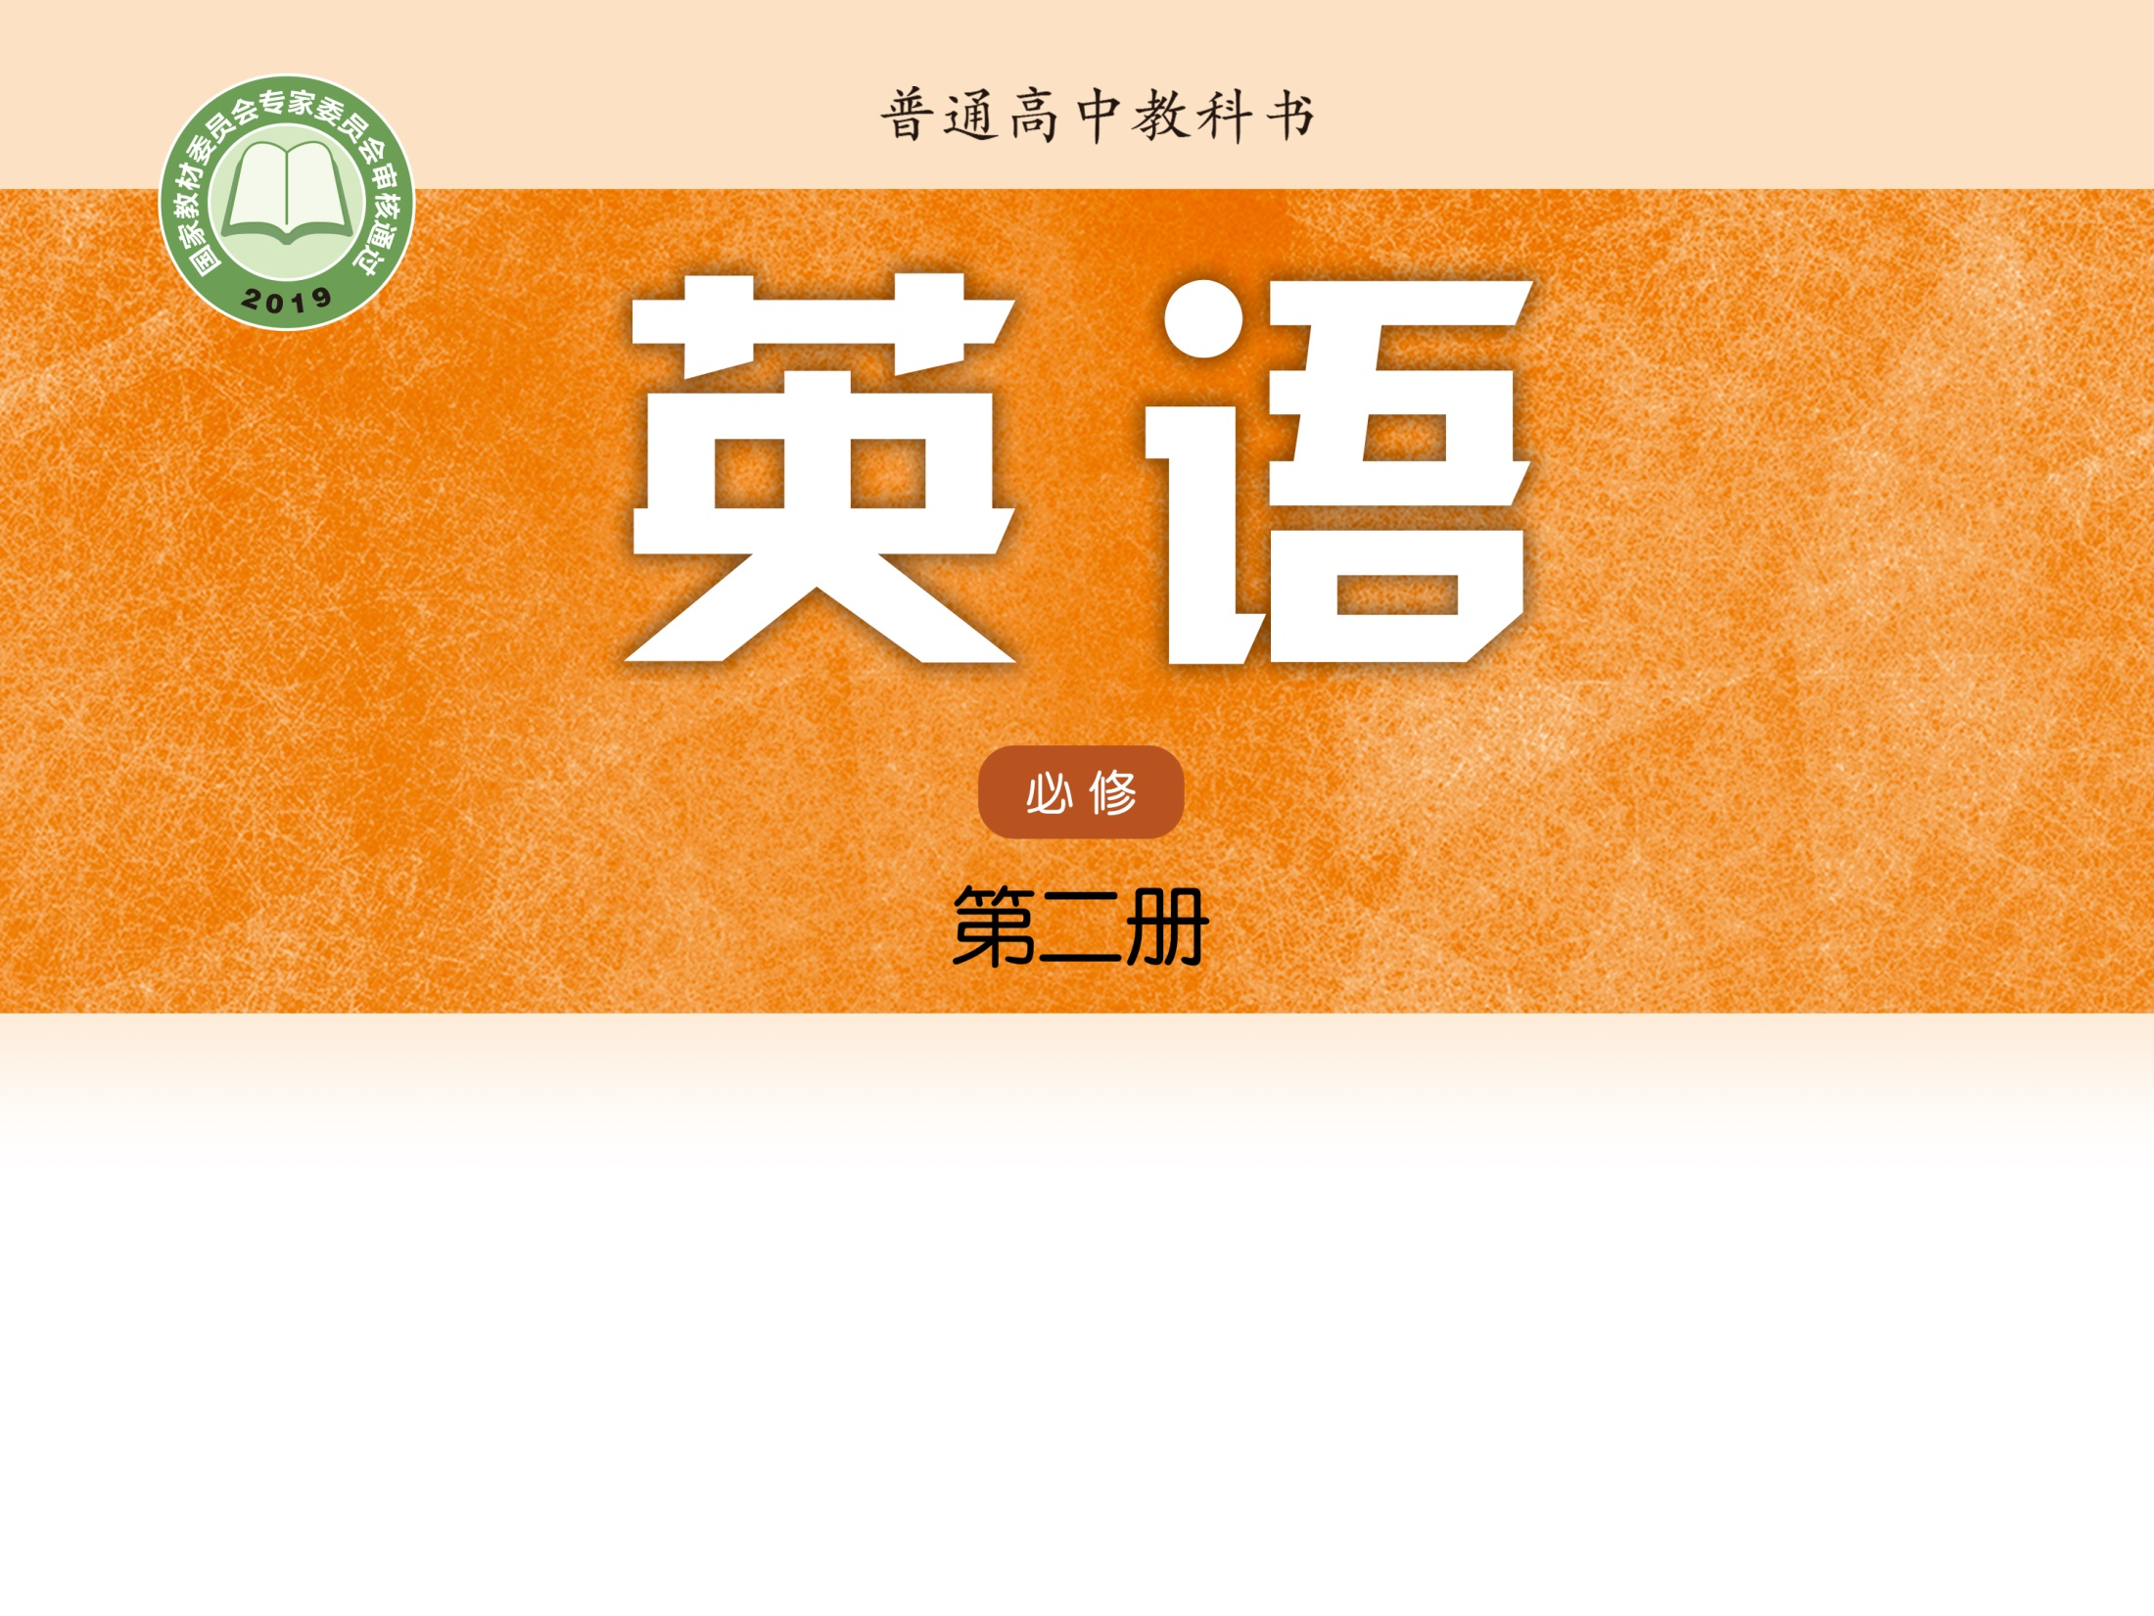
Unit 4 Exploring literature
Integrated skills (Ⅰ)
瞿舸 湘阴县第一中学

Slide 2

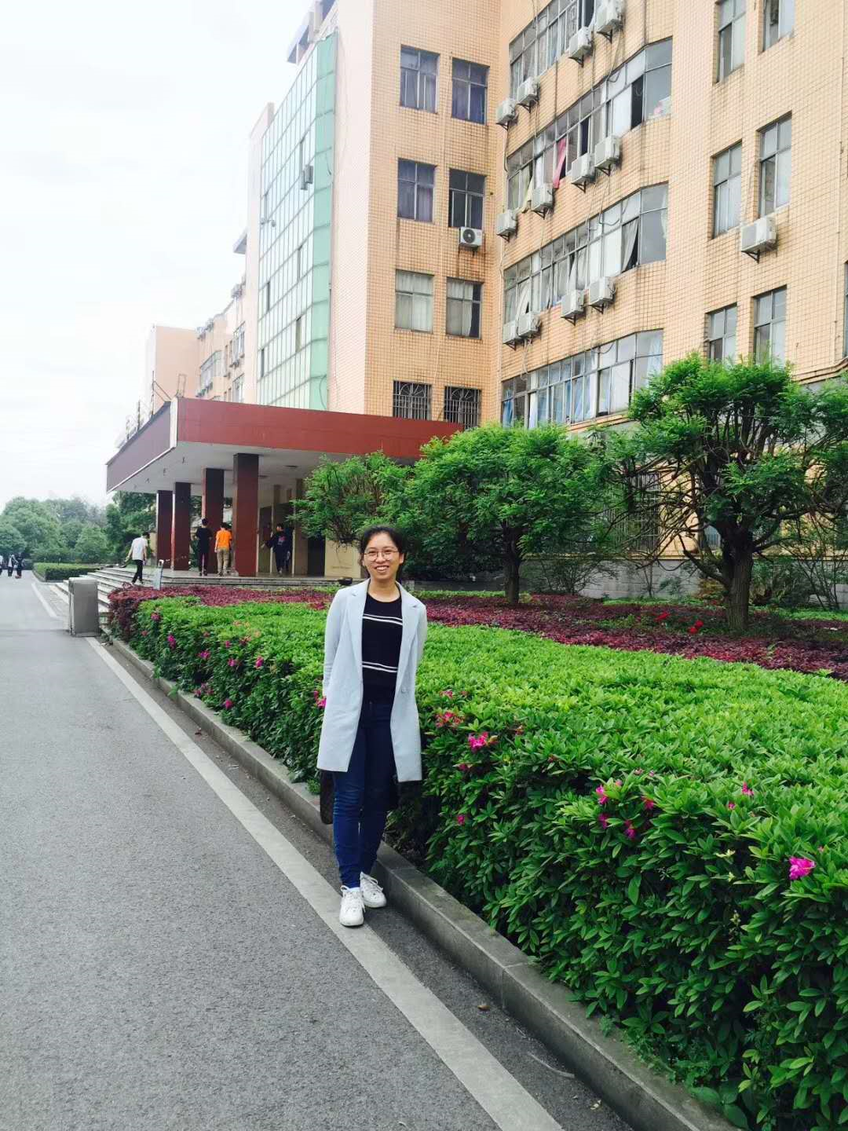
瞿舸
中南大学外国语学院硕士研究生
全国中学生英语能力竞赛中被评为“全国优秀指导教师”
湖南省中小学教师线上集体备课比赛二等奖

Slide 3

01
Lead-in

Slide 4
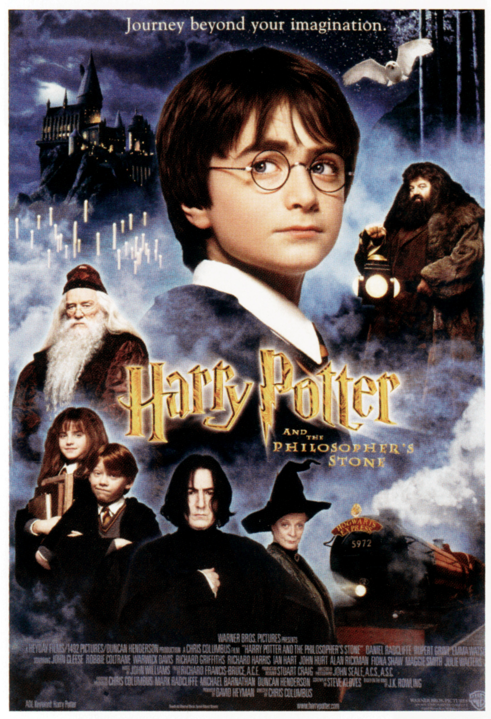
Lead-in
Do you like reading?
What kinds of book do you usually read or enjoy reading?

Slide 5
02
Types of literature

Slide 6
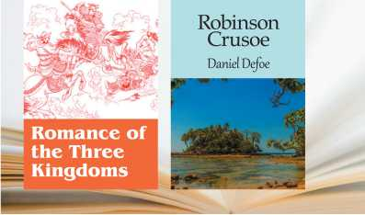
Types of literature
What type of literature do they belong to?

Slide 7

Types of literature
Novel
Charles Dickens：
Great Expectations
Oliver Twist
A Tale of Two Cities
• A long, detailed story with many characters
• Usually divided into several chapters

Slide 8
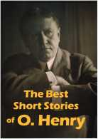
Types of literature
Short story
The Cop and the Anthem
The Gift of the Magi
The Last Leaf
• A short piece of writing with a few characters

Slide 9
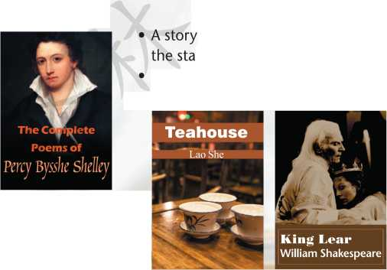
Types of literature
If Winter comes,
can Spring be far behind?
If Winter comes,
can Spring be far behind?
If Winter comes,
can Spring be far behind?
— “Ode to the West Wind”
— “Ode to the West Wind”
— “Ode to the West Wind”

Slide 10

Types of literature
Poetry
George Gordon Byron：
“Don Juan”
William Butler Yeats：
“When you are old”
• Using beautiful, artistic language to express feelings or describe situations
• Often written in separate lines

Slide 11
Types of literature
Play
William Shakespeare:
Hamlet
The Merchant of Venice
King Lear
Cao Yu:
Thunder
Sunrise
What type of literature does it belong to?

Slide 12
Types of literature
Play
• A story written for performance on the stage
• Usually made up of dialogues between
characters and stage directions

Slide 13

Types of literature
Autobiography
a self-written account of the life of oneself
Writer:
Benjamin Franklin

Slide 14
Types of literature
Biography
• a detailed description of a person’s life
Writer:
Romain Rolland

Slide 15
Types of literature
Types of literature
Autobiography vs Biography
Autobiography
The story of the writer’s own life
Biography
The story of a person’s life written by someone else

Slide 16
03
Watching

Slide 17
Pre-watching
Prediction
Please have a guess:
What types of literature are the most popular?
What types of literature are the least popular?

Slide 18
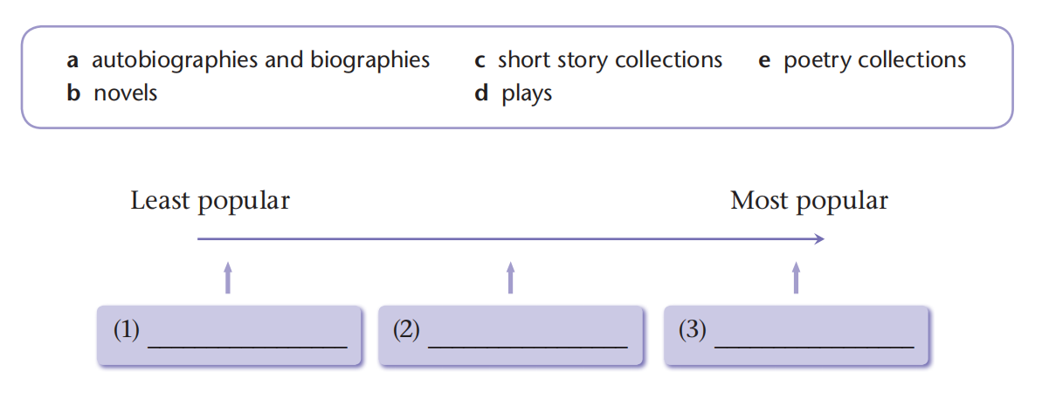
While watching
Complete the chart
a, e
d
b, c

Slide 19
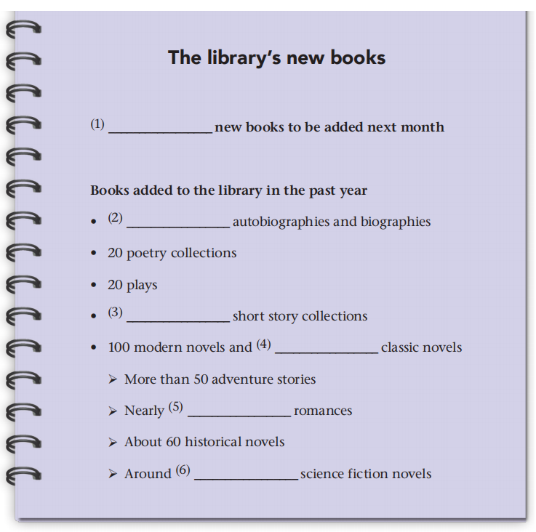
While watching
Complete the notes
200
30
30
200
70
120

Slide 20
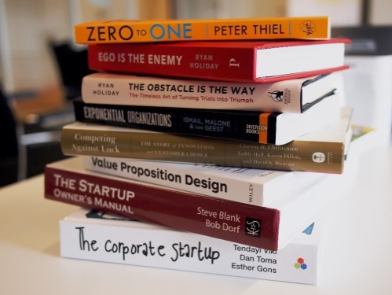
Post-watching
Discuss
Why novels and short story collections are very popular among students?
Why autobiographies, biographies as well as poetry collections are the least popular types of literature?

Slide 21
04
Assessment

Slide 22
Assessment
“The Road Not Taken”
(by Robert Frost)
Pride and Prejudice
(by Jane Austen)
The Biography of Su Dongpo
(by Lin Yutang)
La Parure
(by Guy de Maupassant)
Romeo and Juliet
(by William Shakespeare)
My Autobiography
(by Charlie Chaplin)
Novel
Short story
Poetry
Play
Autobiography
Biography

Slide 23
Homework
1. Review the content on page 50, and preview the content on page 52.
2. Make a table to list the books that you have read or like reading in terms of types of literature.

Slide 24


