Slide 1


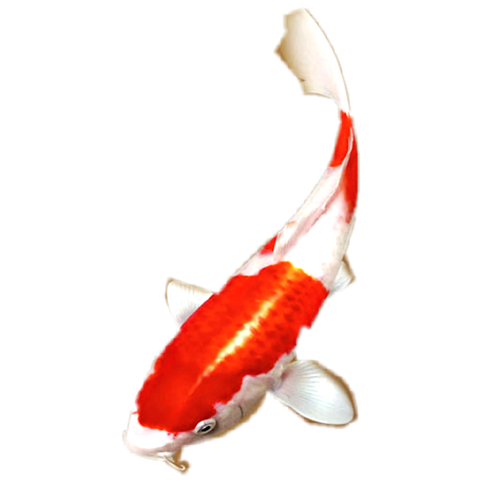
传统节日课件

Slide 2
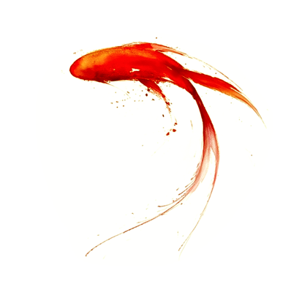
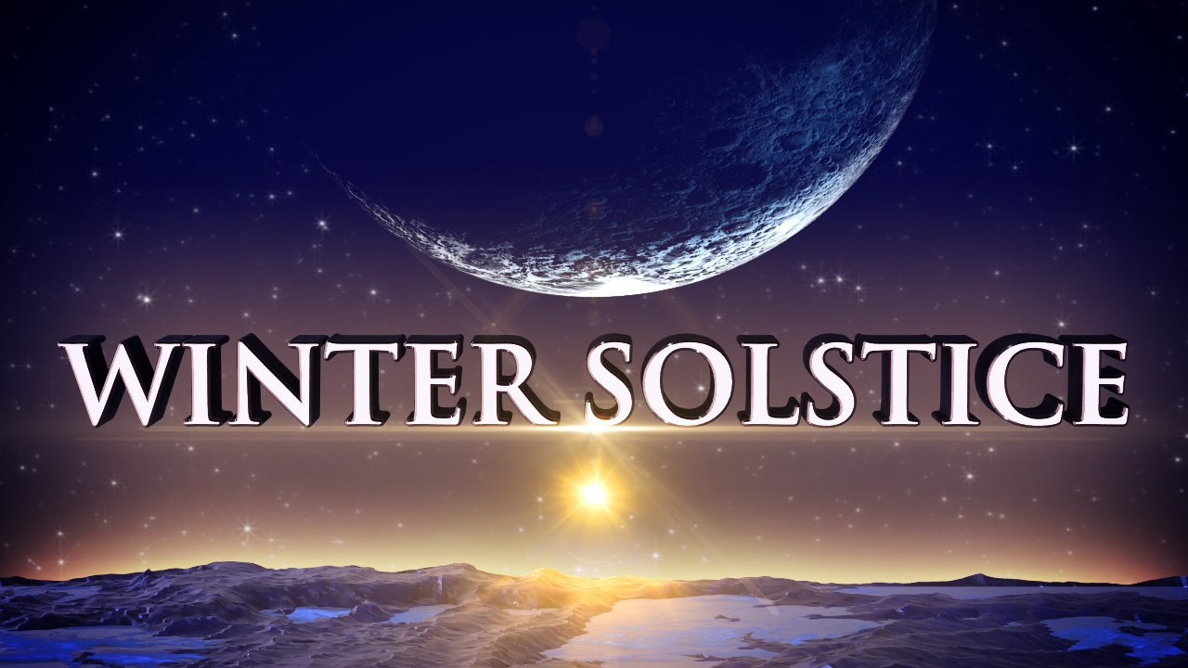
冬至

Slide 3
原汁原味输入地道英文
Winter Solstice Festival （冬至）
Introduction
Falling around December 22nd, the Winter Solstice is one of the traditional Chinese festivals and also one of the 24 solar terms.
solstice [词源]：sol- (= sun太阳) + sistere (stand still, sta- “to stand”)，point at which the sun seems to stand still
[举一反三]：词缀 sol- ：solar 太阳的；词根 sta- ：stand 站立；establish 建立；确立

Slide 4
fall [节假日输出表达必备词汇]：降临；到来；(日期) 适逢
[举一反三]：
1. My birthday falls on a Monday this year.
2. The Lantern Festival falls on the fifteenth day of the first lunar month, which marks the end of the Chinese New Year celebrations.
3. Harvest festivals are traditionally held on or near the Sunday of the Harvest Moon, which falls in September, about Sept. 23.
traditional Chinese festival [输出表达]：中国传统节日
24 solar terms [认知词块]：二十四节气
term：某事发生的时段 / 时期

Slide 5
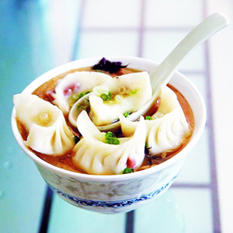
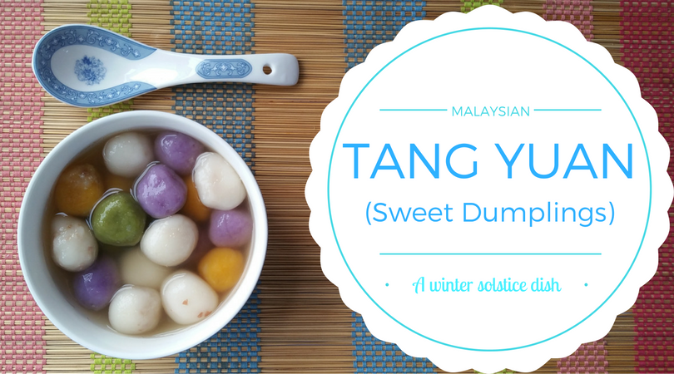
Since the Spring and Autumn Period (770–476 BC), by observing the movements of the sun with a sundial, China had determined the point of Winter Solstice. On the day, the Northern hemisphere（北半球）has the shortest daytime and longest night-time. After the day, the daytime will become longer and longer. It became a festival from Han Dynasty (202 BC–220 AD). People usually eat dumplings or tangyuan to celebrate the day.

Slide 6
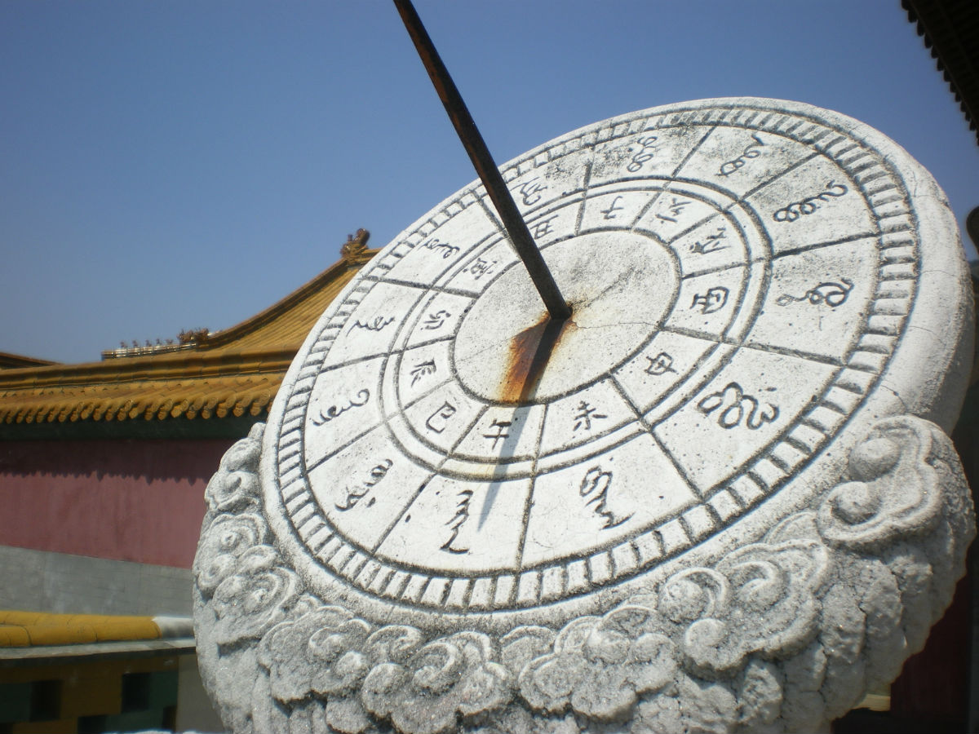
sundial [构词法]：sun + dial（刻度盘；仪表盘）。日晷仪也称日晷，是观测日影记时的仪器，主要是根据日影的位置，以指定当时的时辰或刻数，是我国古代较为普遍使用的计时仪器。
observe [正式用语]：观测；观察
determine [正式用语]：确定
point [一词多义]：时间点

Slide 7
文化知识拓展：
Spring and Autumn Period：春秋时期从公元前770年开始至公元前476年结束。历史上通常将周平王东迁至公元前476年之间的历史时期称之为“春秋”时代，这段时间基本上和《春秋》一书记事所跨时间相同。所以“春秋时期”得名于鲁史《春秋》（儒家经典之一，是中国现存最早的一部编年体史书）。春秋时期是中国历史上社会经济急剧变化，政治局面错综复杂，军事斗争层出不穷，学术文化异彩纷呈的一个变革时期。如：以法治国的法家和以礼治国的儒家，能打仗的兵家，能说会道的纵横家，能看风水的道家、阴阳家。不止有后世各朝各代遵以为治国之本的儒家学说，战场上大放异彩的兵法，《孙子兵法》亦源于此，求仙问道，追寻飘渺之物的玄学道学，也是这个时期开始形成系统的。这个时期无比辉煌，伟人们层出不穷，几乎中国各个行业的祖师爷，都是生活在这个时期。

Slide 8
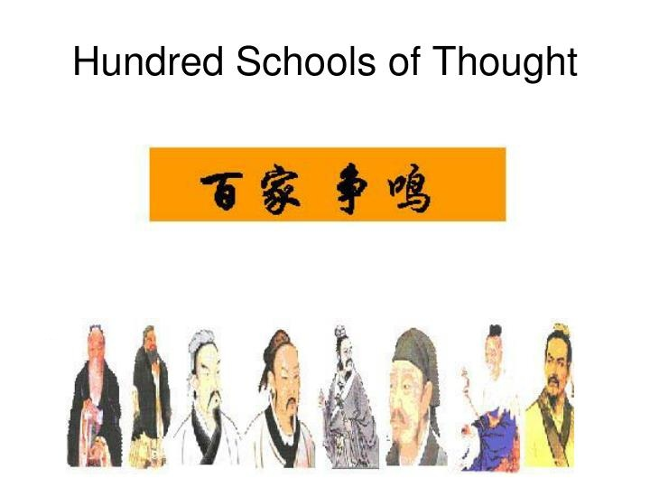
主要诸子百家（Hundred Schools of Thought）
儒家Confucianism：孔子 Confucius、孟子 Mencius、荀子 Xunzi；主要思想：“仁政”“民贵君轻”，反对兼并战。
“By nature men are similar; by practice, men are wide apart” – Confucius 性相近，习相远。
“If you let people follow their feelings, they will be able to do good. This is what is meant by saying that human nature is good.” – Mencius 人性本善。
“The nature of man is evil; what is good in him is artificial.”
– Xunzi 人性本恶，物性本恶其善伪也。
墨家 Mohism：墨子 Mozi， 主要思想：“人定胜天”。
道家 Taoism：庄子 Zhuangzi，老子 Lao Tzu。
“Life is a series of natural and spontaneous changes.
Don't resist them -- that only creates sorrow. Let reality
be reality. Let things flow naturally forward in whatever they like.” – Lao Tzu
法家 Legalism：韩非子 Hanfeizi，商鞅 Shang Yang。
“In the state of an intelligent ruler, there are no books. Instead, the laws serve as lessons.”

Slide 9
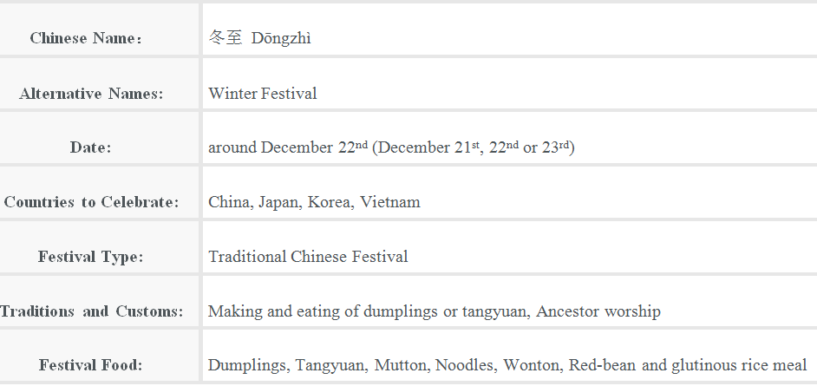
Fast Facts about Winter Solstice

Slide 10
Why the Chinese People celebrate Winter Solstice?
The reason why the Chinese people celebrate the Winter solstice is related to the theory of Yin and Yang. According to the Chinese astrology（占星术）, Yang symbolizes masculine（阳刚）and positive; Yin has the opposite meanings. The ancient people think from the winter solstice, the Yin is at its peak and will disappear gradually, while the Yang or positive things will become stronger and stronger from the day. So winter solstice is regarded as an auspicious（吉利的）day to celebrate.

Slide 11
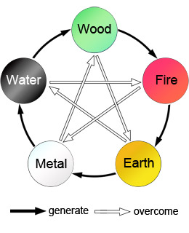
theory of Yin and Yang [认知词块]：阴阳学说
文化知识拓展：Yin (dark, cold, female, negative) and Yang (light, hot, male, positive) "阴阳说"是把"阴"和"阳"看作事物内部的两种互相消长的协调力量，认为它是孕育天地万物的生成法则阴阳，代表一切事物的最基本对立面。一般来说，凡是剧烈运动着的、外向的、上升的、温热的、明亮的，都属于阳;相对静止着的、内守的、下降的、寒冷、晦暗的，都属于阴。
“五行说”Five Elements (water, fire, wood, metal,
and earth) ：是由"金、木、水、火、土五种基本元素
不断循环变化"的理论发展出"五行相生相克"的理念。

Slide 12
symbolize [构词法]：象征；symbol（象征）+ -ize （动词后缀）
be related to [输出词块]：与……有关
at sth’s peak [认知词块]： 处于某事物的顶峰
while [语法点拨]：(表示对比) 然而
be regarded as [输出词块]：被认为是

Slide 13
Origin and History
The winter solstice festival was originated from the Han Dynasty (202 BC–220 AD) and thrived（繁荣；兴盛）in the Tang and Song dynasties (618–1279). People in the old times attached great importance to the festival. In Han Dynasty, the festival is regarded as the Winter Festival and people had one day off for the holiday. Officials organized the ceremonies to celebrate the day and people visited each other with delicious food. During the Tang and Song Dynasties, the day was to sacrifice to the heaven and the ancestors. The common people prayed at the tombs of their ancestors and deceased（已故的）relatives on the day.

Slide 14
be originated from [认知词块]：起源于；originate [构词法]：origin（起源）+ -ate（动词后缀）
attach great importance to [输出词块]：对……非常重视
have / take one day off [输出词块]：休假一天
the common people [词块]：平民百姓；普通人；老百姓
sacrifice [熟词生义]：祭拜；献祭

Slide 15
Traditions and Customs
Traditions and customs for the day vary in different areas of China. In the northern part of China, people usually eat dumplings, wonton and mutton to celebrate the day. In the southern part, tangyuan and noodles are the festival food. In some places, people also sacrifice to the heaven and ancestors on the day.
The dumpling is the essential food for people in northern China. After the winter solstice, it will become colder and colder. By eating dumplings, people think they can avoid their ears from being frostbitten as the dumplings look like people’s ear.
vary [同义替换]：不同 (differ)
frostbite [构词法]：frost（霜；冰冻）+ bite（咬；刺痛），比喻用法，即冻伤

Slide 16
Story
Zhang Zhongjing（张仲景）(150-219), is a famous physician in Eastern Han Dynasty. He was once an official in Changsha. When he returned home for private life, he saw people lived a very hard life and their ears were red with cold in the snowing winter. He was very sad and let his disciple cook to drive out the chill with mutton, hot pepper and some medicine. Zhang let him boil them first and cut them up, then wrap them with flour. After boiling, he gave the food to the people there. By eating this kind of ear-like food, people’s ears were all cured. Later, every winter solstice, people cook such kind of food which was called dumplings to avoid ears from being frozen.

Slide 17
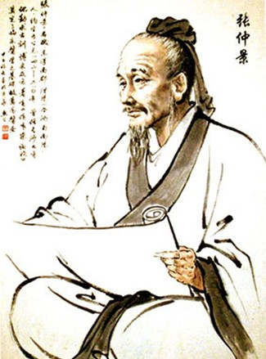
文化知识背景：
张仲景 (约公元150~219年)，名机，字仲景，东汉南阳郡涅阳县 (今河南邓州市) 人。东汉末年著名医学家，被后人尊称为医圣，南阳五圣之一。张仲景广泛收集医方，写出了传世巨著《伤寒杂病论》。它确立的辨证论治原则，是中医临床的基本原则，是中医的灵魂所在。在方剂学方面，《伤寒杂病论》也做出了巨大贡献，创造了很多剂型，记载了大量有效的方剂。其所确立的六经辨证的治疗原则，受到历代医学家的推崇。

Slide 18
physician [正式用语]：医生；内科医生
red with cold [词块]：冻得通红
disciple [词源]：from Latin discipulus “learner”, from discere “learn”门徒；弟子；同源词：discipline n 训练；管教；纪律
drive out [短语动词]：驱除；小品词out “去除；除掉；消失”，如put out 扑灭；run out 用完，耗尽；cross out 划掉；删去
drive out the chill [认知词块]：驱寒
cut up [短语动词]：切碎；小品词up“成碎片货分成几部分”，如tear up撕碎；break up破碎，分解，驱散

Slide 19
文化知识拓展
24 solar terms 二十四节气
Based on the changes of the sun’s position in the zodiac throughout the year and practical needs of agriculture in ancient China, the “24 solar terms” is an important kind of calendar in China. It indicates different periods of seasons, the changes of weather, some natural phenomena and more, guiding farmers in agriculture production greatly. Common people also follow the calendar to watch out weather changes and live a healthy life.
二十四节气是中国古代根据太阳在黄道带中位置的变化和农业生产的实际需要而制定的一种重要历法。它反映了季节的不同时期、天气的变化、一些自然现象等，对农民的农业生产有很大的指导作用。老百姓也遵循此日历来观察天气变化，过着健康的生活。

Slide 20
On November 30, 2016, the UNESCO was inscribed China's "The Twenty-Four Solar Terms" on the Representative List of the Intangible Cultural Heritage of Humanity.
在国际气象界，二十四节气被誉为“中国的第五大发明”。2016年11月30日，二十四节气被正式列入联合国教科文组织人类非物质文化遗产代表作名录。
二十四节气分别是：立春、雨水、惊蛰、春分、清明、谷雨、立夏、小满、芒种、夏至、小暑、大暑、立秋、处暑、白露、秋分、寒露、霜降、立冬、小雪、大雪、冬至、小寒、大寒。

Slide 21
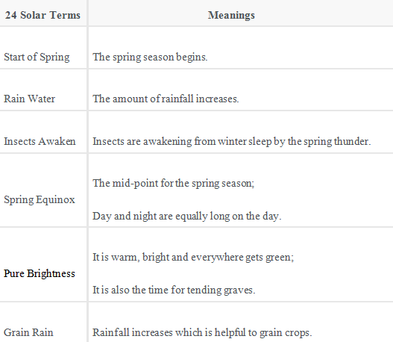
Twenty-four Chinese Solar Terms in 2019/2020

Slide 22
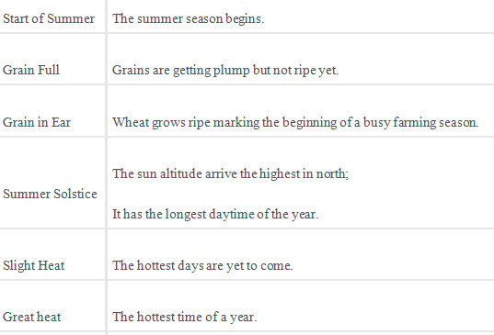
Twenty-four Chinese Solar Terms in 2019/2020

Slide 23
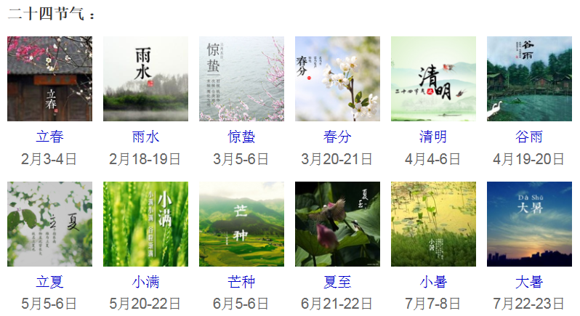

Slide 24
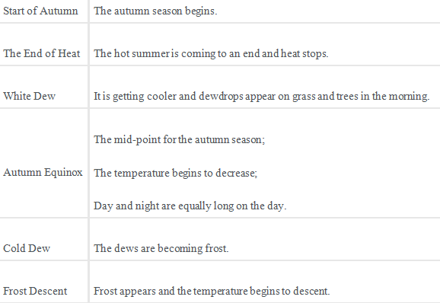
Twenty-four Chinese Solar Terms in 2019/2020

Slide 25
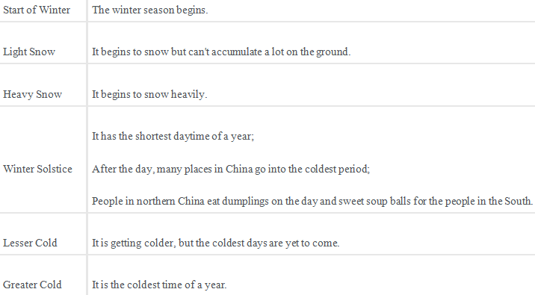
Twenty-four Chinese Solar Terms in 2019/2020

Slide 26
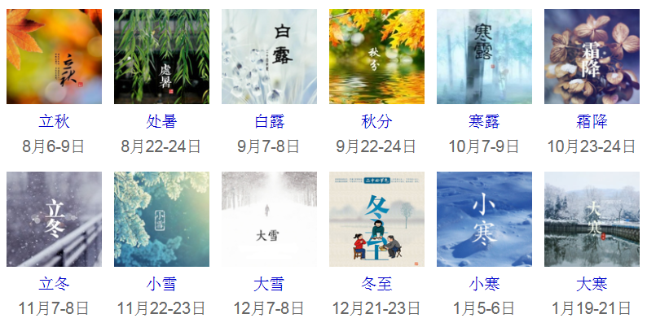

Slide 27

感谢您的聆听
感谢聆听

