Slide 1

Unit 1 Wish you were here
Welcome to the unit & Reading (I)
龙薇 株洲市第二中学

Slide 2


龙薇
中学一级教师
株洲市英语创新课堂一等奖
株洲市一师一优课一等奖

Slide 3
Step
1
Brainstorming
插入自选图片和音乐

Slide 4
Step
1
Brainstorming
•How do you feel when you hear the song and watch
these pictures?
•What words, expressions or saying can you think of
when we talk about travelling?

Slide 5
Step
1
Brainstorming
•What words, expressions or saying can you think of
when we talk about travelling?
What do you usually do while travelling?
How do you feel when you go on a trip?
What attracts you most when you travel?
What benefits can travelling bring us?...

Slide 6
enjoyable
exciting
relaxing
wonderful...
experience
splendid
magnificent
breathtaking
fanscinating
awesome...
scenery
Travelling
go sightseeing,
taking photos
climbing mountains...
journey,destination,tourist, guide, route,travel agency...
•get close to nature
•broaden our horizon
•experience different ways of life
•better understand various cultures
•relieve one's stress
You can either travel or read,
and either your body or soul
must be on the way.

Slide 7
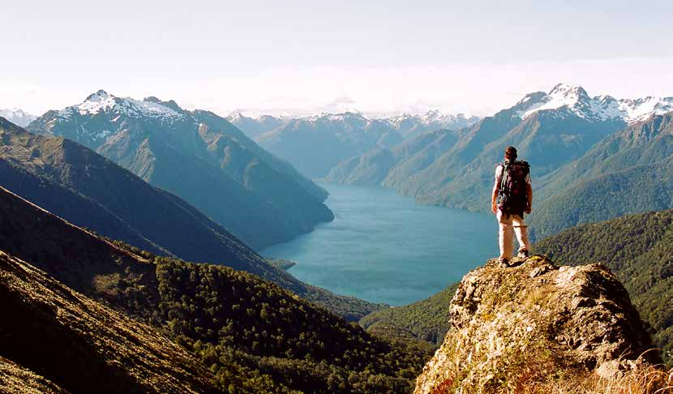

The real voyage consists not in seeking new landscapes, but in having new eyes.

Slide 8
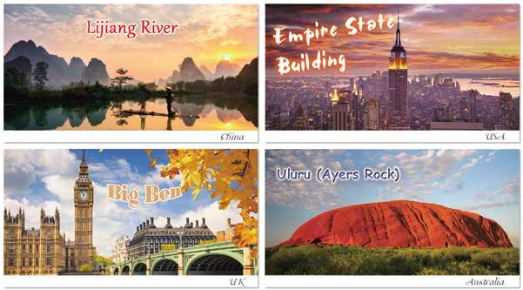
Do you know these well-known attractions? How would you describe them?

Slide 9
The Lijiang River is situated in Guangxi, China, and it is a part of the Lijiang River Scenic Zone. This scenic zone is famous
for its natural and historic beauty. The postcard shows the stunning karst mountains that the area is known for in the background. The river itself is so still that it reflects the sky
and mountains clearly.The sun casts its beautiful light across
the sky, adding a warm glow to the peaceful scenery. There is also a man on a bamboo raft in the foreground.

Slide 10
The Empire State Building is in New York City, USA. It is a 102-story skyscraper and is often seen in American films. Tourists visit the Empire State Building to get a panoramic view of New York from the 86th-floor and 102nd-floor observatories.The postcard shows a breathtaking view of this famous building against the backdrop of Manhattan. In the postcard, the sun is setting and the building is lit up,which emphasizes its distinct shape and makes it stand out.

Slide 11
The Big Ben clock tower is located in London, UK. It is among the most popular landmarks and represents the city.
It is easily recognizable and forms a part of the scenic area at the northern end of the Houses of Parliament, which can also be seen in the postcard. It dominates the skyline and is close to other sights of the city like Westminster Abbey. In the postcard, you can notice the Victorian style of architecture that is found almost throughout London.

Slide 12
Uluru, also known as Ayers Rock, is located in central
Australia. It is a UNESCO World Heritage Site and one of Australia’s best-known tourist destinations. It stands out prominently because of its unusual red colour as seen in the postcard.Tourists are also fascinated by its huge size and dome shape, which are in contrast with the flat and featureless surroundings shown in the postcard.

Slide 13
Step
2
Sharing experiences
Have you ever been to any well-known attractions or popular places of interest? If so, share your experience.

Slide 14
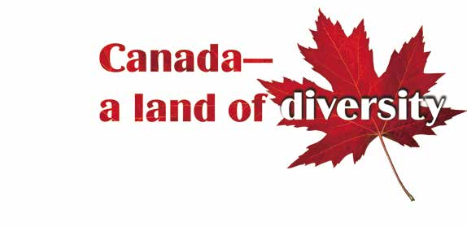
Step
3
Pre-reading
It is the second largest country in the world.
Its official language is English and French.
The national symbol of it is the maple leaf.

Slide 15
Let's have a trip to Canada.
It means that a range of people or things that are very different from each other.

Slide 16



Step
4
Global reading
There is great diversity in geography.
Canada is ethnically diverse.
The country also has a rich diversity of cultures.
Canada is a unique place to live and visit.

Slide 17
Step
5
Detailed reading
Read para.2 and answer:
•Where are the grand Rocky Mountains?
• Is there great diversity in geography ? Find the details.
They rise to the east of the Pacific coast.
To the east of the pacific coast...

Slide 18
Step
5
Detailed reading
Read para.3 and answer：
•What can reflect the diversity of Canada's residents?
• How many ethnic groups are mentioned?What are they？
Canada’s many rural areas and urban centers.
The major ethnic groups include the English, Scottish and French while the minority groups include resident from Singapore and the Pacific Islands

Slide 19
Step
5
Detailed reading
Read para.4 and answer：
•In What ways can you feel the subcultures there?
• How does the author support his idea?
In languages, cuisine, architecture, art and music.
By giving examples.

Slide 20
Step
5
Detailed reading
Read para.4 and fill in the blanks：
Examples | What's special about it? | What can we do there?
dynamic city with the
highest percentage of
Chinese Canadians
participate in the
celebrations of...
take tea...
Vancouver
one of the largest
French-speaking cities
in the world
Montreal
sample the food with...
see the original building...
dance to fiddle tunes
enjoy the cultures and traditions of Celtic settlers
Cape Breton

Slide 21
Step
5
Detailed reading
Read para.5 and answer：
•What makes Canada a unique place to live and visit?
Its geographical wonders, ethnic groups and their cultures.

Slide 22
Step
6
Further thinking
What is the purpose of the website article?
To vividly present the beauty and richness of Canada to
us and attract more tourists to this country.

Slide 23
Step
6
Further thinking
How does the author make his description vivid and appealing to attract the readers?
By using rhetorical devices and many descriptive adjectives.

Slide 24
Step
6
Further thinking
What rhetorical devices are used in the article?
Simile.
Canada is like a blooming flower, unfolding with
breathtaking beauty and richness to win the heart of...
Personification.
Ancient, slow-moving glaciers hug the land and a huge
variety of wildlife wanders the remote forests.

Slide 25
Step
6
Further thinking
Find the descriptive adjectives and their synonyms.
Adjectives | Synonyms
breathtaking
splendid, spectacular, magnificent, amazing, awesome, stunning...
broad
vast,huge, extensive, immense, great...
distinct
unique,different, specific,distinctive...
mighty
grand, great, massive,enormous
impressive,powerful...

Slide 26
Step
6
Further thinking
Canada is a land of diversity, and so is China. What aspects can reflect China's diversity?

Slide 27
China's diversity is reflected in its geography, wildlife and people. China has spectacular deserts, jungles, grassy plains and wetlands, which play an important role in creating its unique biodiversity. Animals like the giant panda and theYangtze River dolphin, are examples of this. China has so many different minorities that travellers can experience a range of local traditions and cultures.

Slide 28
Homework
1.Finish exercise B1 on page 5.
2.Write a summary of the website article based on the structure(within 80 words).

Slide 29


