Slide 1

Unit 1 Wish you were here
Integrated skills (I)
段志梅 株洲市九方中学

Slide 2

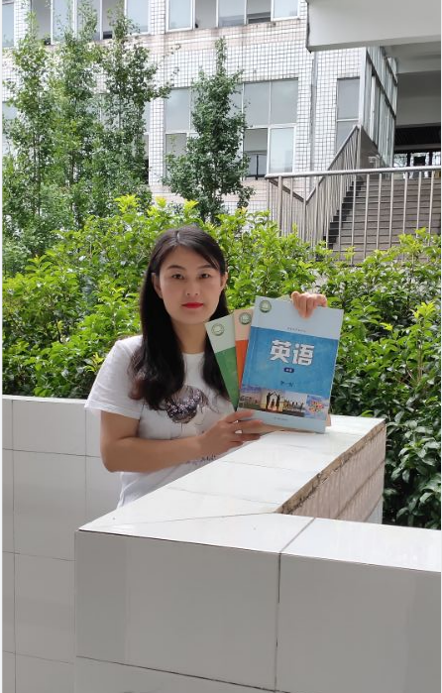
段志梅
此处放老师的个人照片
株洲市英语骨干教师，指导学生参赛，多次获得国家级荣誉
2016、2020年度“一师一优课，一课一名师”市级优课
荣立株洲市三等功
株洲市优秀党员

Slide 3
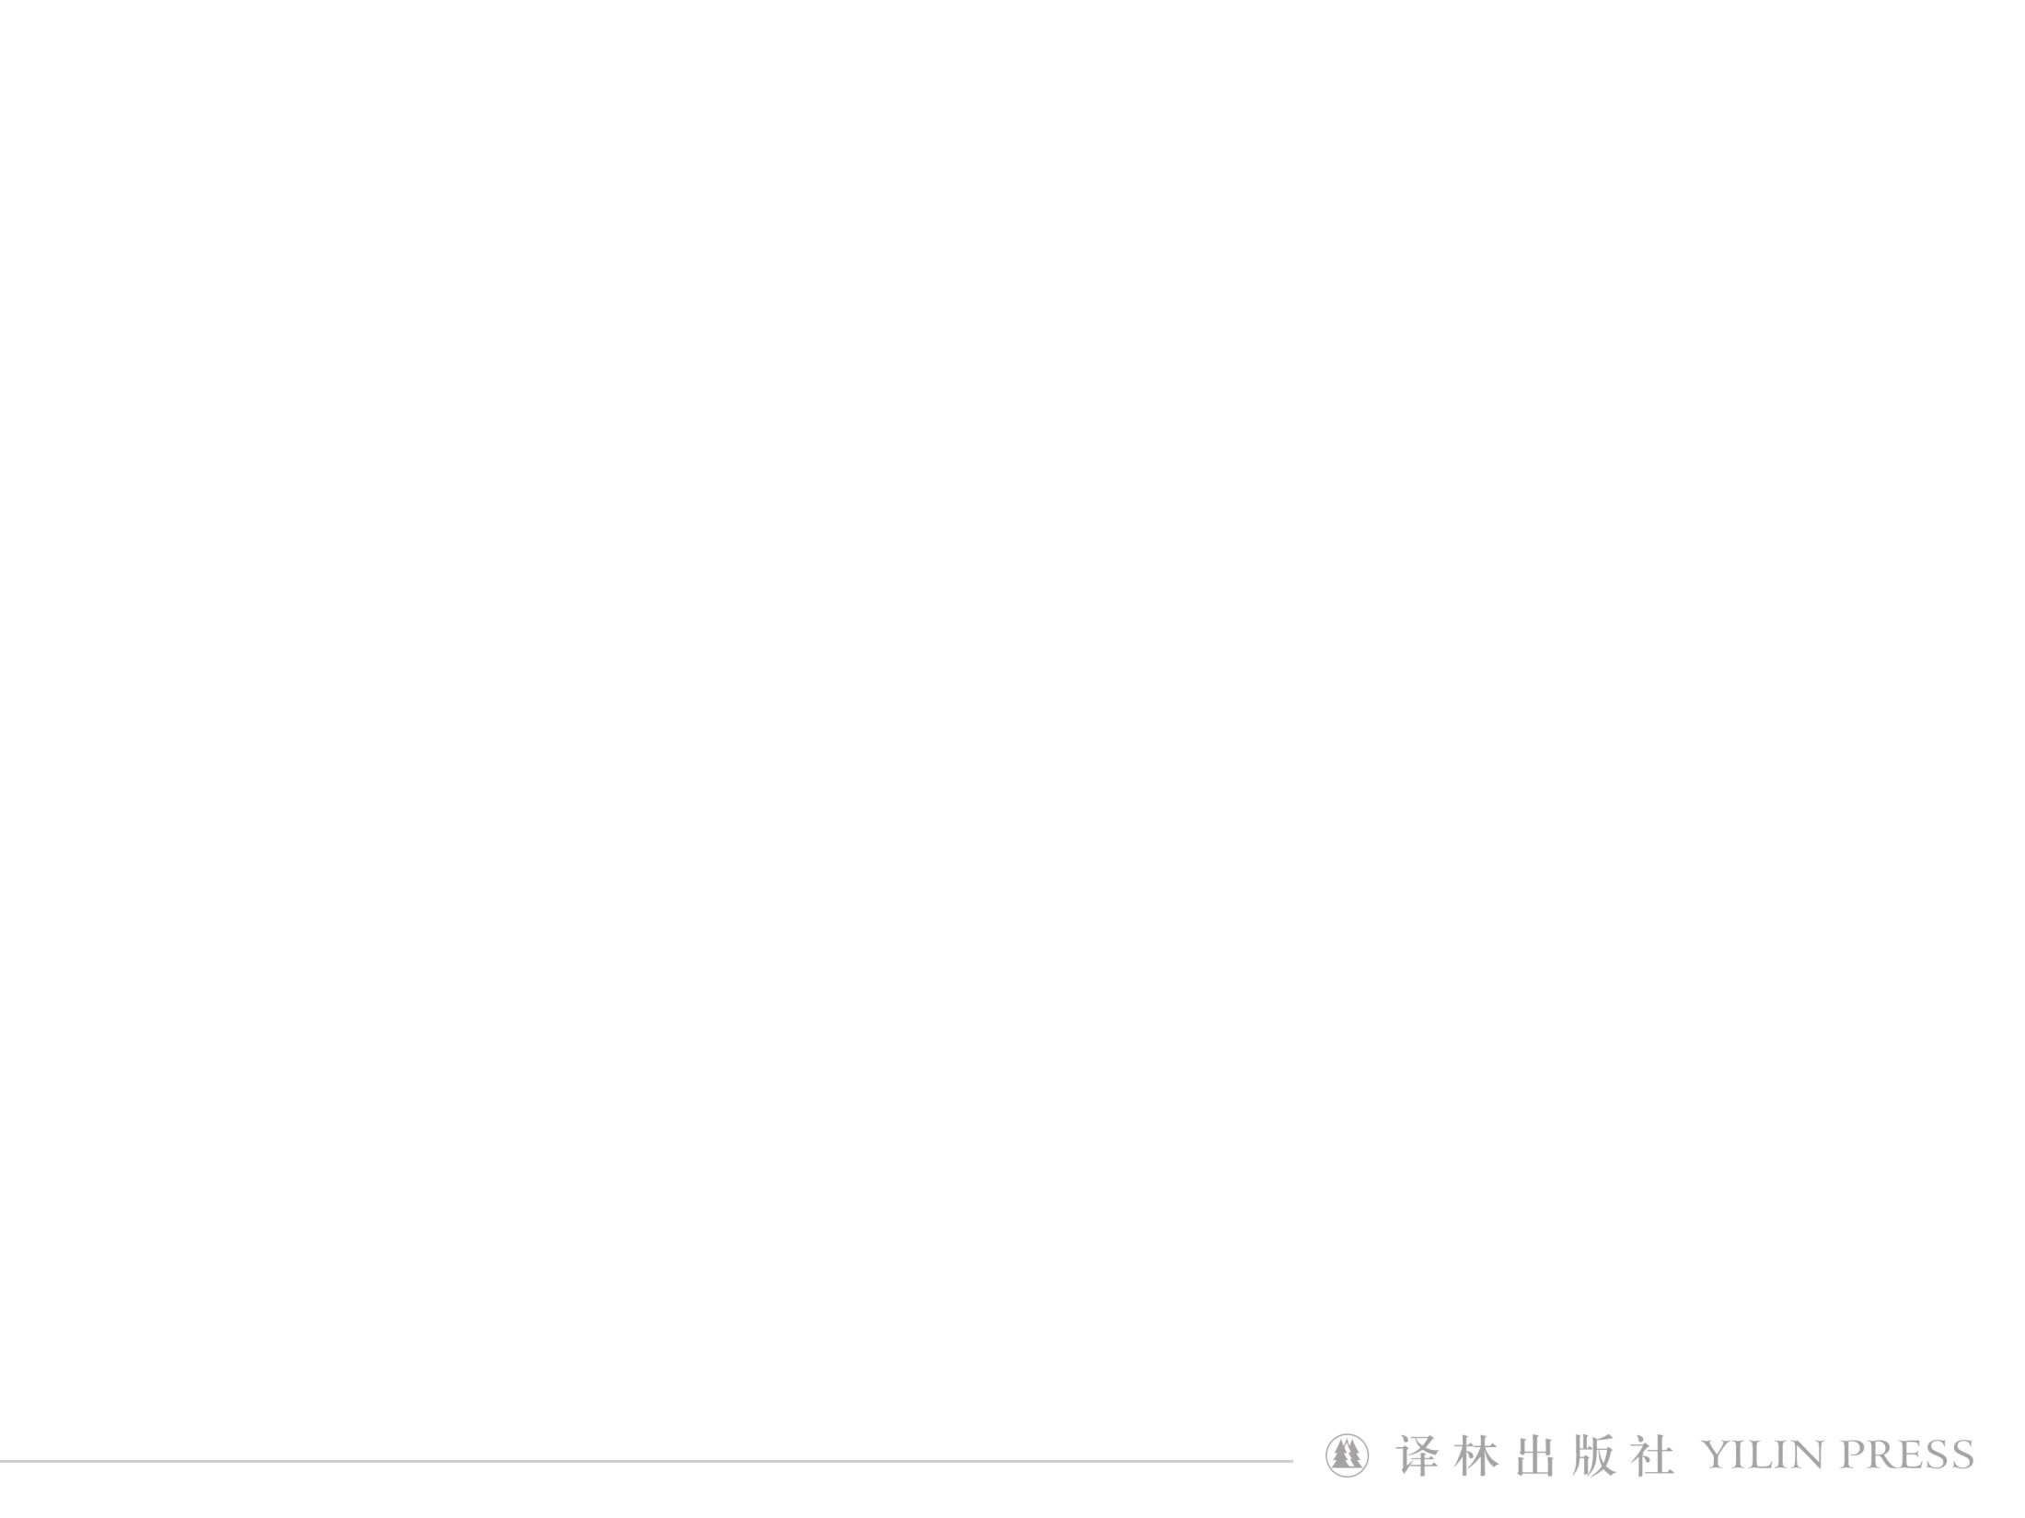
Step 1 Lead-in
What will the headmaster prepare for his travel?
backpack
smartphone
money
Travel
documents
medicine
…
tickets

Slide 4
Step 2 Listen and answer
Making a travel plan
Listen to the recording for the first time and finish A1 on page 8.
Attention: When、What、How many days...
Suggested answers:
(1) Next month.
(2) They will learn more about Chinese methods of education.
(3) Three days.
(4) At the end of the class.

Slide 5
Step 2 Listen and answer
First predict the answers of A2 and then finish it by listening to the recording again.
Suggested answers:
(1) 15 (2) attend a conference (3) give some lectures
(4) our city museum (5) a local restaurant (6) on foot
Questions:
(1) Where are the foreign guests from?
(2) How do the foreign guests remind themselves of their trip here?

Slide 6
Step 3 Read and speak
Scan the travel plan about Shanghai on page 9 suggested by Ms Zhao and answer the following questions.
● What are the tourist attractions and activities suggested?
● If the guests are interested in Buddhism, which attraction will you recommend?
● Can you suggest some typical foods of Shanghai?

Slide 7
Making a travel plan
Discuss
● Basic information about your hometown
● Tourist attractions
● Food
● Cultural products
Make a dialogue

Slide 8



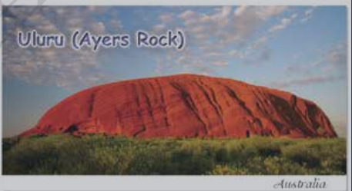
Step 4 Share
Let’s Share!

Slide 9
S1: Let’s discuss our two-day travel plan for the guests from America visiting our city next month.
S2: OK. We should introduce our city by sharing some basic information with them. For example, Xi’an is the oldest of the four great ancient capitals. That should interest them.
S1: I agree. So on the first day we should start with a visit to the main attraction--the Terracotta Army. That would be a great way to connect them with our city’s history.
S2: After the tomb visit, let’s have lunch at a nearby restaurant that serves local food like flatbread in mutton soup.
S1: Great plan. I propose we go to the Textile Town after lunch. They’ll enjoy watching the local artists at work and they can buy souvenirs if they want to. And on the second day, we can...
S2: Sorry, shall we talk a bit more about the evening plan before we move on?
S1: Sure.
Sample answer

Slide 10
S2: In the evening, we could walk along the popular food and shopping street in the city, where our guests can try the wonderful foods available there.
S1: Yes! Like biangbiang nooodles, a famous Xi’an dish.
S2: True! Let’s discuss the second day’s plan.
S1: What about a visit to the ancient city wall and the famous Bell Tower and Drum Tower?
S2: Great idea! After another delicious lunch, we should also take a tour of the Big Wild Goose Pagoda, and then have another great dinner of local food.
S1: Perfect, I think that is great way to end their two-day visit.
S2: Sorry, may I add something? For dinner we should find a place where they can eat while watching Qinqiang Opera.
S1: I like your idea very much. I know our guests will never forget their short visit to the wonderful city of Xi’an.

Slide 11
Homework
1. Polish your dialogue.
2. Search the Internet for more information about the history and development in your hometown and take a note of them.

Slide 12


