Slide 1

Unit 1 Wish you were here
Extended reading
宁瑜 株洲市第十三中学

Slide 2

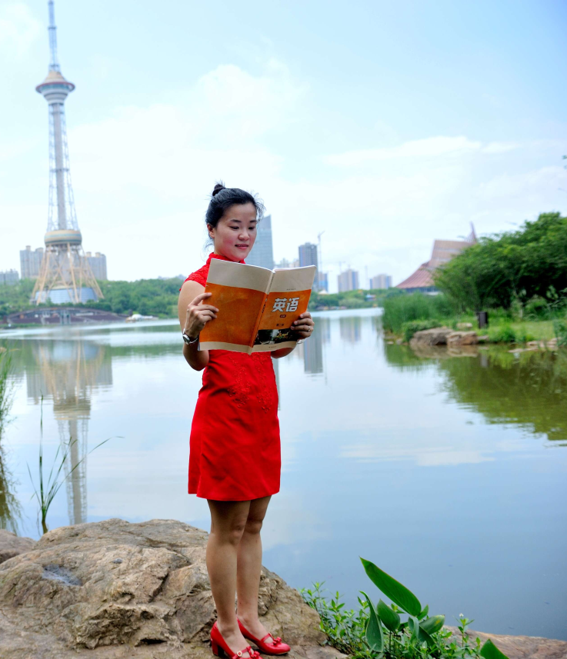
宁瑜
中学一级教师
株洲市十三中英语教研组长
株洲市“建功新时代” 教学能手
湖南省“一师一优课 一课一名师”优课

Slide 3

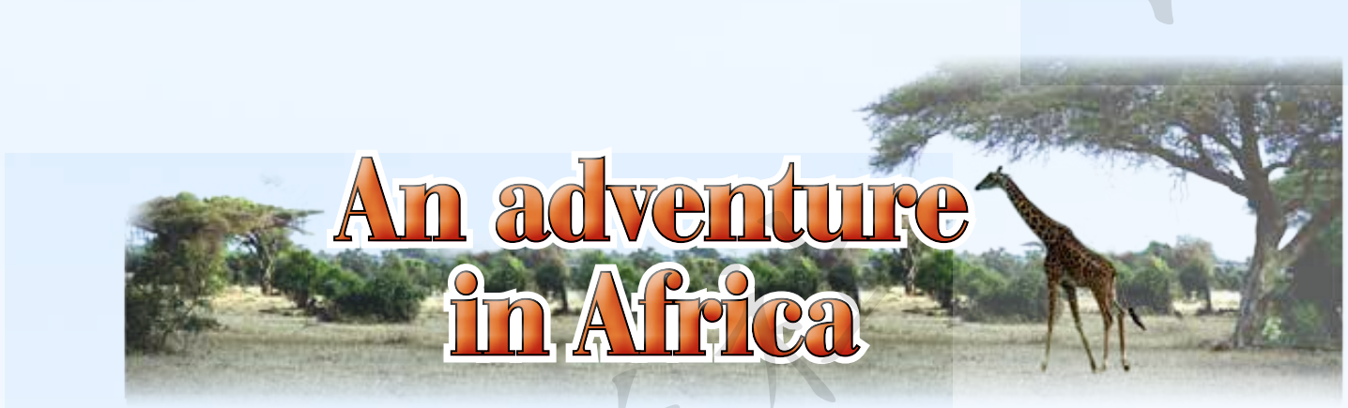
Step
1
Brainstorming
◆ What do you know about Africa? ◆ If you have the chance to visit Africa, what do you want to see and do there?

Slide 4
Step
1
Brainstorming
◆ What do you think of his journey would be like?

Slide 5
Step
2
Scanning
1.Read the first travel journal and answer the following questions.
◆ Where was he? And when did he go there?
◆ Which places are mentioned in the passage?
◆ When did they arrive at their desert camp?
2.Read the second travel journal and answer the following questions.
◆ Where was he? And when did he go there?
◆ What’s the main idea of each paragraph?

Slide 6
Step
3
Detailed reading
1. Read the first travel journal and answer the following questions.
◆ Please talk about his routine.
Marrakesh
Sahara
Merzouga
desert camp
sharp bends

Slide 7
Step
3
Detailed reading
◆ What first came into sight when the author and his parents entered the Sahara Desert? What resolution did he made?
Unending sand dunes. He made a resolution to respect and protect the unique landscape because it was very fragile.

Slide 8
Step
3
Detailed reading
◆ What’s the weather like in Sahara?
During the daytime
The wind was blowing grains of sand from the tops of the dunes; The sun was beating down hard and bright; The sky was a deep shade of blue that I had never seen before; The colours of the dunes contrasted strikingly with the blue of the cloudless sky.
At night
Stars were already shining brightly in the darkening sky and it was getting cold with the approach of the night.
vs
hot
cold

Slide 9
Step
3
Detailed reading
◆ What left a deep impression on the author?
He was deeply impressed with the sand dune, the sun, the sky and stars.

Slide 10
Step
3
Detailed reading
2.Read the second travel journal and answer the following questions.
◆What happened to them when they were very near to their rest camp in Amboseli National Park? And why? How did they solve the problem?
Problem
They were stuck in the mud.
Reason
Father, against mother’s advice, decided to drive through a large pool of water that stretch across the dirt road.
Solution
Two tall slim local people wandered over and pushed us free.

Slide 11
Step
3
Detailed reading
◆ Why did the author say it was indeed the greatest show in the earth?
Because he hadn’t seen anything like this before. The mountain rose up over the plains before them. Tall grasses and trees dotted the plains, which were alive with the African wildlife they had come to see. Giraffes, with their necks, were pulling leaves from the highest branches. In the distance, elephants were eating grass, ears flapping lazily as they moved slowly over the plains.

Slide 12
Step
3
Detailed reading
◆ What happened after the author returned to the car and fetch more possessions? And how did he feel?
A small grey monkey sitting on a tree a few metres away and eating a banana. He must feel joyful.

Slide 13
Step
3
Detailed reading
3. Summarize the author’s travel experience.
In Morocco | My parents and I drove all the way to the Sahara Desert. I was amazed at the wild beauty of the desert. When we arrived at our desert camp, it was getting dark and cold. I saw some camels and would go on a camel ride the next day.
In Kenya | On our way to Amboseli National Park, our car got completely stuck in the mud and two local people helped us. In the afternoon, we arrived at our hut. I saw the magnificant Mount Kilimanjaro, giraffes pulling leaves from the trees and elephants eating grass. As we began to unpack the car, I saw a cute monkey eating a banana, but I soon realized it was my banana!

Slide 14
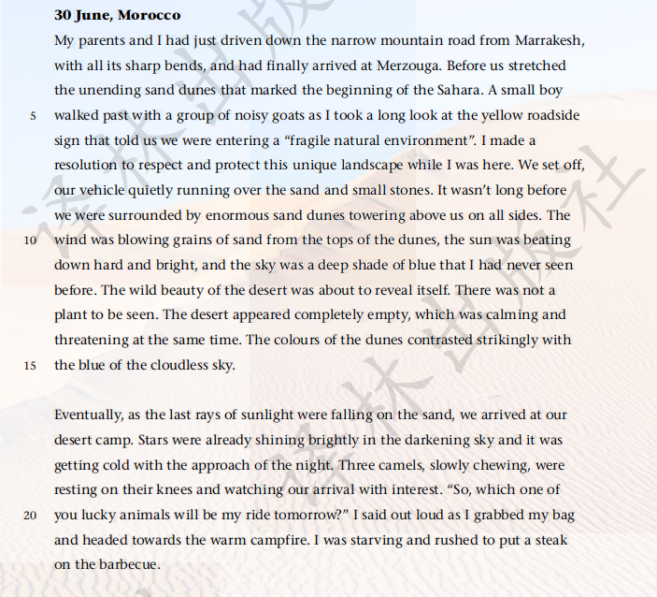
Step
4
Appreciating language
◆ How did the author describe the desert in the first journal entry.

Slide 15
Step
4
Appreciating language
◆ How did the author describe the desert in the first journal entry.
Firstly, the author describes how the sand dunes changed along the way in time order. When he first entered the Sahara Desert, he saw unending sand dunes that stretched before him. Later, when he went deep into the desert, the sand dunes became enormous, towering above them on all sides. The wind was blowing grains of sand from the top of the dunes. Secondly, the author uses vivid words and contrast to describe the size and color of the dunes. For example, when describing the size, he uses adjectives such as “enormous” and the verb “towering”; the colors of the dunes are made clear and vivid against the blue of the sky. Thirdly, the author describes how he feels about the desert. For example, he uses the following words like “wide beauty”, “completely empty” and “calming and threatening” to express his amazement at the scene as well as his awe and respect for nature.

Slide 16
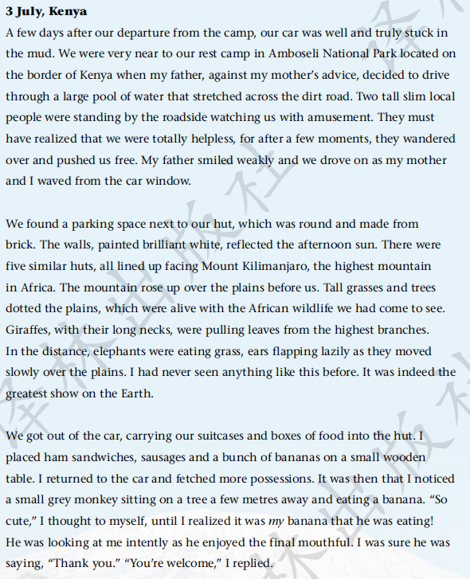
Step
4
Appreciating language
◆ What did the author see on the plains in the second journal entry? And please analyse how the author describe them.
Make the picture an action shot

Slide 17
Step
4
Appreciating language
◆ What did the author see on the plains in the second journal entry? And please analyse how the author describe them.
The author describes Mount Kilimanjaro towering into the sky, the tall grasses and trees dotting the plains and the wildlife wandering on the plains.
To show the whole picture of the plains and make the reader feel personally on the scene, the author arranges details according to their location indicated by some words, such as “ next to”, “over”, “before”, and “in the distance”. The picture unfolds before the reader like a wide-angle photo. Furthermore, to make all the landscapes, plants and animals as vivid and impressive as possible, the author applied many specific verbs like “ found”, “reflected”, “facing”, “rose”, “dotted”, “pulling”, “eating”, “flapping” and “ moved”, as well as adjectives and adverbs including “round”, “brilliant”, “highest”, “long”, “lazily” and “slowly”, making the picture an action shot. In addition, the author also uses metaphor in the last sentence of paragraph two, comparing what he saw to the greatest show on the Earth to express how excited and satisfied he felt at that moment.

Slide 18
Step
5
Critical thinking
Pay attention to the title “ An adventure in Africa” and think why the author uses the word “adventure” instead of “journey” or other words.

Slide 19
Step
5
Critical thinking
Pay attention to the title “ An adventure in Africa” and think why the author uses the word “adventure” instead of “journey” or other words.
An adventure implies an unusual, exciting or dangerous experience, journey or series of events. First, the author, along with his parents, experienced some dangerous things. For example, they drove down the narrow mountain road with sharp bends and their car got completely stuck in the mud. Second, during this journey, the author saw some unusual and breathtaking scenery, such as the desert landscape, Mount Kilimanjaro, and African wildlife wandering on the plains. He also had the chance to get close to wildlife, riding camels, watching giraffes pulling leaves and elephants eating grass, and interacting with the monkey.

Slide 20
Step
6
Further thinking
What is the most memorable travel experience you have had? What was special about it?
?

Slide 21
Homework
Polish the short passage about their travel experience.

Slide 22


