Slide 1

Unit 1 Wish you were here
Reading (II)
龙 薇 株洲市第二中学

Slide 2
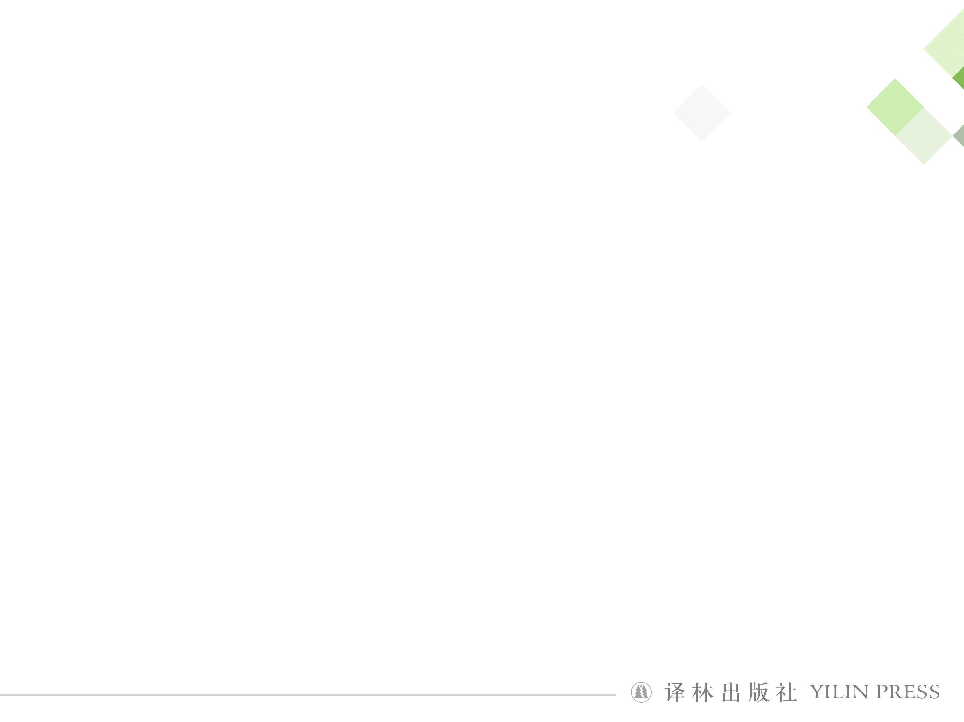

龙薇
中学一级教师
株洲市英语创新课堂一等奖
株洲市一师一优课一等奖

Slide 3
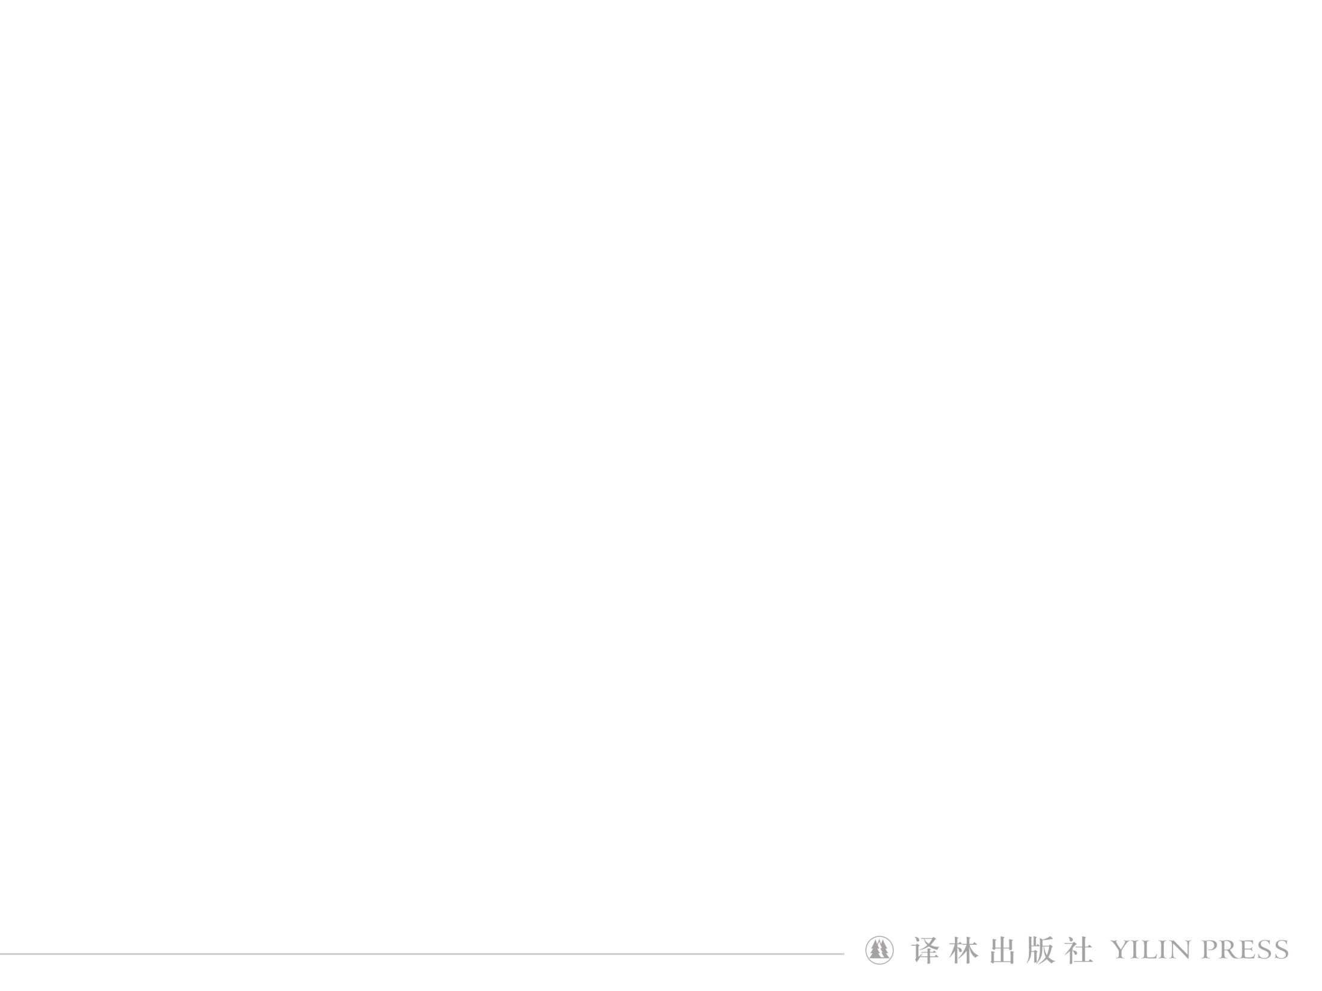
Step
1
Revision
•What does Canada have to offer tourists?
breathtaking beauty and richness
geographical wonders
diverse ethnic groups
distinct cultures
a blooming flower

Slide 4
Read and underline the following key words
or expressions.
1. have something to offer 2. apart from
3. by means of 4. one out of five
5. in turn 6.bring about
7.define your encounter
8. off the beaten track
9.it comes as no surprise that
10.be consistently ranked as
1.blooming
2.unfold
3.stretch
4.distinct
5.dynamic
6.sample

Slide 5
Step
2
Word study
Canada is like a blooming flower, unfolding with
breathtaking beauty and richness to win the heart of
those who enjoy what it has to offer.
unfold：1. spread open or flat sth that has previously
been folded.
2. to gradually make sth known to other people
她张开双臂。
She unfolded her arms.
The audience watched as the story unfolded before their eyes.
观众看着剧情逐渐展开。

Slide 6
Step
2
Word study
Canada is like a blooming flower, unfolding with
breathtaking beauty and richness to win the heart of
those who enjoy what it has to offer.
have sth. to offer： to have something available that
somebody wants
This town does not have much to offer. Its shops are
very small and it has only one cinema.
这个小镇没有什么可提供的。商店很小，只有一家
电影院。

Slide 7
Step
2
Word study
It is a broad and beautiful country stretching from the
Atlantic to the Pacific Ocean.
stretch: extend; to spread over an area of land
1.He stretched and yawned lazily.
2.Make sure that the rope is stretched tight.
3.Fields and hills stretched out as far as we could see.
4.She stretched acrossed the table for the butter.
5.The sweater has stretched.
a. pull it to become longer or looser
b. to spread; to extend
c. to pull sth so that it is smooth and tight
d. to contract your muscles
e.to reach out

Slide 8
Step
2
Word study
It is also one of the most ethnically diverse nations
in the world with distinct cultures.
distinct:1. clearly different of a different kind
2. to describe things that can easily or clearly
heard, seen etc.
The result of the questionaire fell into two distinct groups.
问卷的结果分为截然不同的两组。
Jane’s voice was quiet but every word was distinct.
简说话声音不大，却字字清晰。
distinction
distinctive
adj. 独特的，特别的
n. 差别，特点，卓越
distinctly
adv. 清楚地，明显地

Slide 9
Step
2
Word study
The male bird has _________ markings on is head.
distinctive
I _________heard someone calling me.
distinctly
The new law makes no ___________between adults and children.
distinction
She had the ____________ of being the first woman to
fly the Atlantic.
distinction
特质，不同凡响

Slide 10
Step
2
Word study
Apart from its geogrphical divesity, Canada’s many
rural areas and urban centers reflect the diversity of its
resident.
apart from：in addition to；as well as

Slide 11
Step
2
Word study
Some of Canada’s earliest settlers, who are thought
to be ancestors of the indigenous peoples, crossed the
Bering Strait by means of a land bridge from a place
now known as Siberia.
加拿大最早期的一些移民被认为是土著民族的祖先，从现称作西伯利亚的地方经由大陆桥穿越白令海峡而来。
means
means: way; approach
_________（pl.）
an effective means
Television is ____________________ of communication.
电视是一种有效地传播手段。
Excuse me, can I take a seat here?
__________________当然行，没问题。
By all means.
by no means
She is ____________________an inexperienced teacher.
她绝不是一个毫无经验的老师。

Slide 12
Step
2
Word study
The major ethnic groups, for example, include the
English, Scottish and French, while the minority
groups include residents from Singapore and the
Pacific islands.
while:to emphasize the difference between two situations...
她是一个夜猫子，而她的丈夫却是个早起的人.
She is a night owl while her husband is an early bird.
While I am willing to help, I do not have much time available.
While my grandma was watching TV, she fell asleep.
I haven’t seen him for quite a while.
Conj.
although
when
a period of time n.

Slide 13
Step
2
Word study
The major ethnic groups, for example, include the
English, Scottish and French, while the minority
groups include residents from Singapore and the
Pacific islands.
minority: 1.a small group within a community or country that is diffeent because of race, religion, language etc.
2. the smaller part of a group
只有少数年轻人爱听古典音乐。
Only a minority of young people like to listen to classical
music.

Slide 14
Step
2
Word study
This ethnic variety, in turn, brings about cultural diversity.
in turn:依次的，轮流的；反过来；
All theories originate from practice and in turn serve practice.
bring about 导致, 实现
bring up 养育,提出
bring in 引进，请...做
bring out 生产，出版
bring back 送还，带回；使想起
bring down 击落，打落；降低（温度，价格等）
bring forth 生产，产出

Slide 15
1. Please __________ all library books by the end of this
week.
2.Once_____________, their second album gained great
popularity among teenagers.
3. We need to ___________new technology.
4. She ________________ by her aunt.
5. Please________________ the matter at the next meeting.
6. The goverment should take measure ______________
prices on all our computers.
bring back
brought out
bring in
was brought up
bring forward/up
to bring down

Slide 16
For example, in Vancouver, a dynamic city with the highest
percentage of Chinese Canadians in the counry, you can
particpate in the celevraions of the Chinese New Year,
or you may take tea in the Dr Sun Yat-Sen Classical Chinese
Garden.
dynamic : 1.very active and energetic
2. to describe a person having a lot of energy
and a strong personality
A___________________________________ will create development oportunities for other countries.
一个更加开放，更具活力的中国经济将给其他国家的发展创造机遇。
Our company is looking for ______________________________who
enjoys working with people.
more open and dynamic Chinese economy
a positive and dynamic person

Slide 17
Step
2
Word study
From the towering mountain peaks to the depths of the forest to the urban centers, Canada’s geographical wonders, ethnic groups and their cultures make it a unique place to live and visit.
depth: 1.the deepest, most extreme or serious part of something
2. the strength and power of feelings
They walked towards the depths of the forest hand in hand .
他们手拉手朝着森林深处走去 。
_______________ by the depth of his mother’s love, the little boy began to cry .
Greatly touched
小男孩被妈妈深沉的爱深深感动，开始哭起来。

Slide 18
Step
2
Word study
Given these cultural differeces, it comes as no surprise
that Canada has been celebrating Multiculturalism Day
since 2002.
given adj. 特定的，规定的，已安排好的
prep.考虑到，鉴于 given that conj. 考虑到
We can find out how much money is spent on food ________________________. (在任何规定时间内)
__________________________ (考虑到她喜欢孩子),
teaching seems the right job for her.
Given _____ they are inexperienced, they’ve done remarkably well.
in any given period
Given her interest in children
that

Slide 19
Step
2
Word study
Given these cultural differeces, it comes as no surprise
that Canada has been celebrating Multiculturalism Day
since 2002.
it comes as no surprise...不足为奇
得知他们食言并不让人觉得意外。
It comes as no surprise to learn that they broke their surprise.
a complete surprise
Her letter came as ____________________.
万万没想到会收到他的来信。

Slide 20
Sentence study

Slide 21
Step
3
Sentence study
To the east of the Pacific coast rise the grand Rocky
Mountains, which are home to high peaks and deep
valleys carved by ice and water.
思考：句子主语是？which引导的是？
那座神秘城堡就矗立在山顶上。
At the top of the hill stood the mysterious castle.
窗户边坐着一位优雅的女士，手里拿着一本杂志。
By the window sat an elegant woman with a magazine in her hand.

Slide 22
Step
3
Sentence study
One truly unique scenic spot in Canada is the mighty
Niagara Falls with water rushing over its edge in a
splendid display of sights and sounds.
with+宾语+宾补（n./adj./adv./to do/doing/done/prep.phr.）
She left the office _____________________.(眼里含着泪)
Jim lay on the bed______________________________.
(眼睛盯着天花板)
He used to sleep_____________________.(窗户是开着的)
with tears in her eyes
with his eyes fixed on the ceiling
with the windows open

Slide 23
Step
3
Sentence study
with the light on
The little girl fell asleep___________________.(灯还亮着)
___________________________（有向导带路），we finally made our way home.
__________________________ (由于没有可以说话的人)，Tom felt lonely.
With our guide leading the way
With no one to talk to

Slide 24
Step
3
Sentence study
One truly unique scenic spot in Canada is the mighty
Niagara Falls with water rushing over its edge in a
splendid display of sights and sounds.
加拿大真正独特的一处景点是雄伟壮阔的尼亚加拉瀑布。
水流从瀑布边缘倾泻而下，景色壮观，水声轰鸣
display v./n. 展示，陈列；显示，显露
这次展览为当地的艺术家提供了展示自己作品的机会。。
The exhibition gives local artists an opportunity to display their work.
I have rarely seen her display any sign of emotion.
我难得见到她将喜怒形于色。

Slide 25
Step
3
Sentence study
on display
a window display
a firework display
a breahtaking display of aerobatics
a display of affection
a display of strength
a display of wealth
展出，陈列
橱窗陈列
烟花表演
惊险的特技飞行表演
爱的流露
实力的显示
财富的炫耀

Slide 26
Step
4
Text review
Canada is a broad and beautiful country _________(stretch) from the Atlantic to the Pacific Ocean. It is like a________(bloom) flower, winning the heart of those who enjoy_________it has to offer. First, in the ten provinces and three territories which make up Canada, there is great _________(diverse) in geography.
stretching
blooming
what
diversity

Slide 27
Step
4
Text review
One truly unique scenic spot is Niagara Falls. _________(locate) on the Niagara River in north-eastern North America, it is one of the continent’s most famous spectacles. The___________(geography) wonder is not only a popular tourist destination, but also serve __________a major power provider.
Located
geographical
as

Slide 28
Step
4
Text review
Apart________ that, Canada demostrates variety in its ethnic composition, with________(settle) from different backgrounds. The major ethnic groups include the English, Scottish and French，_________ the minority groups include residents from singapore and the Pacific Islands.
The ethnic variety, in turn, brings________ cultural diversity. ________(give) the above-mentioned aspects, it comes as no surprise_________ Canada is an ideal place ________(live) and visit.
from
settlers
while
about
Given
that
to live

Slide 29
Homework
1.Finish exercise A and B on page 57.
2.Supposing you are a tour guide, please use the words, expressions and rhetorical devices you have learnt in this article to introduce a city or tourist attraction in China.

Slide 30


