Slide 1

Unit 1 Wish you were here
Integrated skills (II)
周奇志 株洲市九方中学

Slide 2
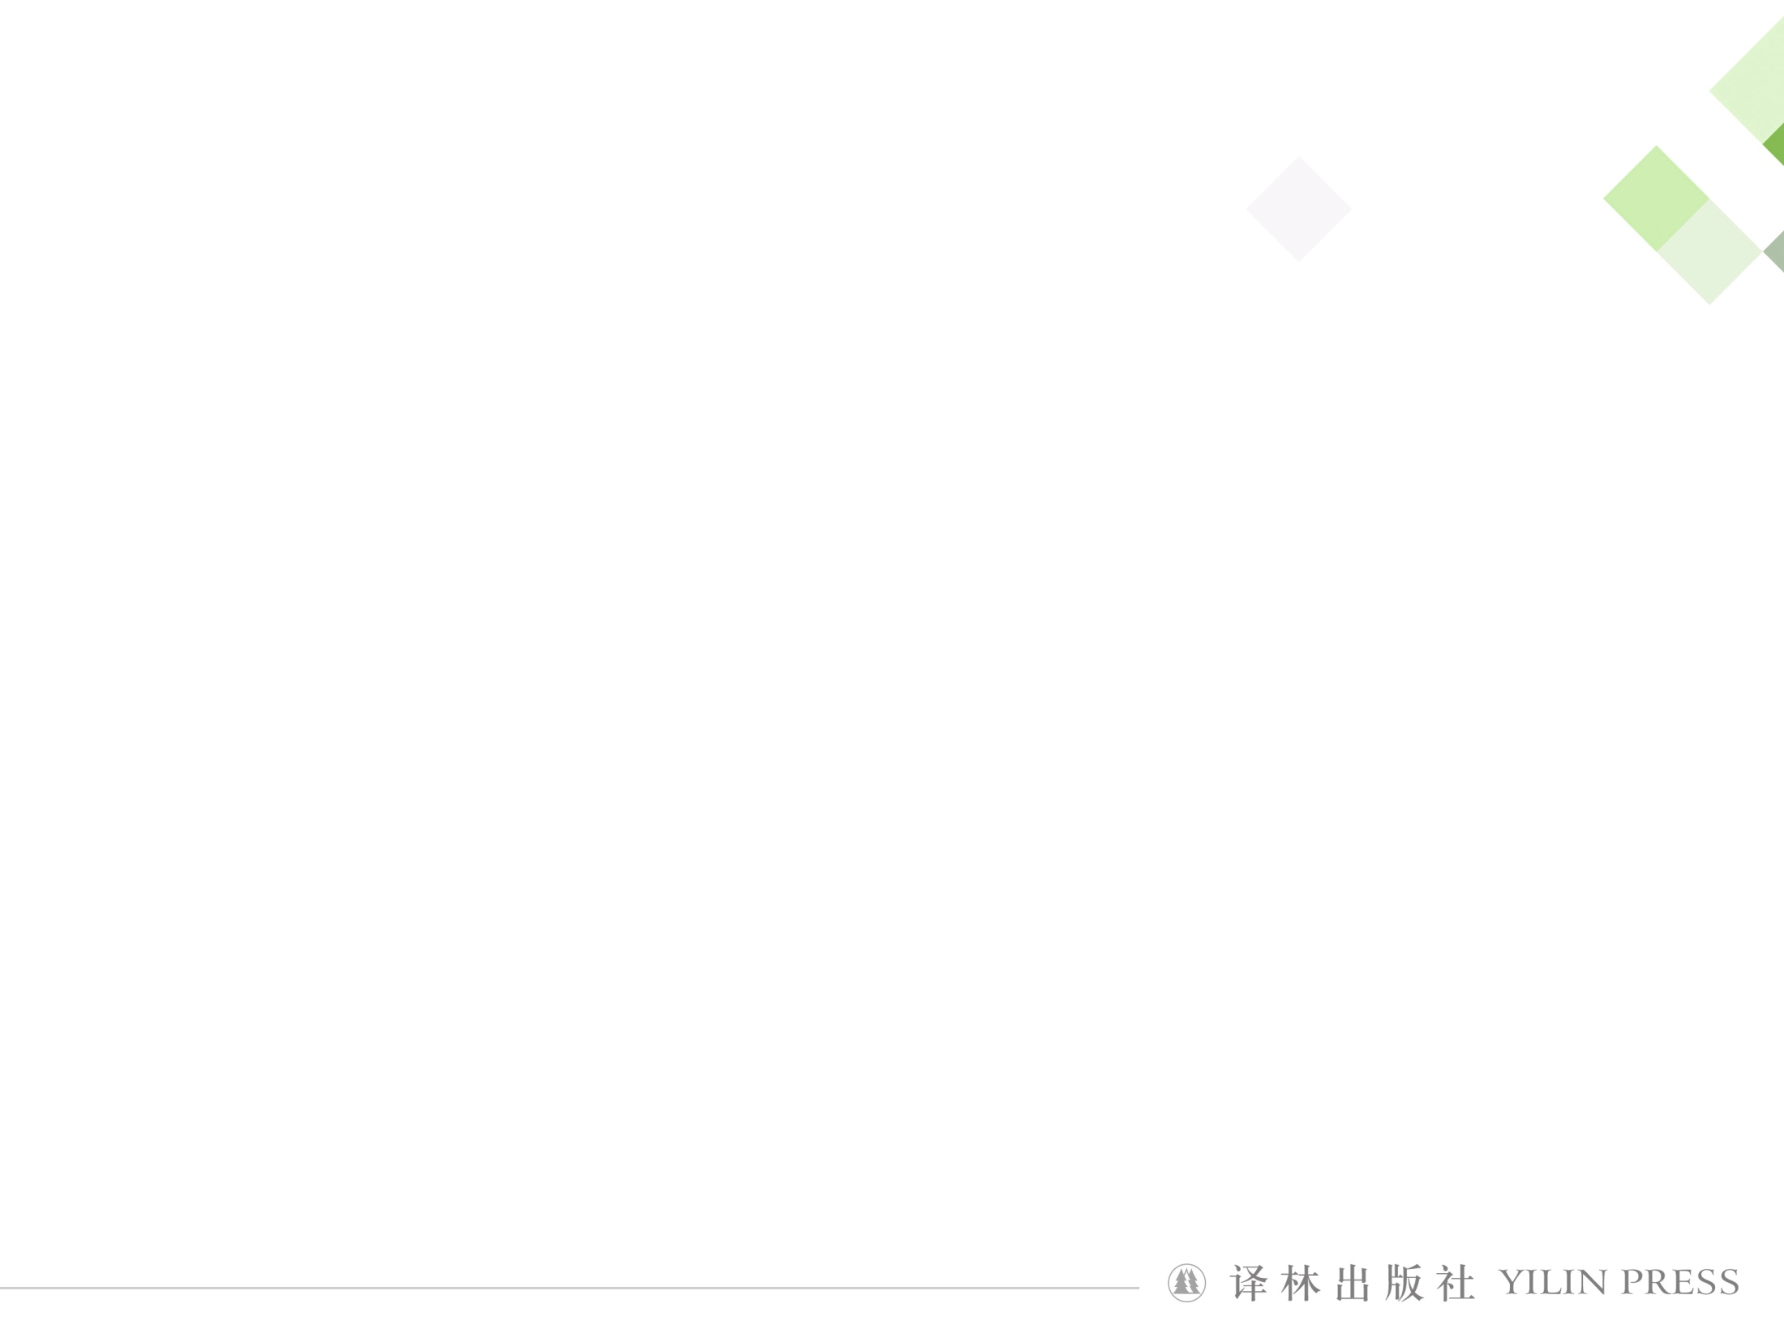
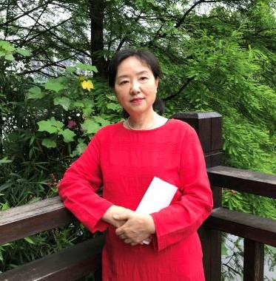
周奇志
湖南省英语特级教师
株洲市优秀教师
株洲市优秀班主任
株洲市教学视导专家
株洲市九方中学教研组长

Slide 3
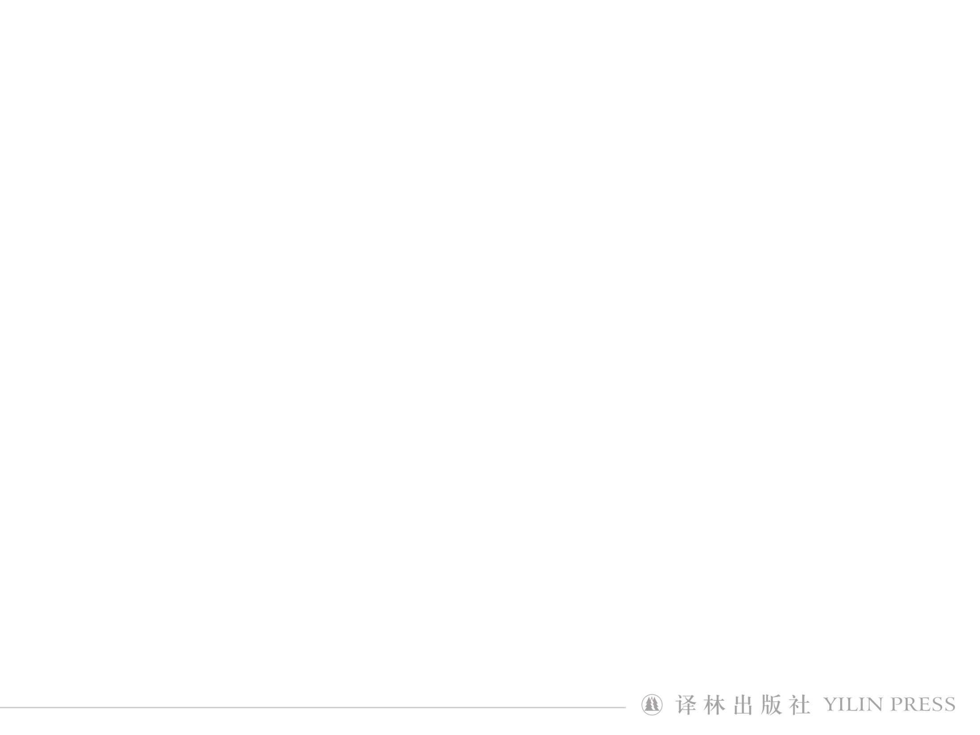
Step 1 lead-in
Read the e-mail
Ms Zhou
How is everything going? Wehaven’t seen each other for a long time, and miss you very much. I’m writing to you to tell an important thing. Fifty teachers from Boston are coming to Shanghai next month. The teachers group will attend a conference and give some lectures as well. The group teacher also want to visit your school to learn about Chinese methods of education. We will stay in Shanghai for five days in total, we will spend 3 days working and then we will have 2 days to explore your city. I’d like you to make a two-day travel plan for our teachers. They are eager to see the best of what Shanghai has to offer.
Yours sincerely
Sandy

Slide 4
Step 1 lead-in
Who will come to Shanghai next month?
What did Sandy ask Ms zhou to do?
Fifteen teachers from Boston will come to Shanghai.
She asks Sandy to make a travel plan for them.

Slide 5
Step 2 Before writing
How to write back an e-mail .
Beginning sentences (greetings and the purpose of the writing)
Introduce our city briefly
Arrange a travel plane and make a list of the activities
Ending sentences (offering our warm welcome)
An
e-mail

Slide 6
Step 2 while writing
In the beginning of an e-mail we can use the following sentences:
I am glad to receive your e-mail….
Knowing that you will...
I’m writing in response to your letter...
It is my honour to invite you to our school.
At the end of an e-mail we can use the following sentences:
I am looking forward to getting your early reply.
I would appreciate it if....
I am sure you will have a wonderful time.

Slide 7
Step 2 while writing
Introduction
to our city
basic information
culture
food
tourists attractions
…
cultural products

Slide 8
Step 2 while writing
Make a list of the activities
Show them around the tourist attractions in the city such as Jingan Temple, The Bund etc.
Have meals in some famous restaurants.such as Yu Garden.
Buy some souvenirs in Nanjing Road, Xuhui District
….

Slide 9
Step 3 Cooperative writing
Requirements:
Correct structure of an e-mail;
Well-organized sentences;
Proper link words;
Beautiful handwriting

Slide 10

Step 3 Peer-review
Is the structure of the e-mail correct?
Is the writing well-organized?
Are there any gammar mistakes in the e-mail？
Are there any proper linking words to make the writing logiacl?
Is the e-mail friendly and polite?
Is the handwriting beautiful?

